Slide 1
Study course "Civil Protection"
7. First aid skills
Developed on the basis of a document by the State Emergency Medical Service "Guidelines for first aid - basic knowledge and skills"
Developed in the framework of the European Commission’s Civil Protection Financial Instrument "Track1" project "Establishment of comprehensive civil protection and disaster management training for governmental institutions, civil protection commissions of municipalities, universities, Fire Safety and Civil Protection College, as well as establishing safety advice for the public" (ECHO/SUB/2022/TRACK1/884396) ​
Funded by The European Union
State Fire and Rescue Service

Slide 2
Tasks
7. FIRST AID SKILLS
Intended results
To introduce educatees to:
the concept of first aid;
an algorithm for action at the scene of an accident;
resuscitation measures and first aid steps.
Educatees:
can explain what first aid is;
know what to do at the scene of an accident;
know how to administer first aid in life-threatening situations.

Slide 3
Table of contents
7. FIRST AID SKILLS
7.1. Introduction
7.2. Steps at the scene of an accident
7.3. Resuscitation measures
7.4. First aid measures
7.5. Contents of the first aid kit

Slide 4
7.1. Introduction

Slide 5
Do you know what first aid is? How is it different from emergency medical assistance?
7. FIRST AID SKILLS
7.1
Introduction
7.2
7.3
7.4
7.5
First aid
Emergency medical assistance
Article 1 of the Law on Medical Treatment

Slide 6
Do you know what first aid is? How is it different from emergency medical assistance?
7. FIRST AID SKILLS
7.1
Introduction
7.2
7.3
7.4
7.5
First aid
Emergency medical assistance
Assistance provided to victims (persons who have been taken ill) in a critical state of danger to life or health by persons with or without medical qualifications, within the scope of their knowledge and possibilities irrespective of their proficiency and equipment.
Assistance to victims (persons who have been taken ill) in a critical state of danger to life or health, provided by persons specially prepared (trained, equipped) for such cases with relevant qualifications in medicine who in accordance with such qualifications have legal liability for their actions or omissions and the consequences of such actions or omissions.
The focus of this course
Article 1 of the Medical Treatment Law

Slide 7
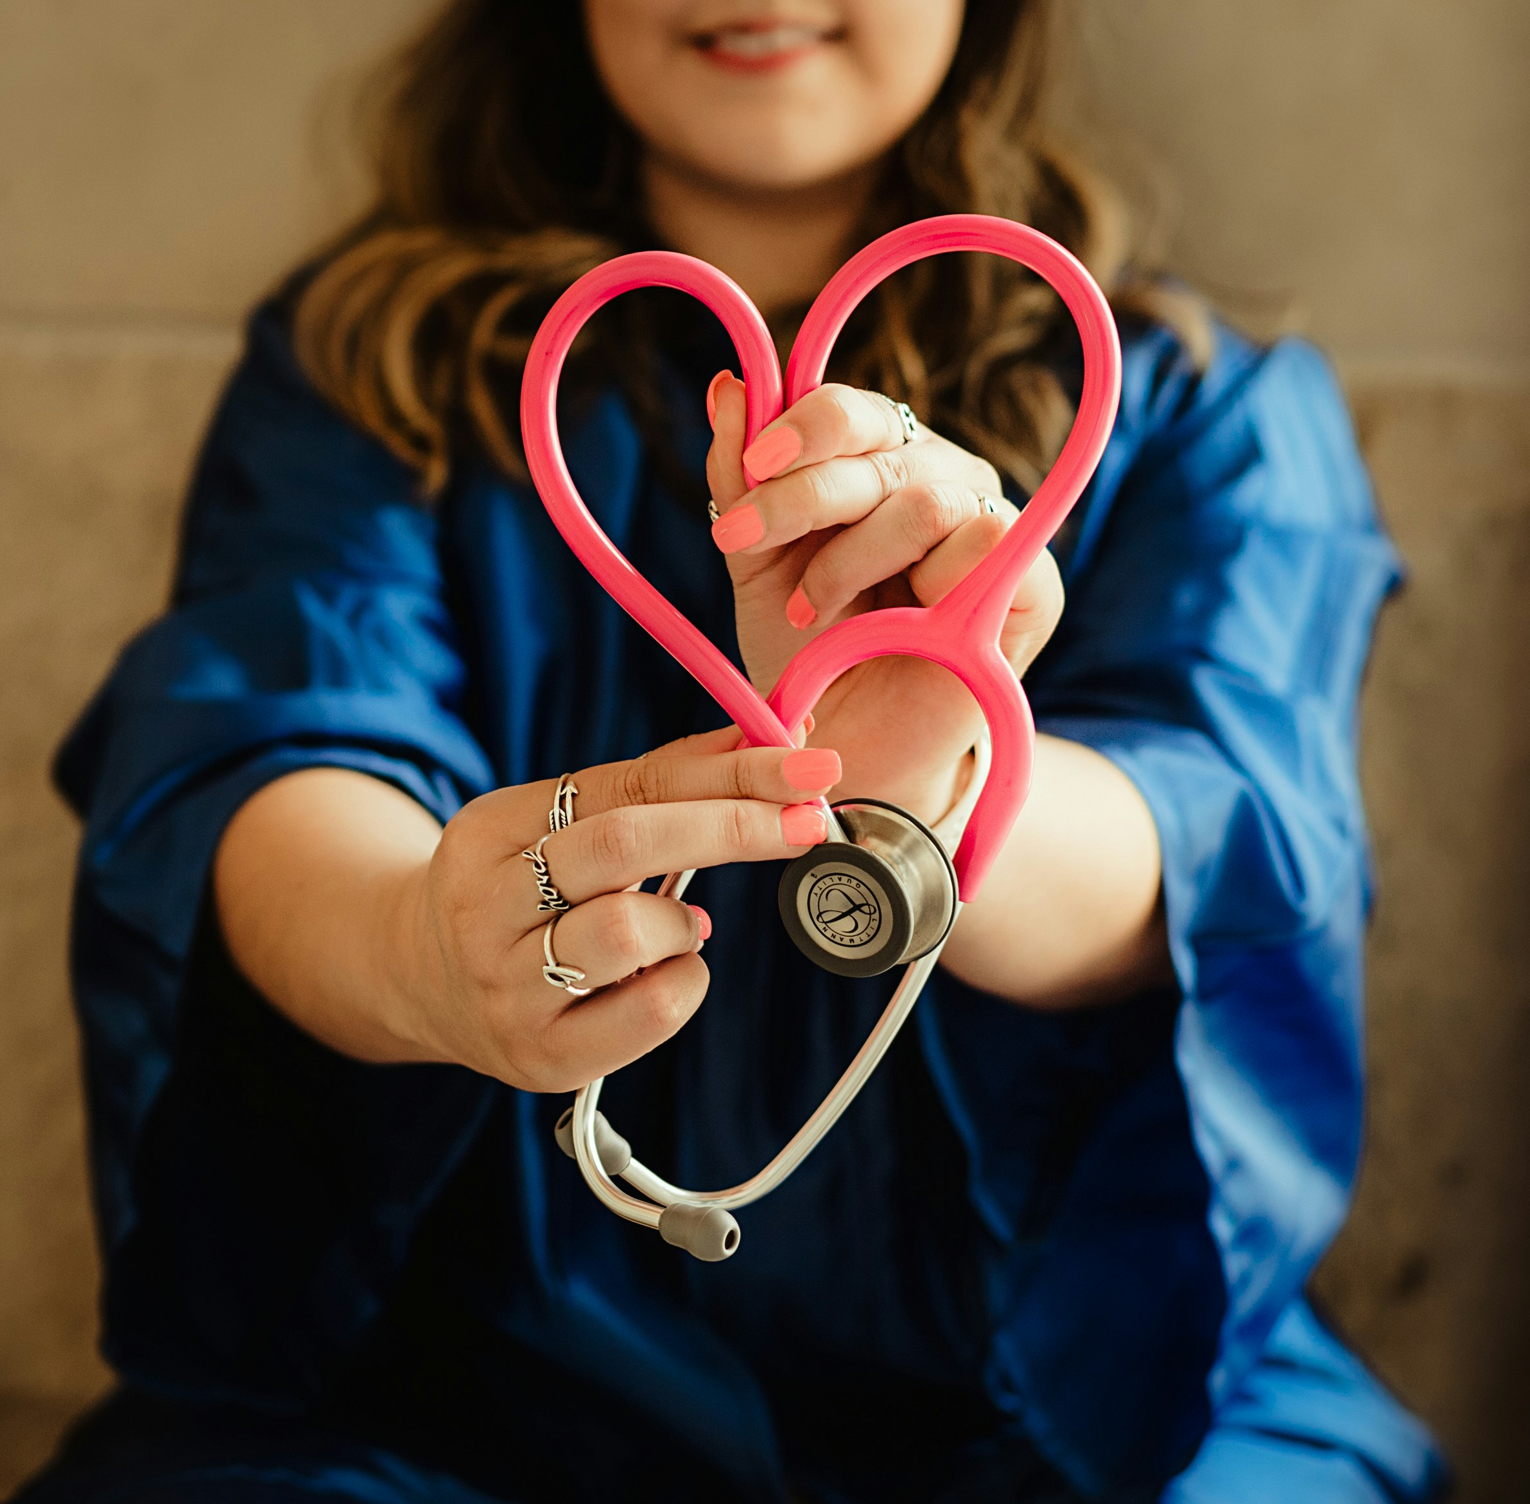
Overall description of first aid
7. FIRST AID SKILLS
7.1
Introduction
7.2
7.3
7.4
7.5
Recognise, assess and determine the need for first aid measures in the event of illness or injury
Provide care using knowledge and skills, within safety requirements and constraints
Act within the chain of survival until the arrival of the Emergency Medical Services

Slide 8
7.2. Steps at the scene of the accident

Slide 9
What is the sequence of the chain of survival? Which steps are you tasked with?
7. FIRST AID SKILLS
7.1
7.2
Steps at the scene of the accident
7.3
7.4
7.5
Please put the steps in the correct order! Which steps do you think you have a role to play?
Calling for help
Emergency assistance
Immediate measures
Hospital
Care for the victim
1
2
3
4
5
...
...
...
...
...

Slide 10
What is the sequence of the chain of survival? Which steps are you tasked with?
7. FIRST AID SKILLS
7.1
7.2
Steps at the scene of the accident
7.3
7.4
7.5
Each chain of survival is only as strong as its weakest link.
Your job is to work within the first three links of the it.
1
2
3
4
5
Immediate measures
Calling for help
Care for the victim
Emergency assistance
Hospital

Slide 11
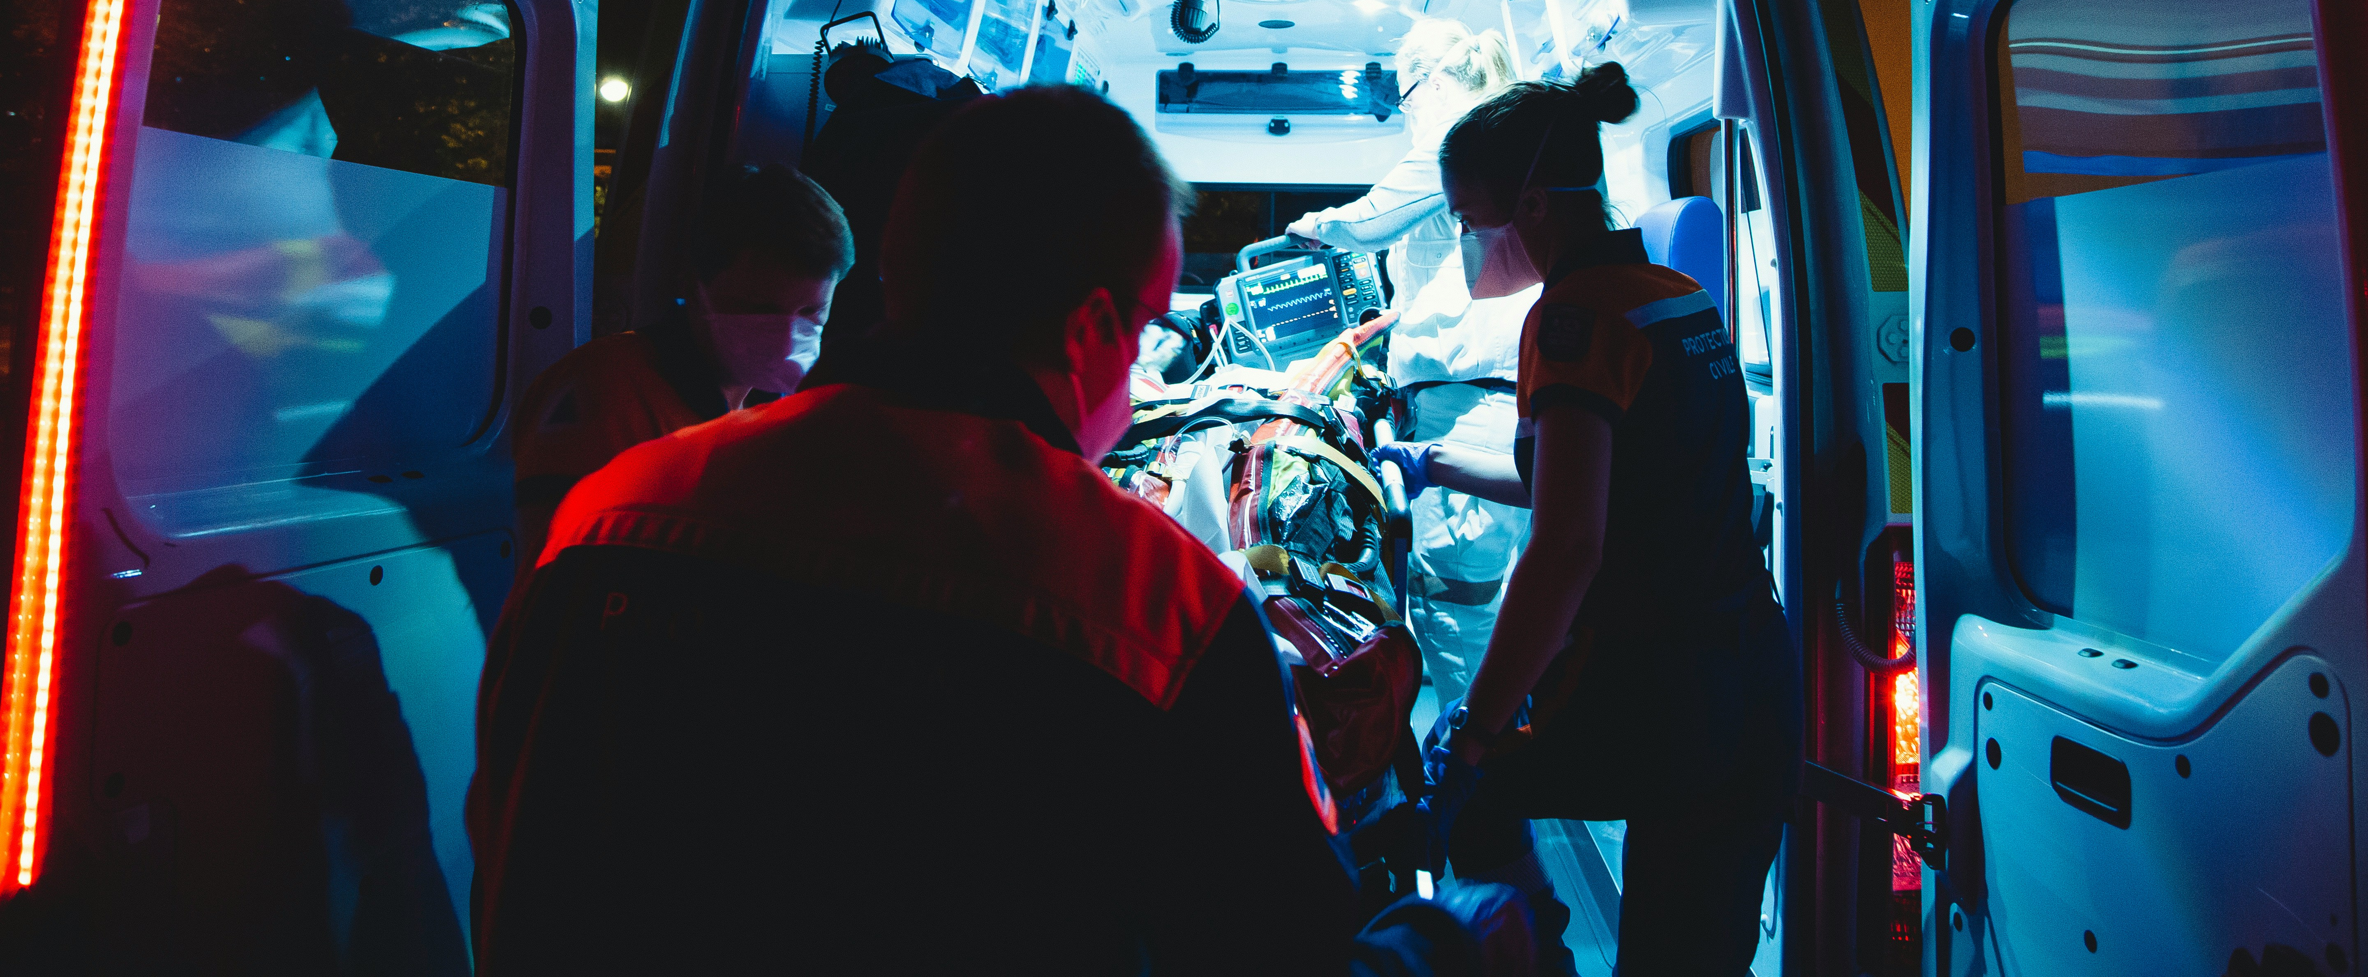
What immediate action should be taken?
7. FIRST AID SKILLS
7.1
7.2
Steps at the scene of the accident
7.3
7.4
7.5
Immediate measures
Calling for help
Victim
Care
Your safety
Preventing external hazards
Life-saving measures
Assess whether giving help puts you at risk
If possible, use protective equipment
In case of risk of infection, use a mouth and nose covering for yourself and, if possible, for the victim
Shutting off gas supply
Extinguishing burning clothing
Cutting off electricity
Installation of warning signs
Etc.
Stop bleeding
Chest compressions
Mouth-to-mouth resuscitation

Slide 12
How to call for help?
7. FIRST AID SKILLS
7.1
7.2
Steps at the scene of the accident
7.3
7.4
7.5
Immediate measures
Calling for help
Victim
Care
Call others for help!
Call an ambulance
If you can help, ask someone else to call an ambulance
Call using:
Report:
113
112
Mobile apps such as eVeselībasPunkts, Mana Drošība, 112 Latvia
Where
accident happened
How many
injured or ill
What happened
Take notice!
Do not terminate the call before the dispatcher has done so
Answer the dispatcher's questions, listen to advice
Provide assistance until the arrival of an ambulance

Slide 13
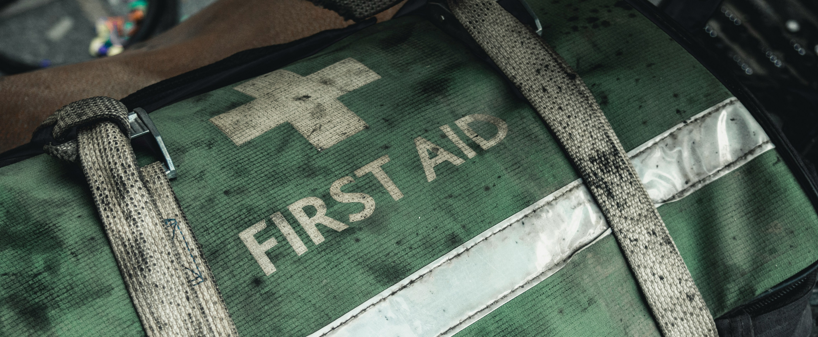
What immediate action should be taken?
7. FIRST AID SKILLS
7.1
7.2
Steps at the scene of the accident
7.3
7.4
7.5
Immediate measures
Calling for help
Victim
Care
Continue to provide assistance until the arrival of an ambulance:
Protect the victim from exposure to the environment:
Provide psychological support:
Do not change the victim's posture unnecessarily
Help the victim into the most comfortable position or lay him down
Watch out for deterioration in the victim's condition
Ensure the comfort of the victim
Keep the victim cool (e.g. wrap in a foil blanket)
Protect against overheating (e.g. move to a cooler place)
Speak calmly, reassuringly but confidently
Introduce yourself
Listen to the victim
Do not leave the victim alone
Inform the victim of your (the rescuer's) actions
Keep the victim informed about what is happening (real positive information)
Maintain light contact with the victim's body
Don't throw anything away
Protect the victim from the curious
Ask if you need to tell someone

Slide 14
7.3. Resuscitation measures

Slide 15
Adult resuscitation algorithm
7. FIRST AID SKILLS
7.1
7.2
7.3
Resuscitation measures
7.4
7.5
Unresponsive?
No
Provide first aid
Yes
Help!
Clear the airways
Respiratory control
Breathing?
No
Call 113 / Have an AED brought
Yes
30 chest compressions
NMPD Instructions "First aid: stable lateral posture"
NMPD Instructions "ABC of First Aid. Revitalisation - adults"
Stable side posture
2 breaths
Call 113
Continue chest compressions and breaths (30:2)
Switch on the AAD, follow its commands

Slide 16
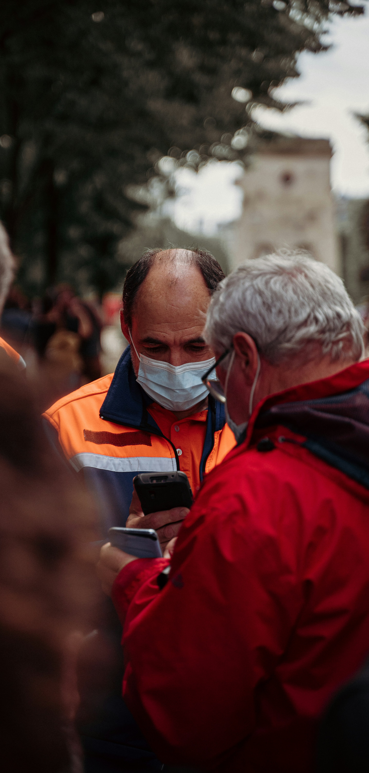
Adult resuscitation algorithm - important to remember
7. FIRST AID SKILLS
7.1
7.2
7.3
Resuscitation measures
7.4
7.5
In any accident where the victim has lost consciousness, the principles of resuscitation should be followed
Chest compressions should be performed with the victim on a firm surface whenever possible
The recommended rate of chest compressions is 100-120 times per minute, with a depth of 5-6 centimetres
When performing mouth-to-mouth, it is recommended to use a respiratory mask with a one-way valve
Do not stop the massage for more than 10 seconds, even if the breathing seems to be failing. When using the defibrillator, try to keep the pauses between cardiac massage and defibrillator operation as short as possible
If there are several rescuers performing resuscitation, they may alternate, taking as little time as possible to switch, each performing resuscitation for 2 minutes

Slide 17
7.4. First aid measures

Slide 18
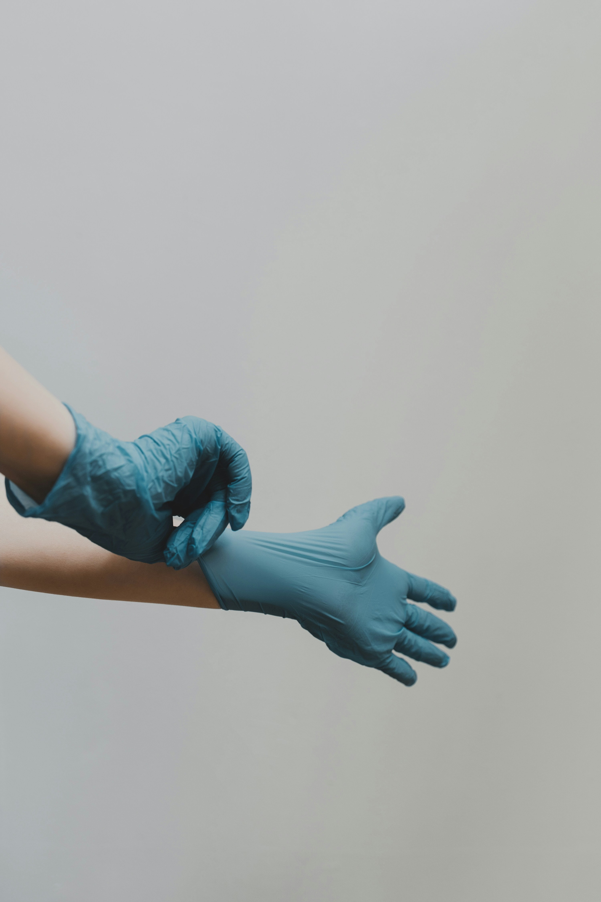
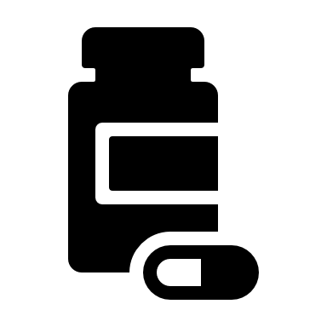
First aid measures
7. FIRST AID SKILLS
7.1
7.2
7.3
7.4
First aid measures
7.5
Common accidents and steps
Important!
If the sequence of actions is numbered in the list of steps, it must be followed. If numbering is not used, the sequence of actions may be changed to suit the circumstances.
Severe bleeding
Thermal damage
Chemical substances
Injuries
Road traffic accident
Accidents caused by animals
Foreign bodies
Diseases

Slide 19
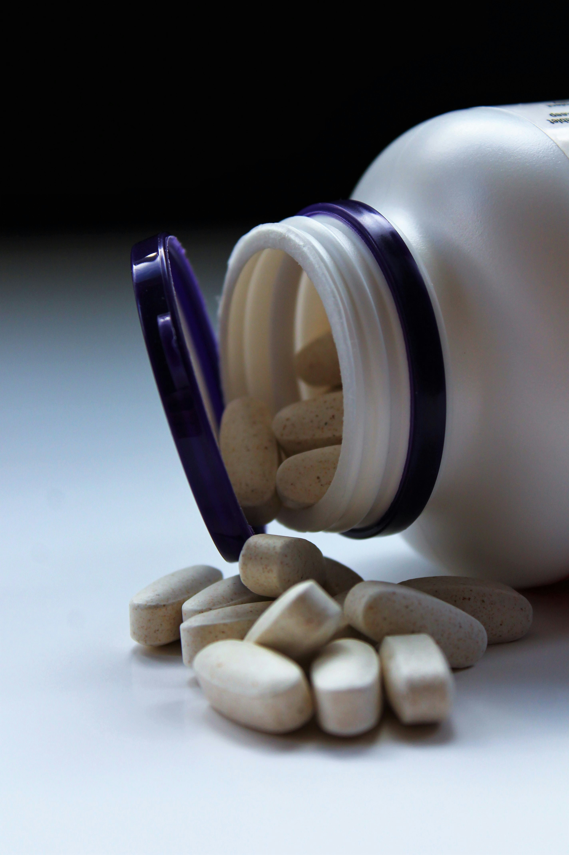
What to do in case of severe bleeding?
7. FIRST AID SKILLS
7.1
7.2
7.3
7.4
First aid measures
7.5
Severe bleeding
What does severe bleeding look like?
How to proceed?
Important!
1
Wear waterproof gloves.
Severe bleeding is life-threatening.
Waterproof products (e.g. plastic bags) can be used as substitutes for gloves.
The wound can be closed with your fingers, hand or fist. If possible, use a gauze pad or a clean piece of cloth.
If bleeding seems to be continuing, press the wound more firmly by placing another gauze pad or piece of cloth over the existing material.
2
Remove clothing from the bleeding area.
3
Apply direct pressure to the bleeding area and close the wound.
4
Lay the victim down with the bleeding area facing up.
5
Call an ambulance.
6
Keep the wound closed until the ambulance arrives.
7
Care for, reassure the victim.
8
Take resuscitation measures if necessary.

Slide 20
What to do if there is heavy bleeding in the arm or in the leg and bandages are available?
7. FIRST AID SKILLS
7.1
7.2
7.3
7.4
First aid measures
7.5
Severe bleeding
How to proceed?
Important!
1
Wear waterproof gloves.
If bleeding seems to be continuing, top up the pressure dressing with another object.
Applying a tourniquet requires a factory-made tourniquet and the skills to use it. Applying a tourniquet is taught in extended first aid training programmes or in first aid training programmes with additional knowledge.
2
Remove clothing from the bleeding area.
3
Close the wound.
4
Lay the victim down with the bleeding area facing up.
5
Apply the pressure dressing.
6
Call an ambulance.
7
Care for, reassure the victim.
8
Take resuscitation measures if necessary.

Slide 21
What to do in case of amputation?
7. FIRST AID SKILLS
7.1
7.2
7.3
7.4
First aid measures
7.5
Severe bleeding
How to proceed?
Important!
1
Wear waterproof gloves.
If bleeding seems to be continuing, press the wound more firmly, if possible by placing another gauze pad or piece of cloth over the existing material.
Do not wash the amputated body part.
Do not allow the amputated body part to freeze or get warm.
What to do with the amputated body part?
Wrap it in clean material.
Put it in an undamaged plastic bag.
Keep it cool (e.g. in the warmest part of the fridge (optimum temperature +4ºC) or in a reservoir (bag, bucket, etc.) with a mixture of ice and water).
2
Remove clothing from the bleeding area.
3
Close the wound.
4
Lay the victim down with the bleeding area facing up.
5
Call an ambulance.
6
Keep the wound closed until the ambulance arrives.
7
If possible, apply a bandage to the amputation wound, wrapping it tightly.
8
Care for, reassure the victim.
9
Take resuscitation measures if necessary.

Slide 22
Other cases
7. FIRST AID SKILLS
7.1
7.2
7.3
7.4
First aid measures
7.5
Severe bleeding
Nosebleeds
Bleeding after a knocked-out tooth
Wounds without heavy bleeding
1
Wear waterproof gloves.
1
Wear waterproof gloves.
1
2
Make the victim pinch the nostril closed.
2
Give cold water to rinse the mouth.
A dirty abrasion or superficial wound can be rinsed with clean water before dressing.
3
Make the victim tilt their head forward.
3
Put a folded compress on the bleeding area.
4
Sit the victim down.
4
2
Make the victim bite their teeth to keep the compress to the bleeding area.
5
Apply cold to
nose and occiput.
Bandage only with dry, preferably sterile, dressings.
6
If bleeding continues for more than 20 minutes, call an ambulance.
5
Call an ambulance or advise the victim to see a dentist.

Slide 23
What to do in case of overheating?
7. FIRST AID SKILLS
7.1
7.2
7.3
7.4
First aid measures
7.5
Thermal damage
Contributing circumstances
How to proceed?
Important!
Heat
Humidity
Insufficient fluid intake
Lack of wind
Inadequate clothing
Physical exertion
1
Make sure the victim stops any physical exertion.
Suggested drinks - mineral water, water, juice, low-fat milk. Carbohydrate/electrolyte drinks are preferable if available.
You can also use cool drink bottles or ice wrapped in a cloth for cooling.
Do not drink alcohol or caffeinated drinks, energy drinks.
2
Immediately move the victim to as cool a place as possible or in the shade, and place them in a semi-recumbent position.
3
Uncover the victim.
4
Re-hydrate the victim's head, neck, chest with cool water.
5
Use cold objects for cooling.
6
Give a cool drink.
7
Ventilate, cool, create air flow.
8
Call an ambulance.
9
Take resuscitation measures if necessary.

Slide 24
What to do in case of cooling?
7. FIRST AID SKILLS
7.1
7.2
7.3
7.4
First aid measures
7.5
Thermal damage
Contributing circumstances
How to proceed?
Important!
Cold
Humidity
Wind
Alcohol
Inadequate clothing
Inability to move
1
Call an ambulance.
Do not give the victim alcohol.
Do not move a victim with impaired consciousness unnecessarily, rub hands and feet, sit or stand.
Do not massage, rub or heat the frostbitten areas.
2
Place the victim in a warm room or at least in a dry place.
3
If possible, remove wet clothes, shoes.
4
Cover with warm, dry clothes and then wrap in a foil blanket.
5
If the victim is not unconscious, give warm, sugary drinks.
Take resuscitation measures if necessary.
6

Slide 25
What to do in case of burns?
7. FIRST AID SKILLS
7.1
7.2
7.3
7.4
First aid measures
7.5
Thermal damage
How to proceed?
Important!
1
If your clothes catch fire, extinguish the flame.
Cooling large areas of the burn can cause the body to cool. In this case, reduce the cooling time or use cool but not cold water.
In case of burns to the respiratory tract, always call an ambulance as there is a risk of suffocating. Facial burns always burn the airways.
If clothing is on fire, the victim should be made to lie down as soon as possible. Extinguish burning clothing by smothering the flames with a blanket, rolling the victim on the ground or pouring water on the victim. You can also use fire extinguishers to extinguish clothing, but be careful of the victim's face when doing so.
Do not tear burnt clothing off your body.
Do not open blisters caused by a burn.
Do not use ointments, powders, disinfectants when giving first aid.
2
Cool the burned area as soon as possible with cool or cold (not ice-cold) water for at least 20 minutes. If possible, pour water between clothing and skin.
3
During cooling, carefully remove clothing, shoes and rings from the injured part of the body.
4
If the burn is larger than the victim's hand, call an ambulance.
5
Cover the burn loosely with a gauze pad, cling film or foil blanket.
6
Care for, reassure the victim.

Slide 26
What to do in case of accidents caused by chemicals?
7. FIRST AID SKILLS
7.1
7.2
7.3
7.4
First aid measures
7.5
Chemical substances
To reduce the risk of exposure to chemicals, waterproof gloves or other waterproof materials (e.g. plastic bags) are preferable.
How to proceed?
Important!
On skin
Remove clothing contaminated with chemicals.
Rinse the affected area with plenty of cool, running water for 20 minutes.
Call an ambulance.
Care for, reassure the victim.
Before rinsing, remove the dry substance.
Rinse so that water does not run onto intact skin.
Do not pull the victim's clothes off over their head.
In the eye
Flush the injured eye with plenty of cool, running water for 20 minutes.
Call an ambulance.
Care for, reassure the victim.
Rinse so that water does not run onto the healthy eye.
Keep the injured eye open when flushing.
If the victim wears contact lenses, they should be removed when rinsing the eye.
It is recommended to apply a bandage to both eyes after flushing.

Slide 27
What to do in case of accidents caused by chemicals?
7. FIRST AID SKILLS
7.1
7.2
7.3
7.4
First aid measures
7.5
Chemical substances
How to proceed?
Important!
In the digestive tract
Call an ambulance.
Give water to rinse the mouth.
Give cool water to drink, but no more than 200 ml.
Care for, reassure the victim.
Take resuscitation measures if necessary.
Do not induce vomiting!
Inhaled chemical
Call an ambulance.
Provide the victim with fresh air.
Care for, reassure the victim.
Take resuscitation measures if necessary.
If the presence of harmful gaseous chemicals in the air is suspected, do not approach the accident site. Move at a safe distance, in the fresh air!
It is particularly dangerous if the victim is in a confined space such as a sewer, cellar, tank, etc.
Only help the victim if the victim has escaped from the hazardous environment.

Slide 28
What to do in case of electrocution?
7. FIRST AID SKILLS
7.1
7.2
7.3
7.4
First aid measures
7.5
Electrocution
How to proceed?
Important!
Low Voltage
(up to 1000 V)
Protect yourself.
Switch off the power.
Call an ambulance.
Take resuscitation measures if necessary.
Always call an ambulance, because even if things seem to be going well, the victim's condition can deteriorate significantly later.
High Voltage
(over 1000 V)
Do not approach the scene of the accident, beware of step voltages and electric arcs.
Call an ambulance, inform about the high voltage.
If necessary, only take resuscitation measures when the high-voltage power is switched off.
Lightning is also an electrical injury. If necessary, resuscitate and always call an ambulance.

Slide 29
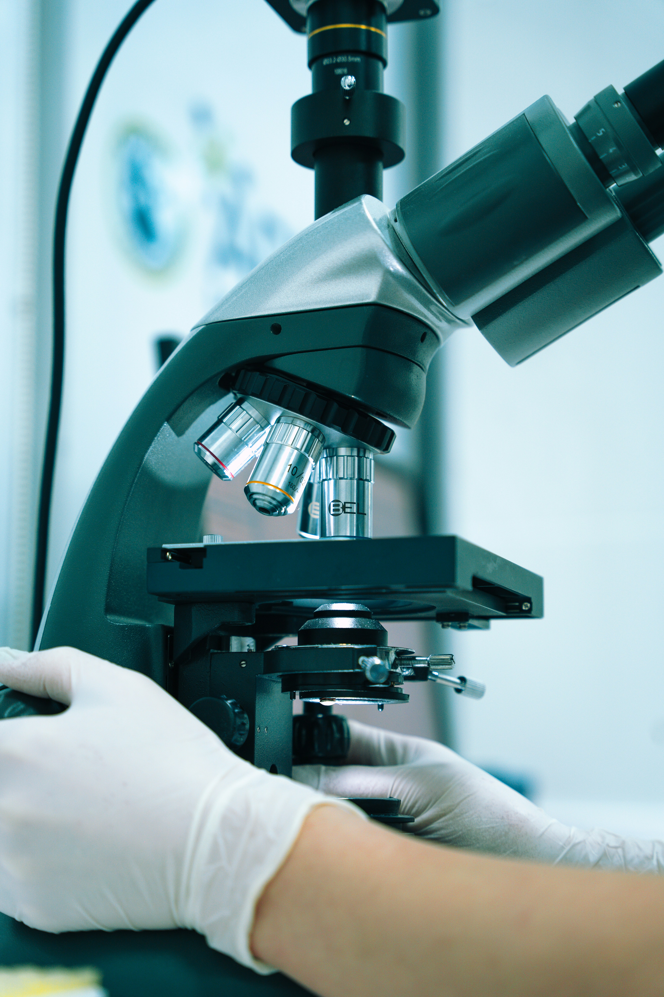
How to help a victim in case of drowning?
7. FIRST AID SKILLS
7.1
7.2
7.3
7.4
First aid measures
7.5
Drowning
How to proceed?
Important!
1
A person with impaired consciousness can also drown in a bath, puddle, garden pool, etc.
Always call an ambulance, because even if things seem to be going well, the victim's condition can deteriorate significantly later.
If you witness an accident, try to remember the scene as well as possible, using landmarks both on the water and on the shore to give rescuers a better idea of where the accident happened.
More information here
Only rescue a victim if it does not endanger your life.
2
The safest rescue is from the shore, throw the life ring tied in the rope. A ball, an empty plastic bottle or any other floating objects that can help the drowning person stay afloat are also useful.
3
Call an ambulance.
4
Take resuscitation measures if necessary.

Slide 30
What to do in case of injury?
7. FIRST AID SKILLS
7.1
7.2
7.3
7.4
First aid measures
7.5
Injuries
How to proceed?
Important!
Hand and leg injuries (victim complains of pain, possible deformity, swelling, difficulty moving)
Do not move the victim.
Keep the deformation caused by the injury.
Call an ambulance.
Care for, reassure the victim.
Don't try to distinguish between different types of injury. Assume that the injury may be a fracture.
Only move the victim if there is a risk to life. Do it gently.
Injuries of the spine
(road accident,
falling from a height,
water jump)
Ask the victim not to move or shake his head.
Do not move the victim yourself! Do not let others move the victim!
Call an ambulance.
Care for, reassure the victim.
Take resuscitation measures if necessary.
A pedestrian, cyclist, etc. is also considered a road accident.
Only move the victim if there is a risk to life.
Be careful with the victim's spine when moving.

Slide 31
What to do in case of injury?
7. FIRST AID SKILLS
7.1
7.2
7.3
7.4
First aid measures
7.5
Injuries
How to proceed?
Important!
Abdominal injuries
Help/allow the victim to get into the most comfortable body position.
Call an ambulance.
If there is a wound, cover with a gauze pad.
Care for, reassure the victim.
Take resuscitation measures if necessary.
The most comfortable positions for the victim might be lying on their back with the roll under their knees or lying on their side with their knees bent.
Do not give medication, food or drink.
Chest injuries
Help/allow the victim to get into the most comfortable body position.
Call an ambulance.
If there is a wound, cover with a gauze pad.
Care for, reassure the victim.
Take resuscitation measures if necessary.
The most comfortable posture for the victim might be lying down.

Slide 32
What to do in case of injury?
7. FIRST AID SKILLS
7.1
7.2
7.3
7.4
First aid measures
7.5
Injuries
How to proceed?
Important!
Head injuries
Help/allow the victim to get into the most comfortable body position.
Call an ambulance.
If the victim vomits, turn them on their side.
If there is a wound, cover with a gauze pad.
Care for, reassure the victim.
Take resuscitation measures if necessary.
The most comfortable posture for the victim might be lying down.
Always call an ambulance, because even if things seem to be going well, the victim's condition can deteriorate significantly later.

Slide 33
How to help a victim in a traffic accident?
7. FIRST AID SKILLS
7.1
7.2
7.3
7.4
First aid measures
7.5
Road traffic accident
How to proceed?
Important!
Stop your car at a safe distance from the accident.
Switch on your car's hazard lights.
Wear a reflective vest, take a first aid kit, emergency sign.
Place the emergency sign at the required distance from the accident scene.
Go to the scene of the accident.
In any road accident, assume that the victim may have a spinal injury.
Watch out for passing vehicles!

Slide 34
How to help a victim in a car accident?
7. FIRST AID SKILLS
7.1
7.2
7.3
7.4
First aid measures
7.5
Road traffic accident
How to proceed?
Important!
If necessary, call an ambulance.
Leave the victim in the car.
Do not move the victim yourself! Do not let others move the victim!
Give the help you need.
Care for, reassure the victim.
Gently pull the victim out of the car if:
the victim's life is in danger;
they are unconscious.
Take resuscitation measures if necessary.
The Rautec technique is recommended for extricating the victim.
Airbags that have deployed are not dangerous for you or the victim.
Beware of airbags that have not been deployed.
NMPD Instructions "ABC of First Aid. What to do after a road accident"

Slide 35
How to help a victim in a motorbike accident?
7. FIRST AID SKILLS
7.1
7.2
7.3
7.4
First aid measures
7.5
Road traffic accident
How to proceed?
Important!
If necessary, call an ambulance.
Remove the helmet very carefully, sparing the victim's neck, if:
they are unconscious;
bleeding from the bottom of the helmet.
Otherwise, leave the helmet on their head.
Do not move the victim yourself! Do not let others move the victim!
Perform the necessary aid.
Care for, reassure the victim.
Take resuscitation measures if necessary.
Help remove the helmet if the victim wants it.

Slide 36
How to deal with accidents caused by animals?
7. FIRST AID SKILLS
7.1
7.2
7.3
7.4
First aid measures
7.5
Accidents
caused by animals
How to proceed?
Important!
Animal bite
If the wound is bleeding heavily, wash it with soap and water.
Bandage the wound.
Call an ambulance.
Danger! Risk of rabies infection!
If the wound is bleeding heavily, do not wash it and proceed as described in the section 'Heavy bleeding'.
Vaccination immediately after an animal bite protects against rabies.
Snake bite
Do not use a tourniquet or bandage, do not attempt to suck out the venom, do not cut or burn.
Pay particular attention to calming the victim.
1
Call an ambulance.
2
Try not to move the bitten
part of the body.
3
Care for, reassure the victim.

Slide 37
How to deal with accidents caused by animals?
7. FIRST AID SKILLS
7.1
7.2
7.3
7.4
First aid measures
7.5
Caused by animals
accidents
How to proceed?
Insect sting
in the oral cavity
1
Call an ambulance.
2
Give ice to suck on or cold drinks to drink in small sips.
3
Cool the throat from the outside.
4
Care for, reassure the victim.
5
Take resuscitation measures if necessary.
Dangerous! Possible airway obstruction and suffocation due to oedema.

Slide 38
What to do in case of foreign bodies obstructing airways?
7. FIRST AID SKILLS
7.1
7.2
7.3
7.4
First aid measures
7.5
Foreign bodies
How to proceed?
Important!
Foreign body in the airways
Ask if the victim has choked.
Allow the victim to cough up the foreign body.
Encourage the victim to cough.
If the victim is no longer able to speak and is actively coughing:
bend the upper body of the victim and deliver 5 blows between the shoulder blades;
if that doesn't help, use the Heimlich technique;
If necessary, continue alternating between the scapular strokes and the Heimlich technique;
call an ambulance;
take resuscitation measures if necessary.
If the Heimlich technique is used, always call an ambulance, as even if things seem to be going well, the victim's condition can deteriorate significantly later.
NMPD instructions "How to give first aid for choking?"

Slide 39
What to do in case of accidents involving foreign bodies?
7. FIRST AID SKILLS
7.1
7.2
7.3
7.4
First aid measures
7.5
Foreign bodies
How to proceed?
Important!
Foreign bodies
in the wound
Do not throw out a foreign body.
Do not allow a foreign body to enter the wound.
1
Stop heavy bleeding.
2
Call an ambulance.
3
Care for, reassure the victim.
Foreign bodies
in the eye
If the foreign body cannot be easily flushed out, assume that it may be stuck. In this case:
apply a bandage to both eyes;
seek medical help.
Do not pull out a foreign object that may have stuck. Seek medical advice.
Foreign bodies
in the ear
If an insect has got into your ear:
put oil or water in the ear to drown it;
seek medical help.
Do not use aids to remove the foreign body. Seek medical advice.

Slide 40
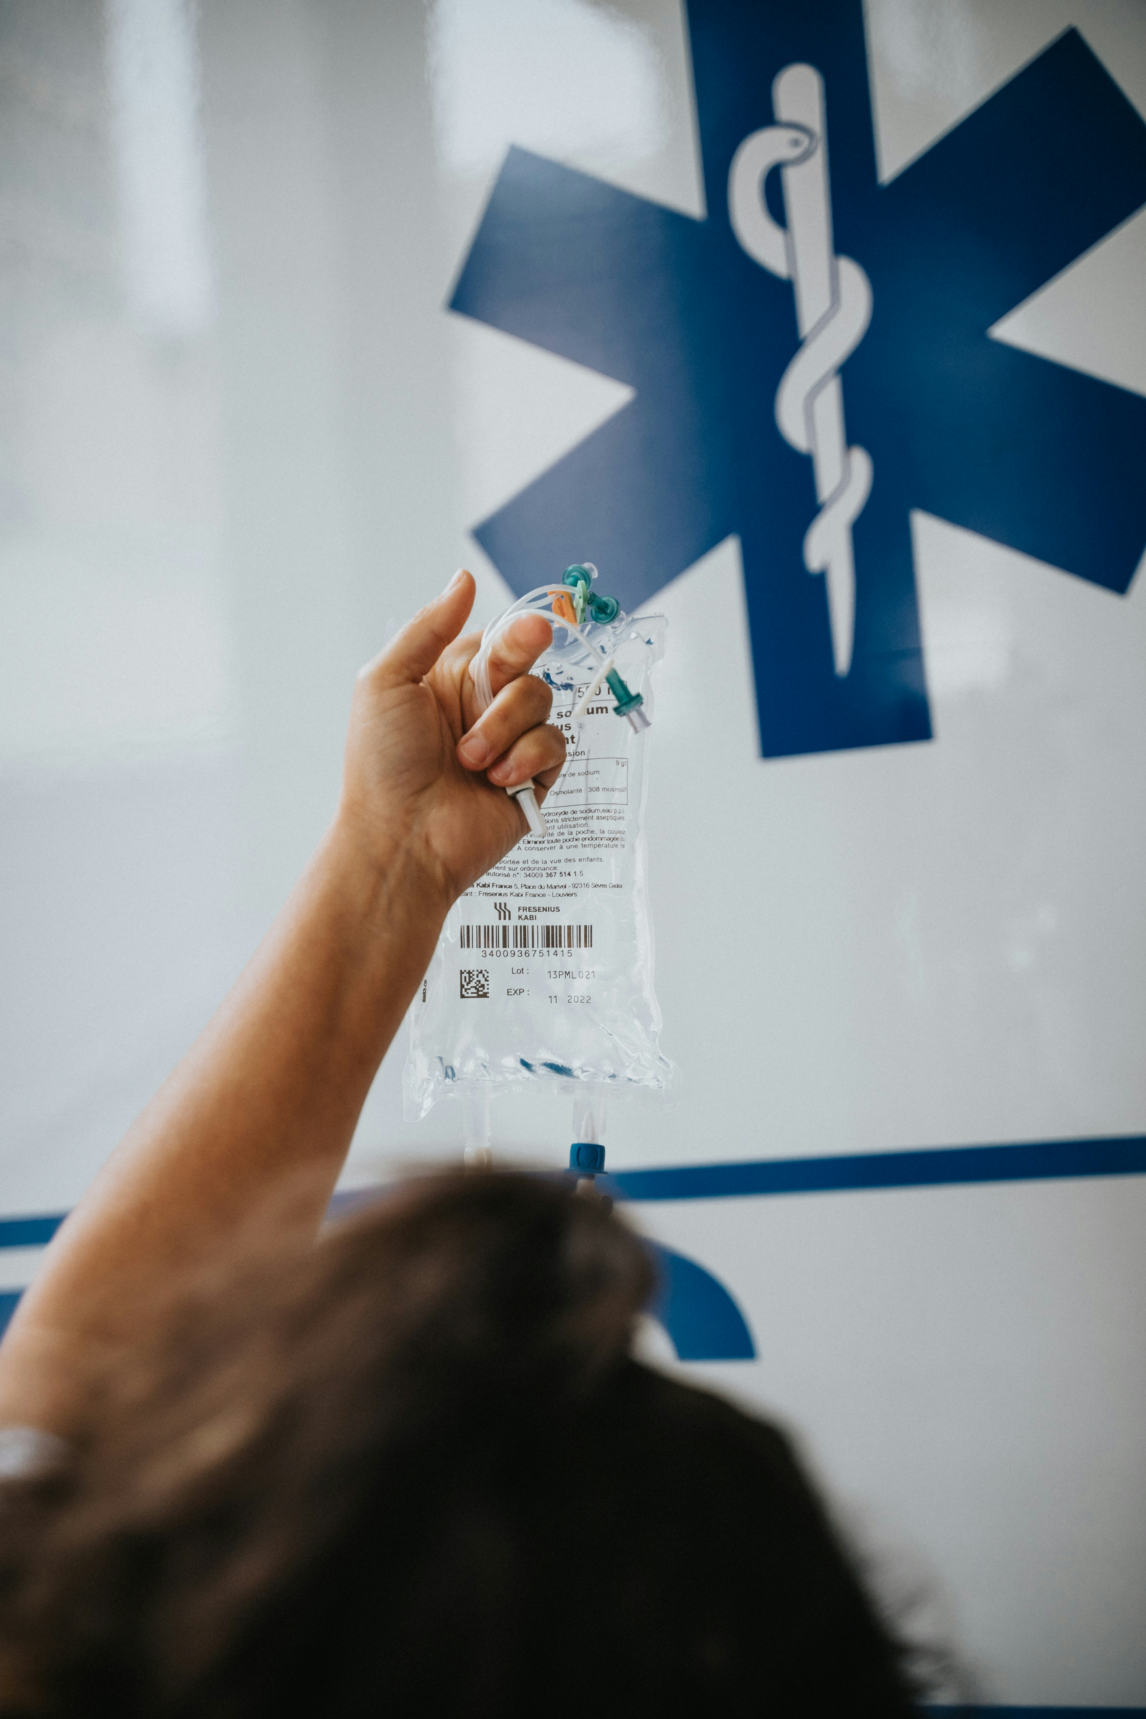
What if the victim has a seizure?
7. FIRST AID SKILLS
7.1
7.2
7.3
7.4
First aid measures
7.5
Diseases
What does a seizure look like?
How to proceed?
During a seizure, protect the victim from possible injury, especially the victim's head.
Call an ambulance.
If necessary, resuscitate only after a seizure, not during it.
Important!
It is especially dangerous if the seizure lasts longer than 5 minutes or if the seizures are repeated over a short period of time.
Do not hold down the victim during the attack, do not try to open the bitten teeth and do not put anything in their mouth.
After a seizure, the victim may be confused, do not leave them alone.

Slide 41
What if the victim has a seizure?
7. FIRST AID SKILLS
7.1
7.2
7.3
7.4
First aid measures
7.5
Diseases
They suddenly fall to the ground. The body becomes stiff and tense. Twitching, crampy movements throughout the body.
How to proceed?
During a seizure, protect the victim from possible injury, especially the victim's head.
Call an ambulance.
If necessary, resuscitate only after a seizure, not during it.
Important!
It is especially dangerous if the seizure lasts longer than 5 minutes or if the seizures are repeated over a short period of time.
Do not hold down the victim during the attack, do not try to open the bitten teeth and do not put anything in their mouth.
After a seizure, the victim may be confused, do not leave them alone.

Slide 42
What to do if the victim has a pain in their chest or shortness of breath?
7. FIRST AID SKILLS
7.1
7.2
7.3
7.4
First aid measures
7.5
Diseases
How to proceed?
Provide the victim with a calm environment and fresh air.
Help/allow the victim to get into the most comfortable body position.
Help the victim to take the medicine they already use.
Call an ambulance.
Care for, reassure the victim.
Take resuscitation measures if necessary.
Important!
Chest pain or shortness of breath can be a sign of life-threatening health problems!
Have someone bring the defibrillator in time to use it immediately if needed.

Slide 43
What to do if the victim has severe abdominal pain?
7. FIRST AID SKILLS
7.1
7.2
7.3
7.4
First aid measures
7.5
Diseases
How to proceed?
Help/allow the victim to get into the most comfortable position.
Call an ambulance.
Care for, reassure the victim.
Take resuscitation measures if necessary.
Important!
The most comfortable positions for the victim might be lying on their back with a roll under their knees or lying on their side with their knees bent.
Do not give medication, warm the abdomen, give food or drinks.
Regardless of the presence of pain, vomiting with black or bloody contents or a black abdominal discharge can be a sign of bleeding in the abdominal organs, which is life-threatening.

Slide 44
How to help someone with diabetes?
7. FIRST AID SKILLS
7.1
7.2
7.3
7.4
First aid measures
7.5
Diseases
What does it look like?
How to proceed?
Important!
Identify people with diabetes among your acquaintances.
Give 3-4 teaspoons of sugar with water or a glass of sweetened drink (fruit juice, lemonade) at a time. Do not use sugar substitutes, they will not help.
Diabetics can have high blood sugar levels or sometimes a sharp drop in them.
A drop in blood sugar levels can lead to a life-threatening condition.
If a diabetic starts to feel unwell but is able to follow commands and swallow, give sugar or sugary drinks.
If the situation does not improve after 15 minutes, call an ambulance and give sugar or sugar-containing drinks again.
If the patient improves within 15 minutes, give a light snack (e.g. a slice of bread, biscuits).
Care for, calm the sick.
Take resuscitation measures if necessary.

Slide 45
How to help in case of a stroke?
7. FIRST AID SKILLS
7.1
7.2
7.3
7.4
First aid measures
7.5
Diseases
What does it look like?
How to proceed?
Recognise the stroke and follow the "FAST" route.
Does one side of the face droop or is it numb? Ask the person to smile. Is the person's smile uneven?
Is one arm weak or numb? Ask the person to raise both arms. Does one arm drift downward?
Speech Difficulty – Is speech slurred?
Time to call 911 – Stroke is an emergency. Every minute counts. Call 911 immediately. Note the time when any of the symptoms first appear.Care for, calm the sick.
Take resuscitation measures if necessary.
F
A
S
T
A stroke is a brain injury caused by a disturbance in the blood flow to the brain that threatens the victim's life.

Slide 46
7.5. Contents of the first aid kit

Slide 47
Minimum contents of a first aid kit
7. FIRST AID SKILLS
7.1
7.2
7.3
7.4
7.5
First aid kit
Nr.p.k. | Names, sizes, type of packaging for first aid kit medical supplies | Minimum number
1. | List of medical supplies in the national language | 1
2. | Disposable gloves in packaging | 2 pairs
3. | Safety pins | 4
4. | Scissors (10 - 14 cm) with rounded ends | 1
5. | CPR breathing barriers with one-way air valves in packaging | 1
6. | Triangular dressing (96 x 96 x 136 cm) per pack | 2
7. | Leucoplast (2 - 3 cm) in a coil | 1
8. | Wound bandages (various sizes) in sterile packaging | 15
9. | Mesh bandage No 3 (40 cm) | 3
10. | Foil blanket (one side metallized, the other brightly coloured) in a pack | 1
11. | Gauze dressings (4 m x 10 cm) in sterile packaging | 4
12. | Gauze dressings (4 m x 5 cm) in sterile packaging | 2
13. | Dressing packs in sterile packaging | 2
14. | Gauze compress (600 x 800 mm) in sterile packaging | 1
15. | Gauze compress (400 x 600 mm) in sterile packaging | 1
16. | Gauze compress (100 x 100 mm) in sterile packaging | 5
It is recommended to supplement the contents of the first aid kit with at least two medical face masks or non-vented respirators with a safety rating of FFP2 - FFP3.

