Slide 1
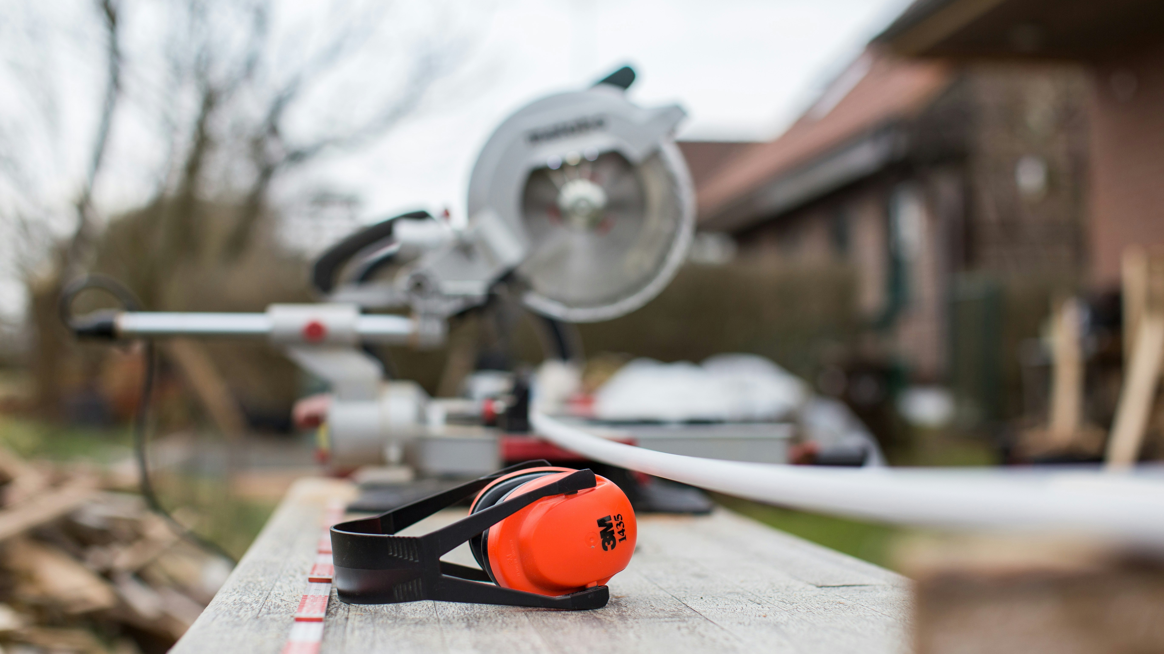


Study course "Civil Protection"​
4. International Assistance
Developed in the framework of the European Commission’s Civil Protection Financial Instrument "Track1" project "Establishment of comprehensive civil protection and disaster management training for governmental institutions, civil protection commissions of municipalities, universities, Fire Safety and Civil Protection College, as well as establishing safety advice for the public" (ECHO/SUB/2022/TRACK1/884396)
Funded by
The European Union
State Fire and Rescue Service

Slide 2


Tasks
4. INTERNATIONAL ASSISTANCE
Intended Results
To introduce educatees to:
international binding partner organisations in the context of civil protection;
civil protection mechanisms in Europe, including in the Baltic Sea region;
the responsibilities of the Cabinet and the Crisis Management Council in requesting and providing international assistance.
Educatees:
      know the main international binding partner organisations and their roles in civil protection;
      can explain the principles and cooperation mechanisms that determine Latvia's access to international assistance and its involvement in providing assistance to other countries.

Slide 3

Table of Contents
4. INTERNATIONAL ASSISTANCE
4.1. Civil Protection Functions in International Organisations
4.2. Civil Protection Mechanism in Europe
4.3. Civil Protection Cooperation Under Bilateral Agreements and in the Baltic Sea Region
4.4. Request for and Provision of International Assistance

Slide 4
Civil Protection Binding Partner Organisations
4. INTERNATIONAL ASSISTANCE
1
United Nations (UN)
3
European Union (EU)
United Nations Office for the Coordination of Humanitarian Affairs
Directorate-General for European Civil Protection and Humanitarian Aid Operations
United Nations Office for Disaster Risk Reduction
2
North Atlantic Treaty Organisation (NATO)
4
Other partner organisations
NATO Resilience Committee
Bilateral cooperation agreements
Euro-Atlantic Disaster Response Coordination Centre
Council of the Baltic Sea States

Slide 5
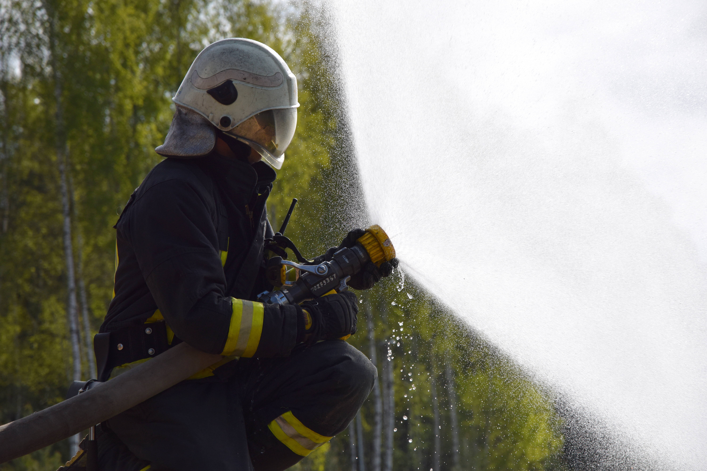
4.1. Civil
Protection Functions in International Organisations

Slide 6

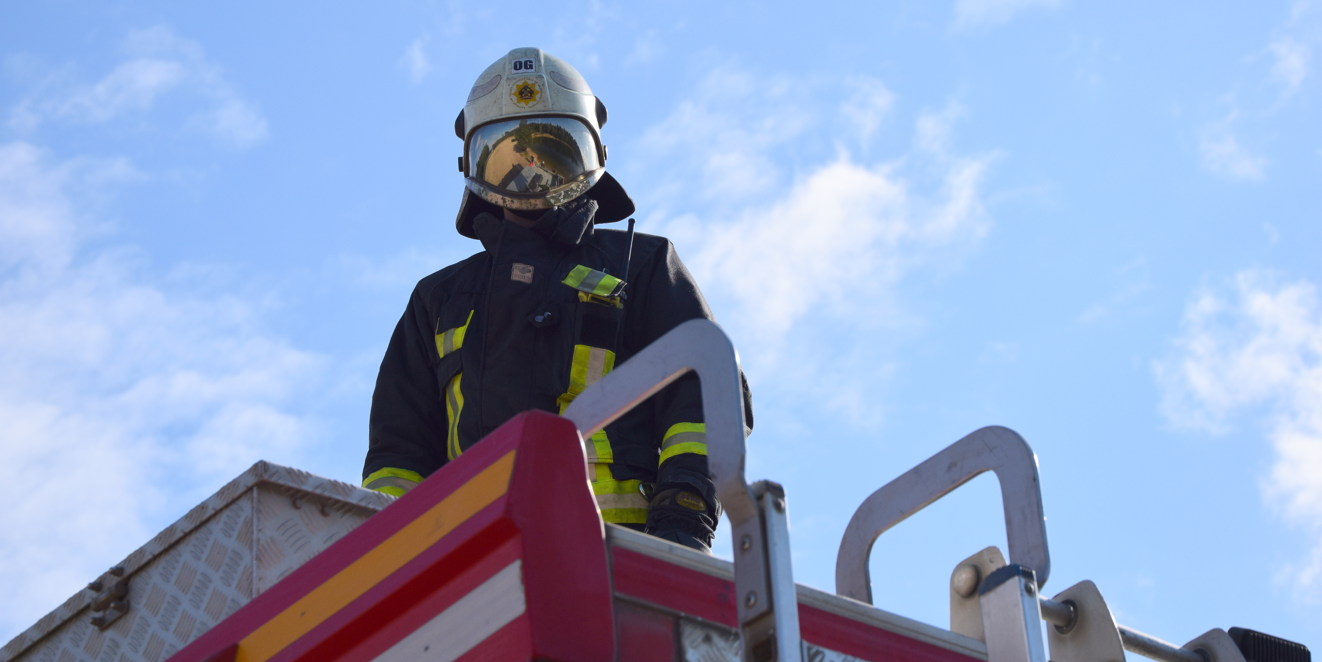
Educatees’ Understanding of the International Civil Protection System
4. INTERNATIONAL ASSISTANCE
4.1
Civil Protection Functions in International Organisations
4.2
4.3
4.4
Which international partner organisations do you think are involved in civil protection?
What are their functions? Please give examples!

Slide 7
Binding International Civil Protection Partner Organisations and Documents Issued by Them
4. INTERNATIONAL ASSISTANCE
4.1
Civil Protection Functions in International Organisations
4.2
4.3
4.4
1
United Nations (UN)
2
North Atlantic Treaty Organisation (NATO)
United Nations Office for the Coordination of Humanitarian Affairs
NATO Resilience Committee
Universal Declaration of Human Rights
Euro-Atlantic Disaster Response Coordination Centre
United Nations Office for Disaster Risk Reduction
NATO 2022 Strategic Concept
Sendai Framework 2015-2030
NATO Baseline Requirements of National Resilience 2016
Unit
Legislative framework / policy planning documents

Slide 8

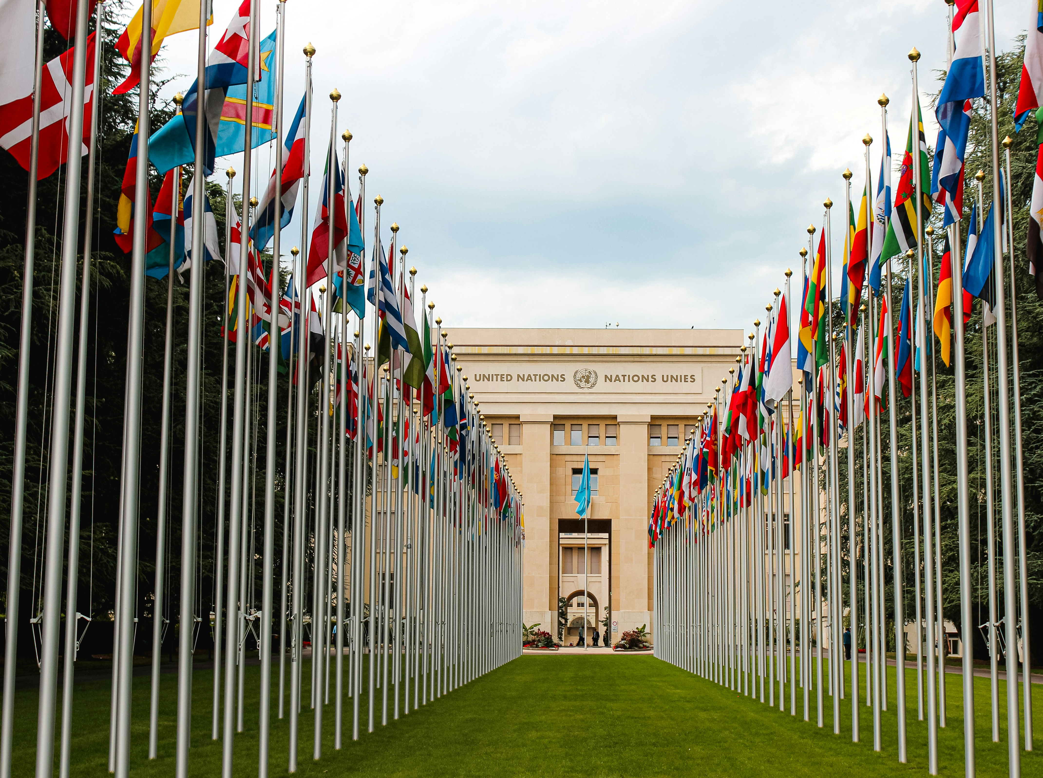
United Nations (UN)
4. INTERNATIONAL ASSISTANCE
4.1
Civil Protection Functions in International Organisations
4.2
4.3
4.4
Operational objectives
Main bodies
Intergovernmental organisation
Established: 1945
Contains: 193 countries (including Latvia since 1991)
To maintain international peace and security
To develop friendly relations among nations
To achieve international co-operation in solving international problems of an economic, social, cultural, or humanitarian character, and in promoting and encouraging respect for human rights and for fundamental freedoms
To be a centre for harmonizing the actions of nations in the attainment of these common ends
General Assembly
Trusteeship Council
United Nations website
Security Council (5+10 Member States)
Economic and Social Council
Secretariat

Slide 9
Universal Declaration of Human Rights (UDHR)
4. INTERNATIONAL ASSISTANCE
4.1
Civil Protection Functions in International Organisations
4.2
4.3
4.4
Main articles on civil protection
Institution: UN
Adoption: 1948
Article 3:
Everyone has the right to life, liberty and security of person.
Article 28:
Everyone is entitled to a social and international order in which the rights and freedoms set forth in this Declaration can be fully realized.
About UDHR
Article 30:
Nothing in this Declaration may be interpreted as implying for any State, group or person any right to engage in any activity or to perform any act aimed at the destruction of any of the rights and freedoms set forth herein.

Slide 10
The United Nations Cluster Approach to Humanitarian Crises and Main Organisations
4. INTERNATIONAL ASSISTANCE
4.1
Civil Protection Functions in International Organisations
4.2
4.3
4.4
The United Nations Office for the Coordination of Humanitarian Affairs (OCHA) is responsible for coordinating information across all clusters.
The Cluster Approach is used for coordinating in non-refugee humanitarian emergencies
Health
WHO
Food Security
WFP and FAO
Logistics
WFP
Emergency Telecommunications
WFP
12
Nutrition
UNICEF
The cluster system spreads accountability for the delivery of services (health, shelter, etc.) across different cluster lead agencies, so that no single agency is accountable for the entire response
Education
UNICEF and Save the Children
Humanitarian & Emergency Relief Coordinator
Reconstruction
Protection
UNHCR
Prevention
The following slides summarise the most important agencies in the field of civil protection
Early
Recovery
UNDP
Shelter
IFRC/UNHCR
Mitigation
Recovery
Camp Coordination and Camp Management
IOM/UNHCR
Water, Sanitation and Hygiene
UNICEF
Response
Cluster approach
Preparedness
Disaster

Slide 11

United Nations Office for the Coordination of Humanitarian Affairs (OCHA)
4. INTERNATIONAL ASSISTANCE
4.1
Civil Protection Functions in International Organisations
4.2
4.3
4.4
Objective
Mission
Established: 1991
Objective: to strengthen international cooperation and preparedness to respond to complex emergencies and natural disasters.
It is responsible for conducting effective humanitarian aid mobilizations in emergency situations.
1
Mobilise and coordinate effective and principled humanitarian action in partnership with national and international actors to alleviate human suffering in emergencies
2
Advocate for the rights of people in need
OCHA website
3
Promote preparedness and prevention
4
Facilitate sustainable solutions

Slide 12

4. INTERNATIONAL ASSISTANCE
4.1
Civil Protection Functions in International Organisations
4.2
4.3
4.4
United Nations Office for Disaster Risk Reduction (UNDRR)
Objective
Strategic objectives
Established: 1999
Ensure the implementation of the UN International Strategy for Disaster Reduction.
Strategy: change focus from disaster management to risk management.
1
Countries use quality risk information and analysis to reduce risk and inform development decisions
2
Disaster risk reduction governance strengthened at global, regional, national and local levels
UNDRR website
3
Catalyse investment and action in disaster
Risk reduction through partnerships and engagement with stakeholders
4
Mobilize governments & other stakeholders through advocacy and knowledge sharing to make drr central to sustainable development

Slide 13
The Sendai Framework for Disaster Risk Reduction 2015-2030
4. INTERNATIONAL ASSISTANCE
4.1
Civil Protection Functions in International Organisations
4.2
4.3
4.4
Goal
Institution: UN UNDRR
Adoption: 2015
Prevent new and reduce existing disaster risk through the implementation of integrated and inclusive economic, structural, legal, social, health, cultural, educational, environmental, technological, political and institutional measures that prevent and reduce hazard exposure and vulnerability to disaster, increase preparedness for response and recovery, and thus strengthen resilience.
Priorities
1
Understanding disaster risk
Sendai Framework
2
Strengthening disaster risk governance to manage disaster risk
3
Investing in disaster risk reduction for resilience
4
Enhancing disaster preparedness for effective response, and to «Build Back Better» in recovery, rehabilitation and reconstruction

Slide 14
The Sendai Framework for Disaster Risk Reduction 2015-2030
4. INTERNATIONAL ASSISTANCE
4.1
Civil Protection Functions in International Organisations
4.2
4.3
4.4
Targets
Institution: UN UNDRR
Adoption: 2015
Target A:
Substantially reduce global disaster mortality by 2030
Target B:
Substantially reduce the number of affected people globally by 2030
Target C:
Reduce direct disaster economic loss
Target D:
Substantially reduce disaster damage to critical infrastructure and disruption of basic services
Sendai Framework
Target E:
Substantially increase the number of countries
Target F:
Substantially enhance international cooperation
Target G:
Substantially increase the availability of and access

Slide 15
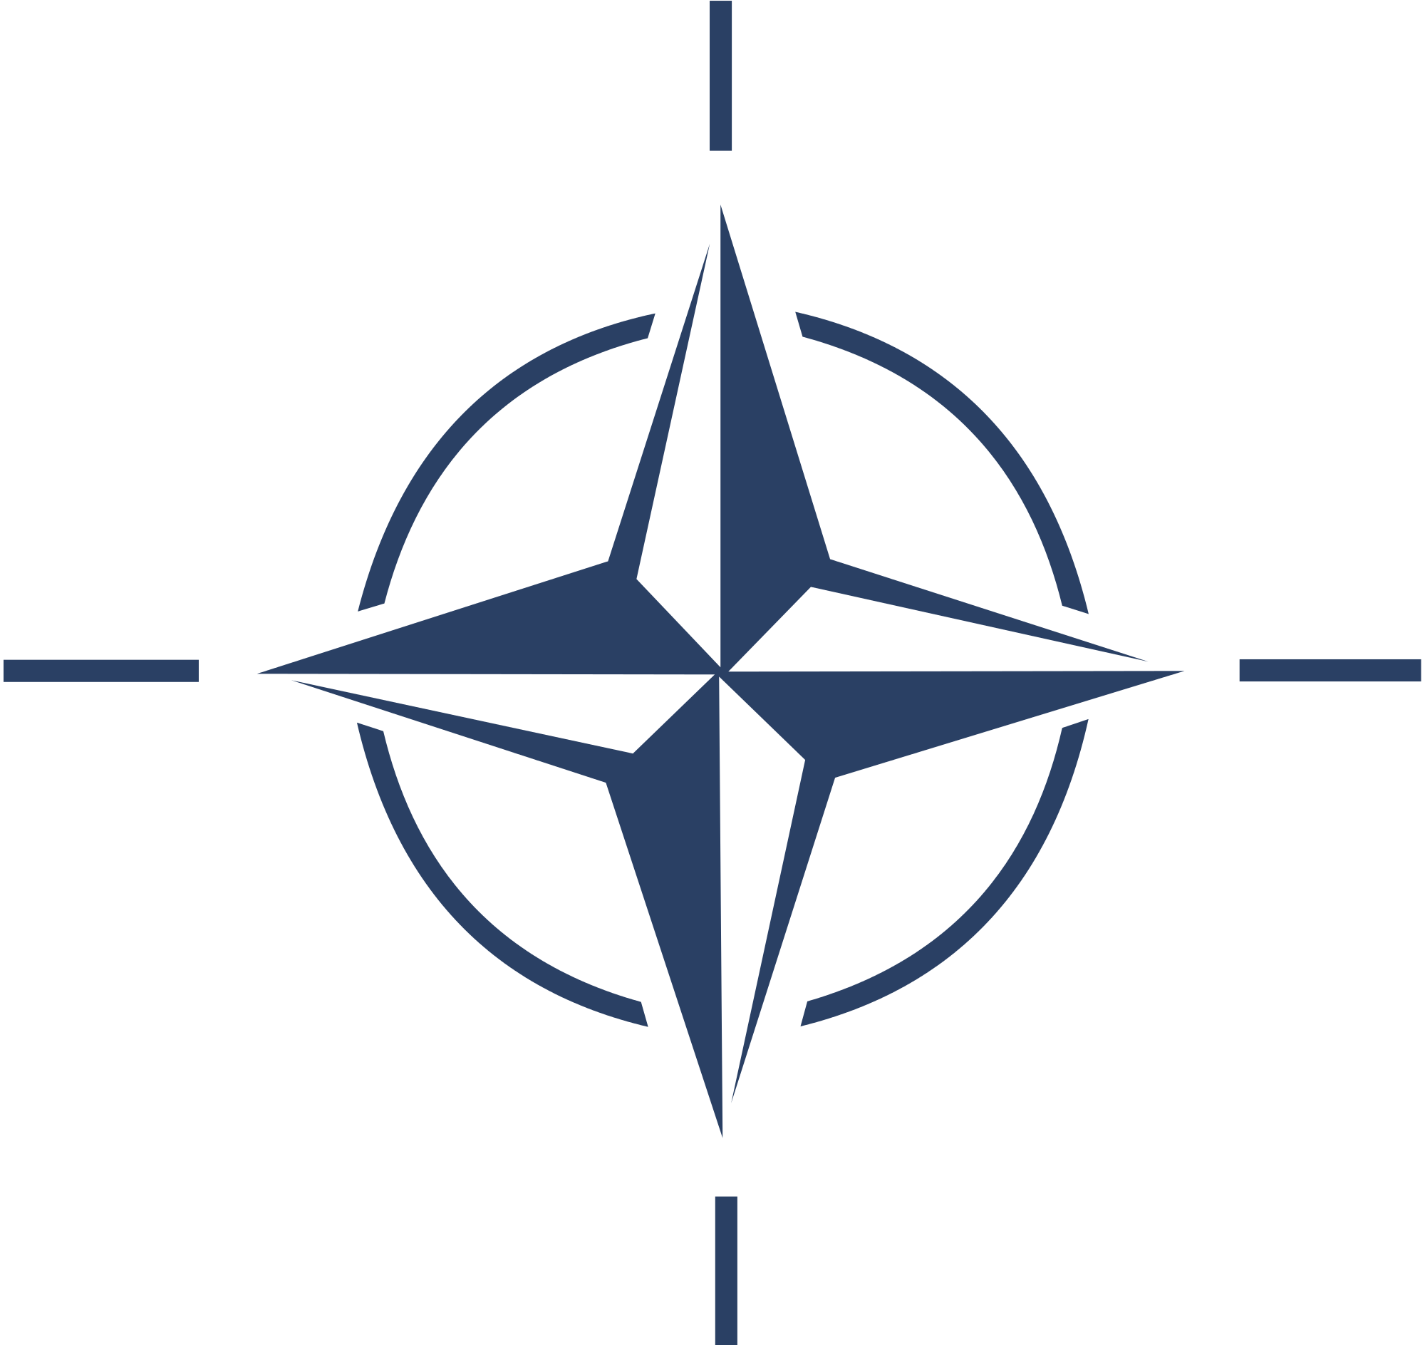
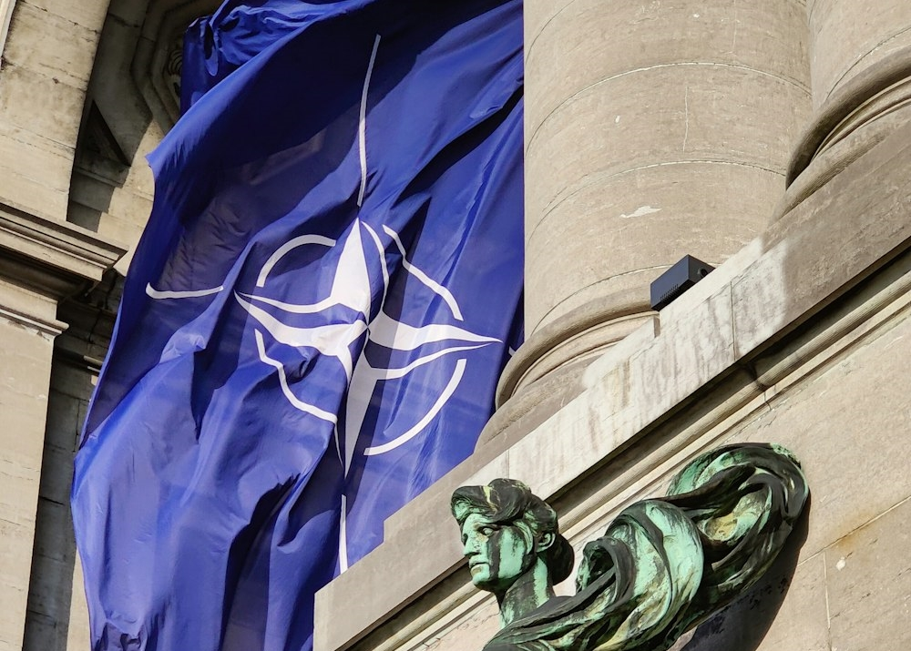
NATO – North Atlantic Treaty Organisation
4. INTERNATIONAL ASSISTANCE
4.1
Civil Protection Functions in International Organisations
4.2
4.3
4.4
Purpose
Ways of implementing security policy
International military alliance
Established: 1949
Contains: 32 countries (including Latvia since 2004)
NATO is a political and military alliance whose purpose is to guarantee the freedom and security of its members through political and military means, based on the principles of the North Atlantic Treaty of 1949 and the United Nations Charter.
Civilian preparedness is ensured to reduce the risk of vulnerability and attack in times of peace, crisis and conflict.
1
Maintaining sufficient military forces to prevent war and ensure effective defence
2
Overall preparedness to deal with circumstances affecting the security of Member States
NATO website
North Atlantic Treaty, Article 3
"In order more effectively to achieve the objectives of this Treaty, the Parties, separately and jointly, by means of continuous and effective self-help and mutual aid, will maintain and develop their individual and collective capacity to resist armed attack."
3
Afostering dialogue and cooperation with other countries to strengthen security in Europe. Including arms control and disarmament

Slide 16
NATO Resilience Committee (RC)
4. INTERNATIONAL ASSISTANCE
4.1
Civil Protection Functions in International Organisations
4.2
4.3
4.4
Objective
Specialised Planning Groups
Established: 2022
The Committee reports directly to the North Atlantic Council and is responsible for strategic and policy direction, planning guidance and overall coordination of resilience activities in NATO.
Groups, composed of appointed experts in their respective fields, support the work of the Committee in the following areas:
Civil Communications Planning Group (CCPG) – on building resilience in the communications sector
Civil Protection Group (CPG) – on how to ensure continuity of government, as well as the ability to deal effectively with the uncontrolled movement of people
Energy Planning Group (EPG) – on oversight of resilient energy supplies
Food and Agriculture Planning Group (FAPG) – on resilience matters in the food and water sector
Joint Health Group (JHG) – on Allies’ ability to deal with mass casualties and disruptive health crises
Transport Group (TG) – on resilient civil transport systems
About the Resilience Committee

Slide 17


4. INTERNATIONAL ASSISTANCE
4.1
Civil Protection Functions in International Organisations
4.2
4.3
4.4
Euro-Atlantic Disaster Response Coordination Centre (EADRCC)
Operational objectives
Mechanism of operation
Created: 1998
EADRCC is NATO’s principal civil emergency response mechanism in the Euro-Atlantic area. It is active all year round, operational on a 24/7 basis, and involves all NATO Allies and partner countries.
The Centre functions as a clearing-house system for coordinating both requests for and offers of assistance mainly in case of natural and man-made disasters.
NATO EADRCC Information Exchange System -
Requesting international assistance in 3 steps
Affected
Country
International organisations
Bilateral
Agreements
About EADRCC
Neighbouring countries
Step 1
Request for international assistance
Step 2
International coordination
69 NATO allies and partner countries
and up-to-date information from countries
Regular situation reports
Step 3
Help

Slide 18
NATO 2022 Strategic Concept
4. INTERNATIONAL ASSISTANCE
4.1
Civil Protection Functions in International Organisations
4.2
4.3
4.4
Goal
Contents
Institution: NATO
Adoption: 2002
The Strategic Concept describes the security environment facing the Alliance, reaffirms its values, and spells out NATO’s key purpose of ensuring collective defence for its Allies, setting out NATO’s priorities, core tasks and approaches for the next decade.
The 2022 Strategic Concept reaffirms that NATO's primary objective is to provide for the common defence of its members, based on a 360-degree approach (the ability to counter threats coming from different directions), and sets out three core tasks:
Deterrence and defence
NATO 2022 Strategic Concept
Crisis prevention and management
Cooperative security

Slide 19
4. INTERNATIONAL ASSISTANCE
4.1
Civil Protection Functions in International Organisations
4.2
4.3
4.4
NATO Baseline Requirements of National Resilience 2016
Baseline Requirements of national resilience
Institution: NATO
Adoption: 2016
1
Assured continuity of government and critical government services
2
Resilient energy supplies
3
Ability to deal effectively with the uncontrolled movement of people
4
Resilient food and water resources
On civil preparedness
5
Ability to deal with mass casualties and disruptive health crises
6
Resilient civil communications systems
7
Resilient transport systems

Slide 20

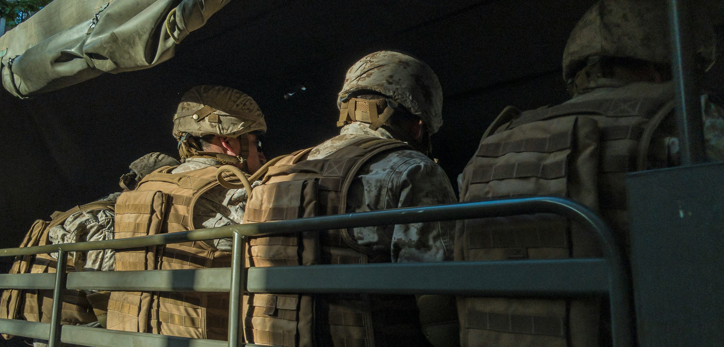
Civil-Military Cooperation
4. INTERNATIONAL ASSISTANCE
4.1
Civil Protection Functions in International Organisations
4.2
4.3
4.4
Civil sector
supports the military sector
Military sector
supports public authorities in disaster
incidents and their aftermath

Slide 21
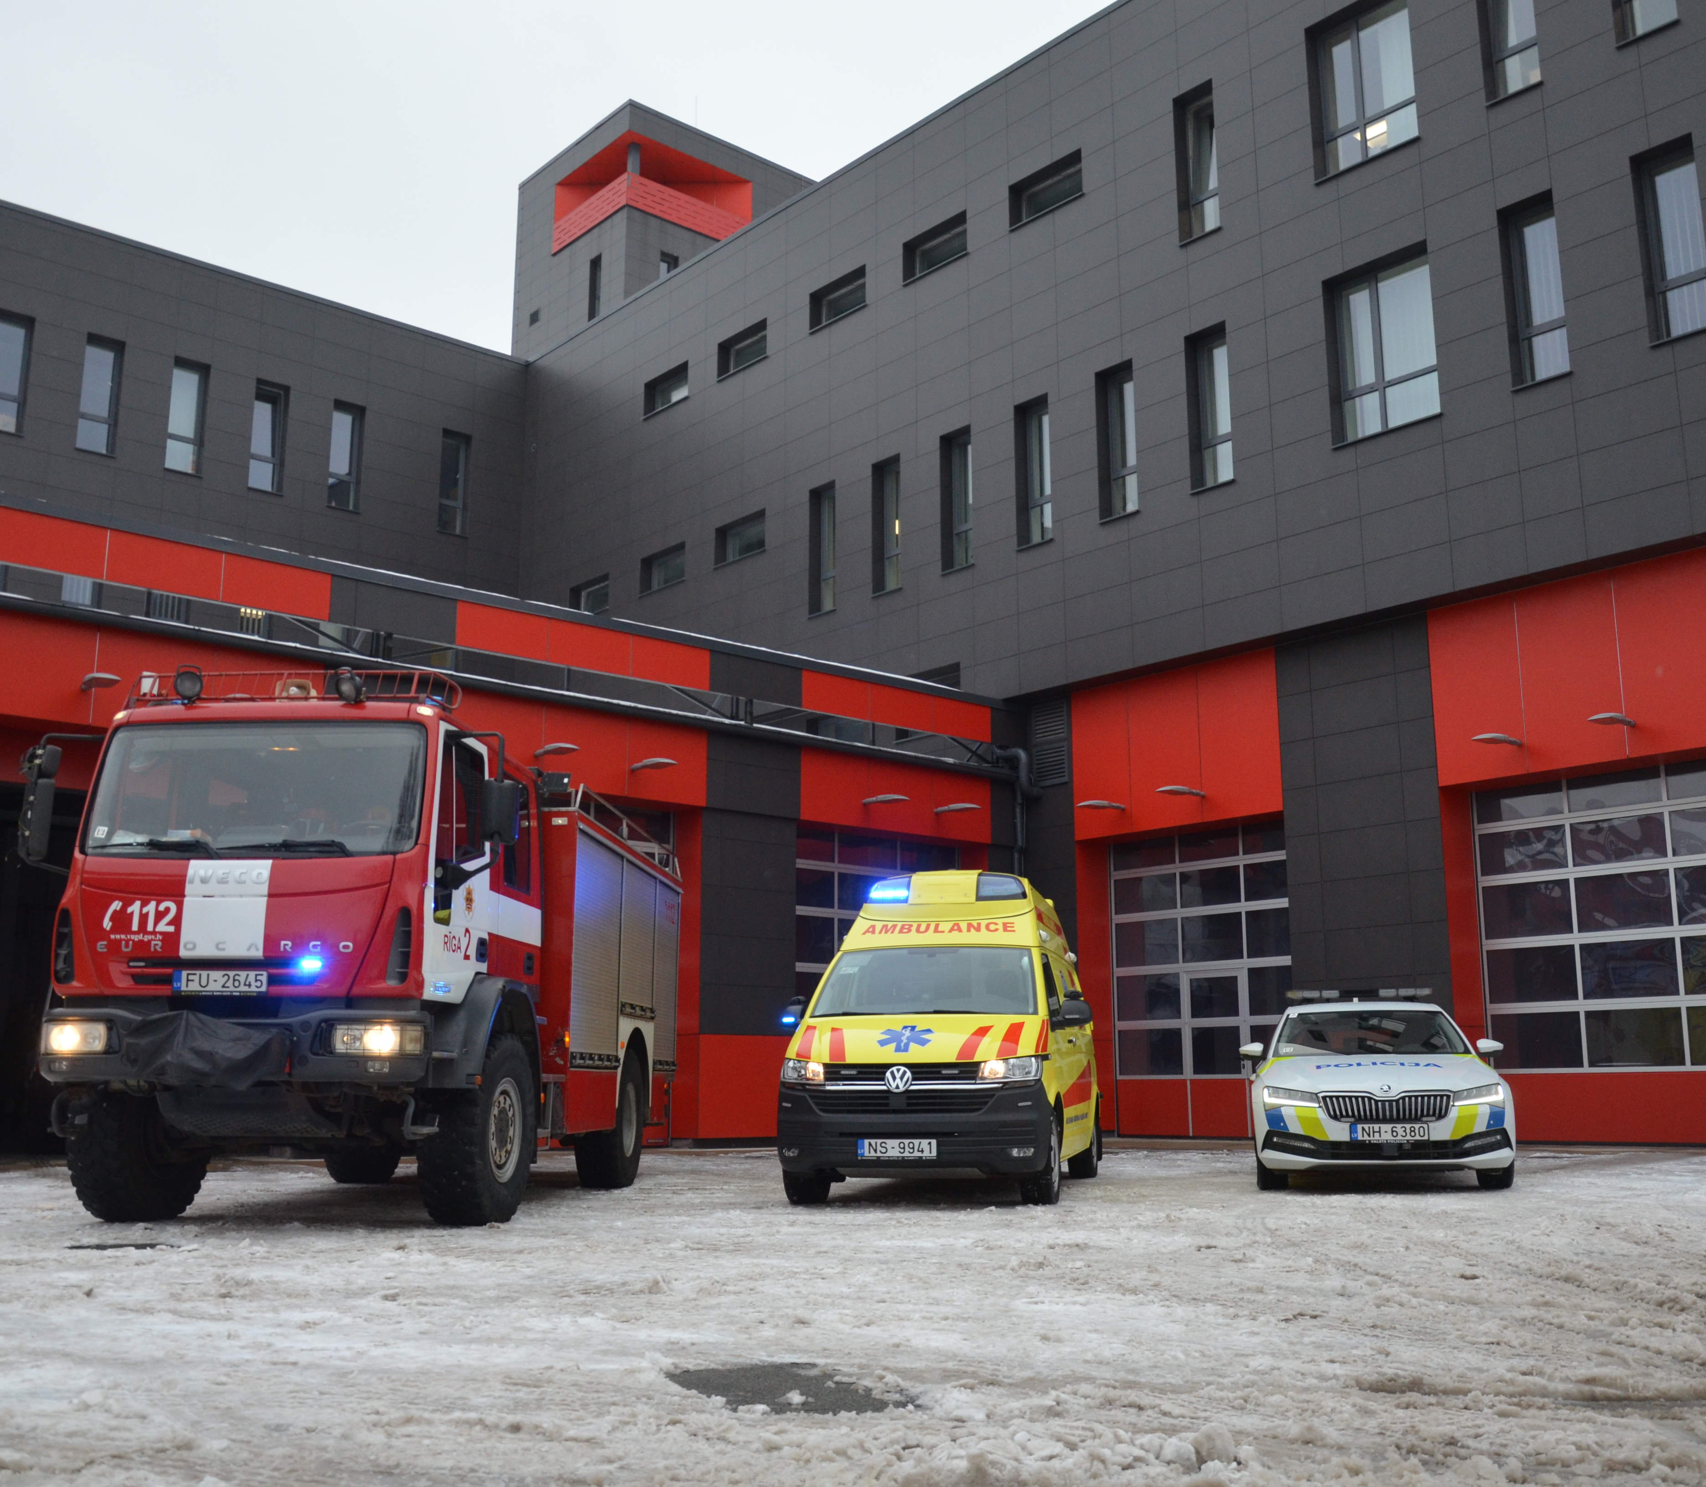
4.2. Civil Protection Mechanism in Europe

Slide 22
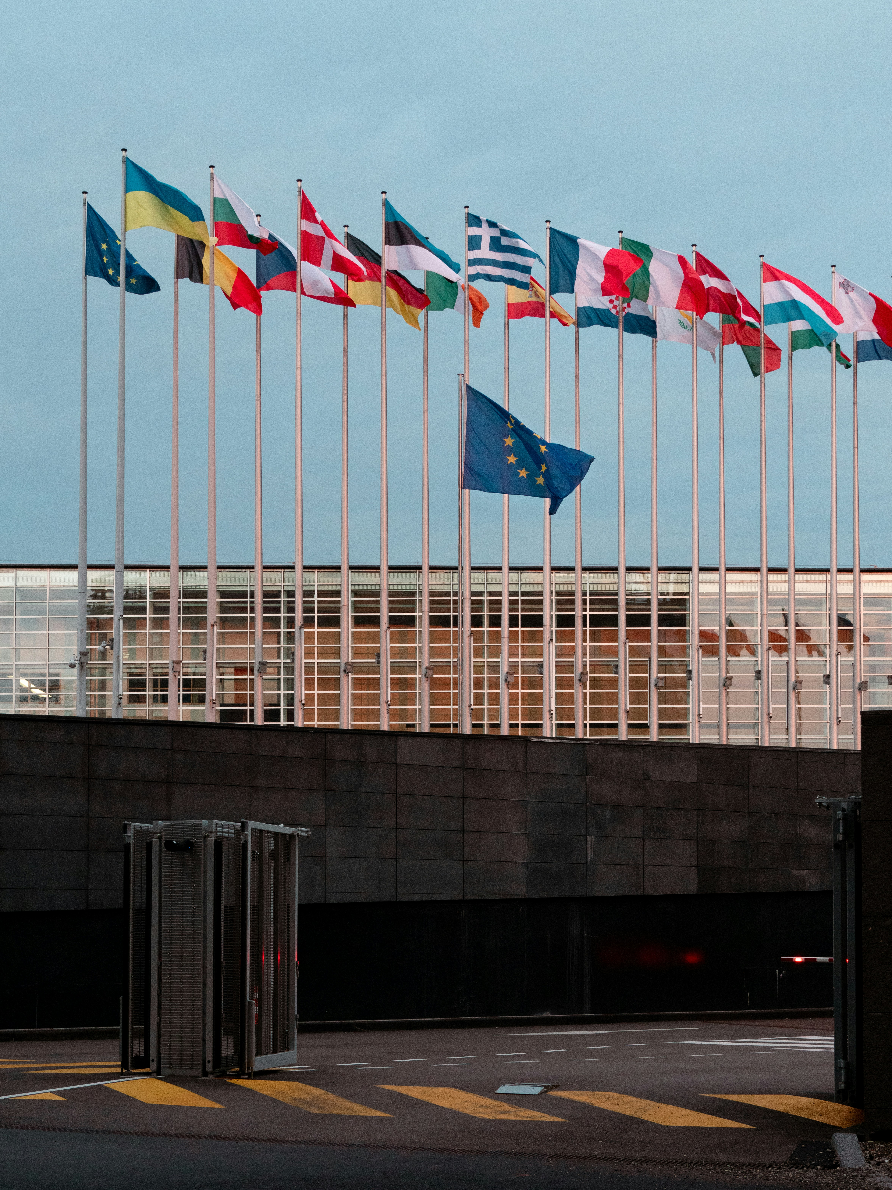
Civil Protection System in the European Union
4. INTERNATIONAL ASSISTANCE
4.1
4.2
Civil Protection Mechanism in Europe
4.3
4.4
European Union (EU)
Directorate-General for European Civil Protection and Humanitarian Aid Operations (DG ECHO)
European Union Civil Protection Mechanism (EUCPM)
Decision on a Union Civil Protection Mechanism
European Union funds for civil protection
Unit/mechanism
Legislative framework / policy planning documents
Foundation

Slide 23

Directorate-General for European Civil Protection and Humanitarian Aid Operations (DG ECHO)
4. INTERNATIONAL ASSISTANCE
4.1
4.2
Civil Protection Mechanism in Europe
4.3
4.4
General objective
Lines of action
Created: 1992
Ensuring the rapid and effective delivery of EU assistance through two main instruments: humanitarian aid and civil protection.
Humanitarian assistance is based on 4 international humanitarian rights:
  Humanity
  Neutrality
  Objectivity
  Independence
  Humanitarian budget – €1.65 billion per year
In civil protection, the EU Civil Protection mechanism and the EU Emergency Response Coordination Centre ensure better coordination and response to disasters in Europe and beyond.
The organisations play a supporting role in coordinating voluntary in-kind assistance from countries participating in the Civil Protection Mechanism.
Specific operational objectives
About DG ECHO
To save and preserve lives.
Prevent and alleviate human suffering.
Safeguard populations affected by natural hazards and man-made crises.
*set out in EU Multiannual financial framework 2021-2027

Slide 24
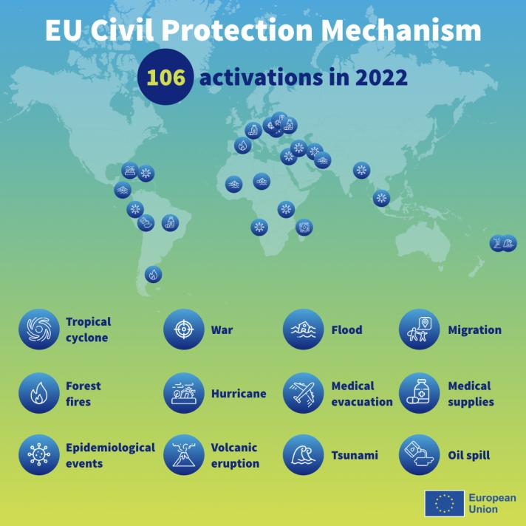
EU Civil Protection Mechanism
4. INTERNATIONAL ASSISTANCE
4.1
4.2
Civil Protection Mechanism in Europe
4.3
4.4
Key objective
Mechanism of operation
Created: 2001
Strengthen civil protection cooperation between EU Member States and the 10 participating countries to improve disaster prevention, preparedness and response.
The Mechanism consists of the EU Member States and 10 participating countries. If an emergency situation exceeds a country's response capacity in Europe and beyond, it can request assistance through the Mechanism.
About EUCPM

Slide 25
Role and Examples of the European Union Civil Protection Mechanism (EUCPM)
4. INTERNATIONAL ASSISTANCE
4.1
4.2
Civil Protection Mechanism in Europe
4.3
4.4
Risk assessment
Learn more
rescEU
It supports the identification of disaster risks across the EU, as well as research to enhance disaster resilience and strengthen early warning tools.
Participating countries are invited to periodically develop risk assessments and make available a summary of the national risk assessment to the European Commission in order to prevent disaster risks in Europe.
A training programme for civil protection experts from EU Member States and participating countries, ensuring interoperability and complementarity between assistance teams.
Large-scale trainings are organised every year to build capacity in the context of specific disasters.
A reserve of European capacities, fully funded by the EU.
Established in 2019 as part of the Mechanism to strengthen Europe's disaster preparedness and crisis response capacity.
This includes a fleet of firefighting aircraft and helicopters, medical evacuation plane, stockpile of medical items and field hospitals that can respond to health emergencies, as well as shelters, transport and logistics assets and energy tools.

Slide 26
Activation and Operation of the European Union Civil Protection Mechanism (EUCPM)
4. INTERNATIONAL ASSISTANCE
4.1
4.2
Civil Protection Mechanism in Europe
4.3
4.4
Activating the operating mechanism
Emergency Response Coordination Centre
Natural or man-made disaster inside or outside the EU
The affected country requests assistance from the Mechanism through the Emergency Response Coordination Centre (ERCC)
ERCC (Emergency Response Coordination Centre)
Collect and analyse information on disasters
Monitor the threat
Prepare a deployment plan for experts, teams and equipment
Map the resources available in the Member States
Coordinate actions
Take preventive measures
Provide emergency communication and monitoring tools through the Common Emergency Communication and Information System (CECIS), a web-based alert and notification site that allows Member States to exchange information with each other and the ERCC
1
EU Civil Protection Mechanism activated
ERCC coordinates the deployment and delivery of assistance
Member States and participating countries offer assistance such as human resources and equipment
2
3
4
The ERCC may send an EU civil protection expert team
5
Assistance provided, experts return
End of emergency response

Slide 27
Decision on a Union Civil Protection Mechanism
4. INTERNATIONAL ASSISTANCE
4.1
4.2
Civil Protection Mechanism in Europe
4.3
4.4
General objective
Specific objectives
Institution: European Parliament and Council of Europe
Adoption: 2013, last amended 2023
To promote solidarity and support, complement, and facilitate the coordination of Member States' actions in the field of civil protection with a view to improving the effectiveness of systems for preventing, preparing for and responding to natural and man-made disasters
To achieve a high level of protection against disasters by preventing or reducing their potential effects, by fostering a culture of prevention and by improving cooperation between the civil protection and other relevant services
To enhance preparedness at Member State and Union level to respond to disasters
To facilitate rapid and efficient response in the event of disasters or imminent disasters
To increase public awareness and preparedness for disasters
To increase the use and accessibility of scientific knowledge on disasters
To strengthen cooperation and coordination measures across borders and between Member States that may be affected by the same types of disasters
Scope
Decision on a Union Civil Protection Mechanism
Civil protection cooperation includes:
prevention and preparedness actions inside the Union and outside the Union;
actions to assist with the response to immediate adverse consequences of a disaster inside or outside the Union, following a request for assistance through the Union Mechanism.

Slide 28
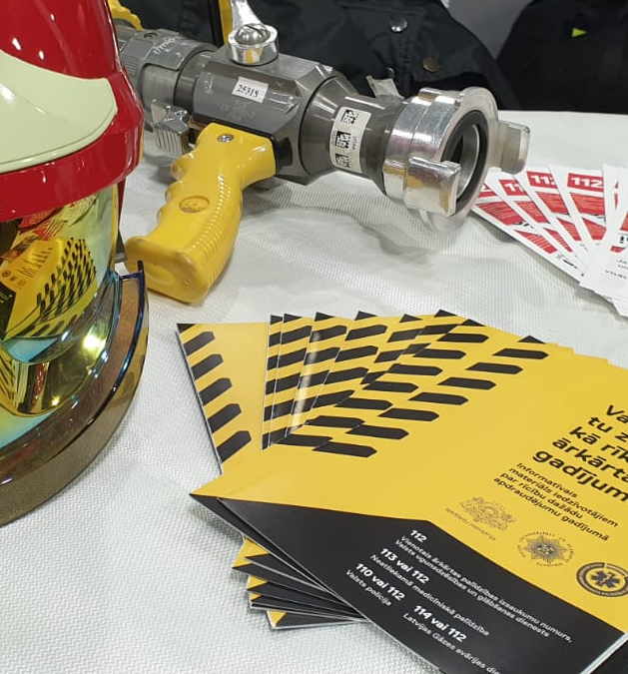
European Union Civil Protection Mechanism Pool: Definition
4. INTERNATIONAL ASSISTANCE
4.1
4.2
Civil Protection Mechanism in Europe
4.3
4.4
The European Civil Protection Pool is a collection of emergency response teams and assets. Pool:
Consists of mobile resources
Able to work independently as well as with other Pools
Established within one or more of the Member States of the Mechanism
Self-sufficient, able to interact with other Pools
Trained, equipped, operating according to international guidelines

Slide 29
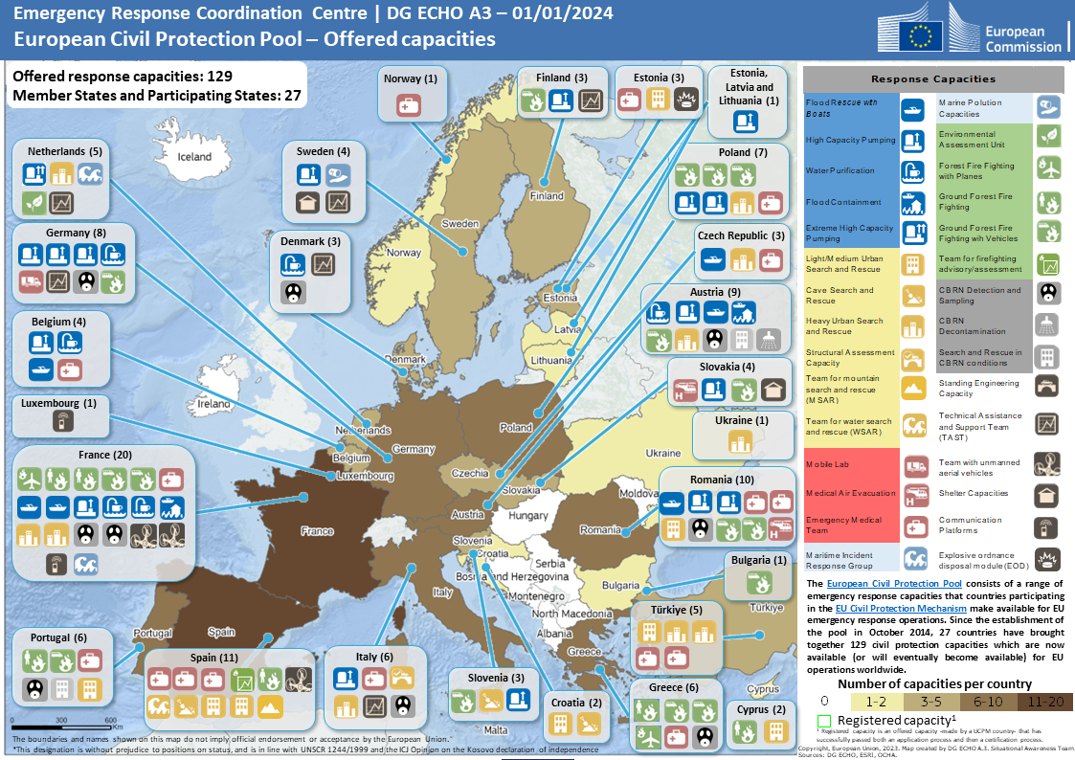
European Union Civil Protection Mechanism Pool: Proposed Capacity from Member States
4. INTERNATIONAL ASSISTANCE
4.1
4.2
Civil Protection Mechanism in Europe
4.3
4.4
SDC pls format
About the European Union Civil Protection Mechanism Pools

Slide 30


EU Civil Protection Modules Involving Latvia
4. INTERNATIONAL ASSISTANCE
4.1
4.2
Civil Protection Mechanism in Europe
4.3
4.4
Latvia-Lithuania Technical Assistance Team (LL TAST)
The joint high capacity pumping team of the Baltic States (Estonia, Latvia, Lithuania) (BaltFloodCombat)
Established in accordance with the requirements defined by the Community Civil Protection Mechanism
Capable of providing administrative, logistical and telecommunications support
Certified and included in the European Civil Protection Pool (ECPP)
Capable of pumping water out of flooded areas
Participated in international flood relief in Poland and Moldova in 2010, Bosnia and Herzegovina in 2014

Slide 31

4.3. Civil Protection Cooperation Under Bilateral Agreements and in the Baltic Sea Region

Slide 32









Bilateral Cooperation Agreements on Mutual Assistance in the Event of Natural Disasters and Other Major Emergencies
4. INTERNATIONAL ASSISTANCE
4.1
4.2
4.3
Civil Protection Cooperation Under Bilateral Agreements and in the Baltic Sea Region
4.4
Ukraine
Lithuania, Hungary
Ukraine, Lithuania
Russia
Estonia
Lithuania and Estonia
2001
2002
2003
2005
2006
2008
2010
2011
2012
2014
2017
2018
On the State Civil Protection Plan
Sweden, Belarus
Sweden
Uzbekistan
Azerbaijan
Georgia
Belarus

Slide 33


Council of the Baltic Sea States (CBSS)
4. INTERNATIONAL ASSISTANCE
4.1
4.2
4.3
Civil Protection Cooperation Under Bilateral Agreements and in the Baltic Sea Region
4.4
Objective
Priorities
Created: 1992
To address transnational and cross-sectoral issues, promote stability in the Baltic Sea region, strengthen Member States' relations with democratic institutions and promote respect for international law and human rights.
The Council is made up of the foreign ministers of the 10 EU countries and a high-level representative of the European Union.
To develop the identity of the Baltic Sea Region and strengthen contacts that support its further development
Develop the Baltic Sea Region as an example for a sustainable society
CBSS website
Promote public security in the Baltic Sea Region

Slide 34

4.4. Request for and Provision of International Assistance

Slide 35










Latvian National Contact Point for Civil Protection –
Authority Responsible for Exchanging Information
4. INTERNATIONAL ASSISTANCE
4.1
4.2
4.3
4.4
Request for and Provision of International Assistance
NATO EADRCC
International organisations
Tasks:
Ensure a continuous flow of information on disasters at home and abroad
Develop coordinated information exchange mechanisms
Monitor and assess the evolution of crisis situations
Accumulate and analyse information on disasters
Compile and record humanitarian and international assistance capacities of disaster management entities
Prepare proposals for inter-sectoral cooperation in crisis management
Ensure the development and involvement of focal point staff in civil protection drills
ERCC
Foreign countries
Crisis Management Council
The Cabinet
National Contact Point for Civil Protection
Regulation on National Contact Point for Civil Protection

Slide 36



Ways of Requesting and Receiving International Assistance:
International Organisations
4. INTERNATIONAL ASSISTANCE
4.1
4.2
4.3
4.4
Request for and Provision of International Assistance
International organisations
The responsible national authority prepares a proposal to the Cabinet (indicating the type, scope and estimated cost)
The Cabinet adopts a decision
(type, scope and estimated cost)
SFRS Operational Control Centre of Civil Protection
+ National Contact Point for Civil Protection
International organisations
Procedures for Requesting International Assistance
Procedures for the Receipt and Provision of Humanitarian Aid

Slide 37

Ways of Requesting and Receiving International Assistance:
Bilateral Agreements
4. INTERNATIONAL ASSISTANCE
4.1
4.2
4.3
4.4
Request for and Provision of International Assistance
Bilateral agreements
Bilateral agreements
(transnational)
SFRS Operational Control Centre of Civil Protection
+ National Contact Point for Civil Protection
Bilateral agreements
(operational)
Responsible public authority (municipality)
prepares a proposal to the Cabinet
(type, scope and estimated cost)
SFRS cooperation with EE and LT
(provide and ask for help in fire-fighting and rescue work)
The Cabinet adopts a decision
(specifying type, scope and
preliminary costs)
The decision shall be adopted by
Chief of the SFRS or
authorised official
Host country support
On-site support coordination – delivery, deployment
(warehouses and on-site), distribution, record-keeping, etc.
Procedures for Requesting International Assistance
Procedures for the Receipt and Provision of Humanitarian Aid

Slide 38
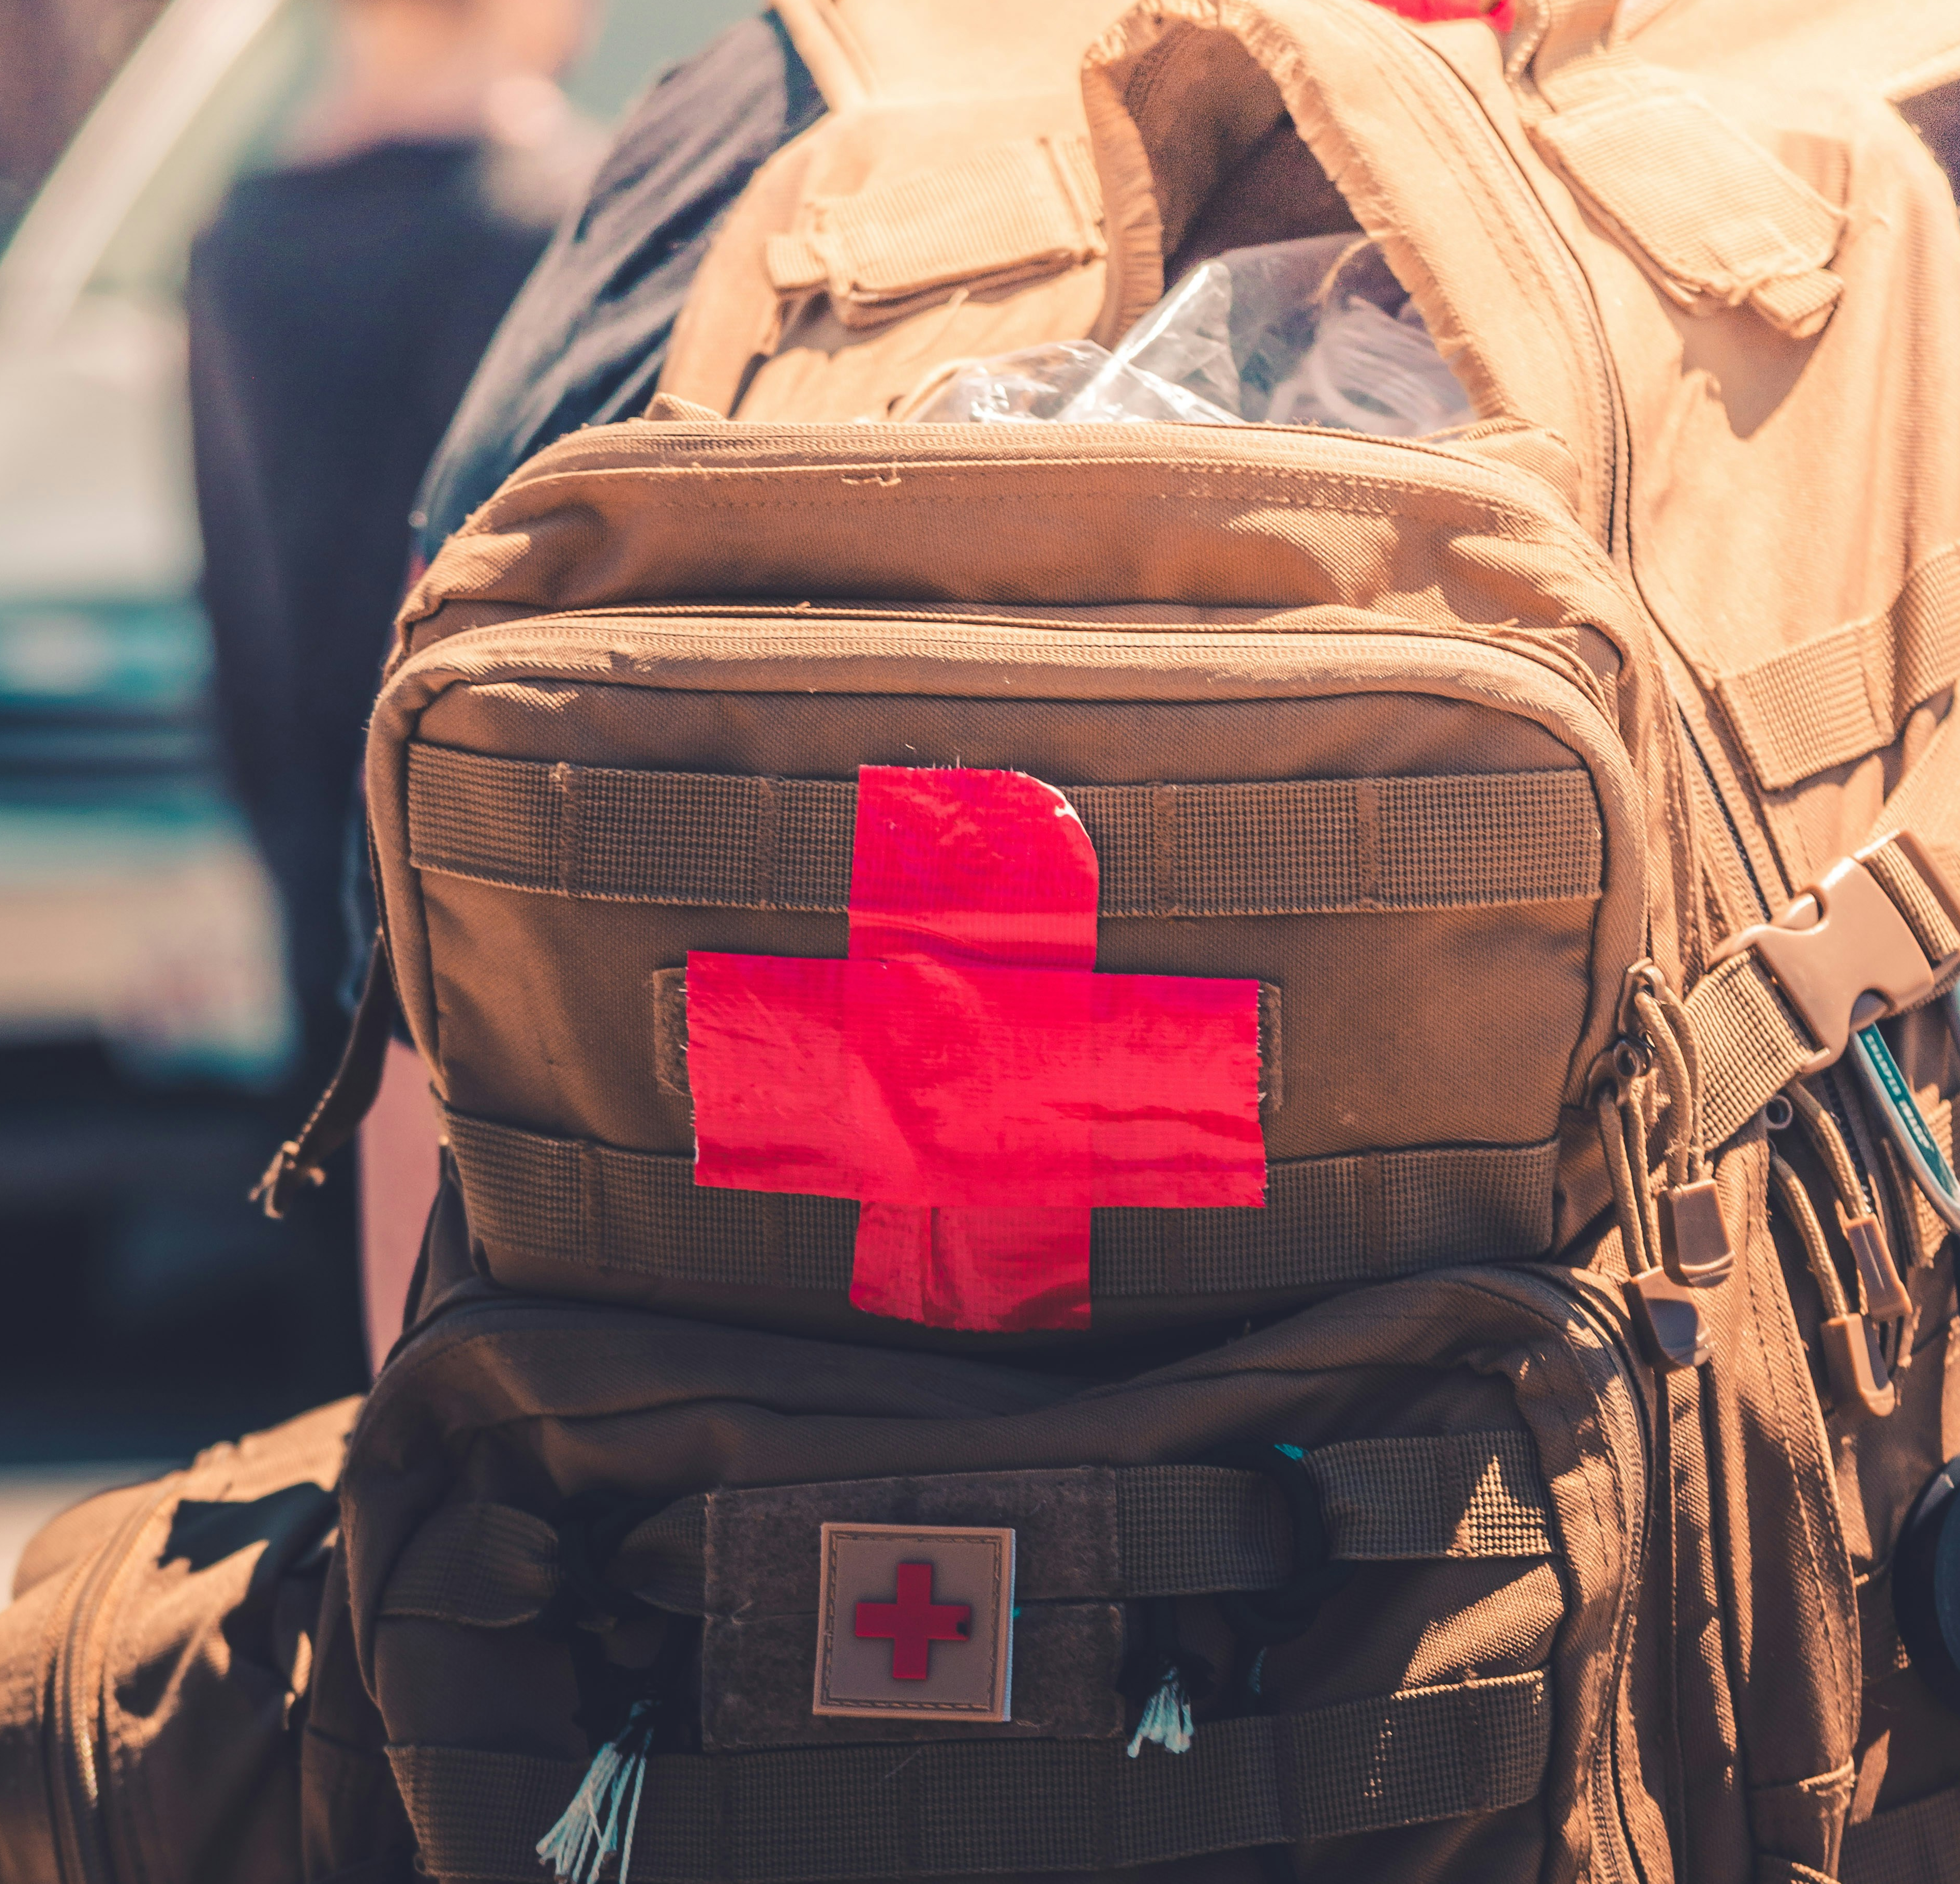
International Humanitarian Aid
4. INTERNATIONAL ASSISTANCE
4.1
4.2
4.3
4.4
Request for and Provision of International Assistance
National Contact Point for Civil Protection receives a request for international humanitarian assistance
National Contact Point for Civil Protection shall immediately inform the responsible ministry
1
2
The responsible ministry prepares information for the Crisis Management Council on the type, scope, funding and source of humanitarian assistance, etc.
Cabinet of Ministers adopts a decision on the provision of assistance
4
3
Responsible ministry coordinates humanitarian aid
The Ministry of Foreign Affairs prepares further Orders
Procedures for the Receipt and Provision of Humanitarian Aid
5
6

Slide 39

Conclusion: International Assistance as a Two-Way Process
4. INTERNATIONAL ASSISTANCE
4.1
4.2
4.3
4.4
Request for and Provision of International Assistance
Country where the disaster occurred
Request for assistance
Resources, experts, teams
International organisations
Support received under bilateral agreements
Support provided under bilateral agreements
Request for assistance
Resources, experts, teams
Latvia

Slide 40

Sources of information (1/4)
4. INTERNATIONAL ASSISTANCE
Images sourced from the website "Unsplash". https://unsplash.com/
Aizsardzības ministrija. NATO darbības pamatprincipi. https://www.mod.gov.lv/lv/nato/par-nato/nato-darbibas-pamatprincipi
Aizsardzības ministrija. Par NATO. https://www.mod.gov.lv/lv/nato/par-nato
Ārlietu ministrija. 2021. Baltijas jūras valstu padome (BJVP). https://www.mfa.gov.lv/lv/baltijas-juras-valstu-padome-bjvp
Council of the Baltic Sea States. About us. https://cbss.org/about-us/
Delfi. 2023. Atbalstam Sīrijas zemestrīcē cietušajiem Latvija plāno piešķirt 70 000 eiro. https://www.delfi.lv/193/politics/55244568/atbalstam-sirijas-zemestrice-cietusajiem-latvija-plano-pieskirt-70-000-eiro
Eiropas Parlamenta un Padomes Lēmums Nr. 1313/2013/ES (2013. gada 17. decembris) par Savienības civilās aizsardzības mehānismu (Dokuments attiecas uz EEZ). http://data.europa.eu/eli/dec/2013/1313/2023-12-18
Eiropas Savienība. Atveseļošanas un noturības mehānisms. https://next-generation-eu.europa.eu/recovery-and-resilience-facility_lv
EU Monitor. 2006. Commission to pay nearly € 9.5 million to support Latvia in dealing with storm disaster in 2005. https://www.eumonitor.eu/9353000/1/j9vvik7m1c3gyxp/vh9ojlrvrpxp?ctx=vgaxlcr1jzkj&tab=1&start_tab0=380
European Commission. 2018. Solidarity with Latvia: €17.7 million of EU funds to support reconstruction works after the floods. https://ec.europa.eu/regional_policy/en/newsroom/news/2018/12/20-12-2018-solidarity-with-latvia-eur17-7-million-of-eu-funds-to-support-reconstruction-works-after-the-floods
European Commission. 2019. Recommendations for National Risk Assessment for Disaster Risk Management in EU. https://www.preventionweb.net/files/65439_nrarecommendationsonline.pdf
European Commission. About European Civil Protection and Humanitarian Aid Operations. https://civil-protection-humanitarian-aid.ec.europa.eu/who/about-echo_en?prefLang=lv
European Commission. Emergency Response Coordination Centre (ERCC). https://civil-protection-humanitarian-aid.ec.europa.eu/what/civil-protection/emergency-response-coordination-centre-ercc_en
European Commission. ERCC - Emergency Response Coordination Centre, CP Pool. https://erccportal.jrc.ec.europa.eu/ERCC-Response/CP-Pool#/
European Commission. EU Civil Protection Mechanism. https://civil-protection-humanitarian-aid.ec.europa.eu/what/civil-protection/eu-civil-protection-mechanism_en
European Commission. EU Solidarity Fund. https://ec.europa.eu/regional_policy/funding/solidarity-fund_en
European Commission. Funding for humanitarian aid. https://civil-protection-humanitarian-aid.ec.europa.eu/funding-evaluations/funding-humanitarian-aid_en
European Commission. rescEU. https://civil-protection-humanitarian-aid.ec.europa.eu/what/civil-protection/resceu_en

Slide 41
Sources of information (2/4)
4. INTERNATIONAL ASSISTANCE
European Committee of the Regions. 2017. Opinion of the European Committee of the Regions — Action Plan on the Sendai Framework for Disaster Risk Reduction 2015-2030 — A disaster risk-informed approach for all EU policies. https://eur-lex.europa.eu/legal-content/EN/TXT/PDF/?uri=CELEX:52016AR5035&from=PL
Italian Government, Civil Protection Department. What are modules? https://www.protezionecivile.it/en/approfondimento/what-are-modules-/
Latvijas Republikas Tiesībsargs. ANO Statūti. https://www.tiesibsargs.lv/resource/ano-statuti/
Latvijas Republikas Tiesībsargs. ANO Vispārējā cilvēktiesību deklarācija. https://www.tiesibsargs.lv/resource/ano-vispareja-cilvektiesibu-deklaracija/
Likums "Par Latvijas Republikas valdības un Azerbaidžānas Republikas valdības vienošanos par sadarbību ārkārtējo situāciju novēršanas un likvidēšanas jomā". https://likumi.lv/ta/id/233295
Likums "Par Latvijas Republikas valdības un Baltkrievijas Republikas valdības vienošanos par sadarbību katastrofu, dabas stihiju, citu ārkārtēju situāciju novēršanā, kā arī to seku likvidēšanā". https://likumi.lv/ta/id/81621
Likums "Par Latvijas Republikas valdības un Gruzijas valdības līgumu par sadarbību civilo ārkārtējo situāciju novēršanas, gatavības un reaģēšanas jomā". https://likumi.lv/ta/id/270228
Likums "Par Latvijas Republikas valdības un Krievijas Federācijas valdības vienošanos par sadarbību ārkārtējo situāciju novēršanas un likvidēšanas jomā". https://likumi.lv/ta/id/233301
Likums "Par Latvijas Republikas valdības un Ukrainas Ministru kabineta līgumu par sadarbību katastrofu novēršanas un to seku likvidēšanas jomā". https://likumi.lv/ta/id/146895
Likums "Par Latvijas Republikas valdības un Ungārijas Republikas valdības līgumu par sadarbību un savstarpējo palīdzību katastrofu un citos plaša mēroga nelaimes gadījumos". https://likumi.lv/ta/id/86098
Likums "Par Latvijas Republikas valdības un Zviedrijas Karalistes valdības līgumu par sadarbību ārkārtēju situāciju novēršanas, gatavības un reaģēšanas jomā". https://likumi.lv/ta/id/68333
Likums "Par Latvijas Republikas valdības, Igaunijas Republikas valdības un Lietuvas Republikas valdības nolīgumu par sadarbību katastrofu novēršanas, gatavības un reaģēšanas jomā". https://likumi.lv/ta/id/298094
Ministru kabineta 2017. gada 12. decembra noteikumi Nr. 721 "Humānās palīdzības saņemšanas un sniegšanas kārtība". https://likumi.lv/ta/id/295778
Ministru kabineta 2017. gada 12. decembra noteikumi Nr. 722 "Starptautiskās palīdzības pieprasīšanas kārtība". https://likumi.lv/ta/id/295779
Ministru kabineta 2017. gada 12. decembra noteikumi Nr. 723 "Valsts civilās aizsardzības kontaktpunkta noteikumi". https://likumi.lv/ta/id/295780
Ministru kabineta 2018. gada 6. novembra rīkojums Nr. 584 "Par dalību Apvienoto Nāciju Organizācijas Katastrofu novērtēšanas un koordinācijas (UNDAC) sistēmā". https://likumi.lv/ta/id/302828
Ministru kabineta 2020. gada 26. augusta rīkojums Nr. 476 "Par Valsts civilās aizsardzības plānu". https://likumi.lv/ta/id/317006
Ministru kabineta 2020. gada 26. augusta rīkojums Nr. 476 "Par Valsts civilās aizsardzības plānu". https://likumi.lv/ta/id/317006

Slide 42
Sources of information (3/4)
4. INTERNATIONAL ASSISTANCE
NATO Allied command transformation. 2023. Resilience in NATO. https://www.act.nato.int/article/resilience-in-nato/#:~:text=In%20NATO%20Headquarters%2C%20the%20Resilience,coordination%20of%20NATO's%20resilience%20activities.
NATO Review. 2019. Resilience: the first line of defence. https://www.nato.int/docu/review/articles/2019/02/27/resilience-the-first-line-of-defence/index.html
Neatliekamās medicīniskās palīdzības dienests. 2024. ERAF projekts “Vienotās neatliekamās medicīniskās palīdzības un katastrofu medicīnas vadības informācijas sistēmas attīstība (2. kārta)”. https://www.nmpd.gov.lv/lv/projekts/eraf-projekts-vienotas-neatliekamas-mediciniskas-palidzibas-un-katastrofu-medicinas-vadibas-informacijas-sistemas-attistiba-2-karta
Reire, G. 2010. Apvienoto Nāciju Organizācijas nozīme starptautiskā miera un drošības uzturēšanā (Promocijas darbs). Latvijas Universitāte, Sociālo zinātņu fakultāte, Politikas zinātnes nodaļa.
Starptautisks divpusējs dokuments "Latvijas Republikas valdības un Ukrainas Ministru kabineta līgums Par kodolnegadījumu operatīvu izziņošanu, par informācijas apmaiņu un sadarbību kodoldrošības un aizsardzības pret radiāciju jomā". https://likumi.lv/ta/lv/starptautiskie-ligumi/id/861
Starptautisks divpusējs dokuments "Latvijas Republikas valdības un Uzbekistānas Republikas valdības vienošanās par sadarbību ārkārtējo situāciju novēršanas un likvidēšanas jomā". https://likumi.lv/ta/lv/starptautiskie-ligumi/id/514
Starptautisks divpusējs dokuments "Latvijas Republikas valdības un Baltkrievijas Republikas valdības līgums par kodolnegadījumu operatīvu izziņošanu, informācijas apmaiņu un sadarbību kodoldrošības un aizsardzības pret radiāciju jomā". https://likumi.lv/ta/lv/starptautiskie-ligumi/id/1758
Starptautisks dokuments "Latvijas Republikas valdības un Lietuvas Republikas valdības līgums par kodolnegadījumu operatīvu izziņošanu, par informācijas apmaiņu un sadarbību kodoldrošības un aizsardzības pret radiāciju jomā". https://m.likumi.lv/doc.php?id=230735
The North Atlantic Treaty Organization. 2021. Euro-Atlantic Disaster Response Coordination Centre. https://www.nato.int/cps/en/natohq/topics_52057.htm?
The North Atlantic Treaty Organization. 2022. Resilience Committee. https://www.nato.int/cps/en/natohq/topics_50093.htm
The North Atlantic Treaty Organization. 2022. Strengthened Resilience Commitment. https://www.nato.int/cps/en/natohq/official_texts_185340.htm
The North Atlantic Treaty Organization. 2023. NATO Resilience Symposium: 2023 Report. https://www.act.nato.int/wp-content/uploads/2024/02/NATO-Resilience-Symposium-Report-2023.pdf
The North Atlantic Treaty Organization. NATO 2022 Strategic Concept. https://www.nato.int/nato_static_fl2014/assets/pdf/2022/6/pdf/290622-strategic-concept.pdf
The North Atlantic Treaty Organization. https://www.nato.int/
The North Atlantic Treaty Organization. What is NATO? https://www.nato.int/nato-welcome/
UNDP. 2023. Latvia targets 2 million euro for reconstruction efforts in Chernihiv Oblast. https://www.undp.org/ukraine/press-releases/latvia-targets-2-million-euro-reconstruction-efforts-chernihiv-oblast

Slide 43
Sources of information (4/4)
4. INTERNATIONAL ASSISTANCE
UNHRC. 2023. Cluster Approach. https://emergency.unhcr.org/coordination-and-communication/cluster-system/cluster-approach
United Nation Human Rights Council. Universal Declaration of Human Rights – Latvian. https://www.ohchr.org/en/human-rights/universal-declaration/translations/latvian
United Nations Office for Disaster Risk Reduction. 2023. Midterm Review of the Implementation of the Sendai Framework for Disaster Risk Reduction 2015-2030. https://dkkv.org/wp-content/uploads/2023/05/MTR-SF_Extracted-Good-Practices_31.03.2023_FINAL-2.pdf
United Nations Office for Disaster Risk Reduction. Early warnings for all (EW4All). https://www.undrr.org/implementing-sendai-framework/sendai-framework-action/early-warnings-for-all
United Nations Office for Disaster Risk Reduction. Implementing the Sendai Framework. https://www.undrr.org/implementing-sendai-framework/what-sendai-framework
United Nations Office for Disaster Risk Reduction. Implementing the Sendai Framework. https://www.undrr.org/implementing-sendai-framework
United Nations Office for Disaster Risk Reduction. https://www.undrr.org/
United Nations Office for Disaster Risk Reduction. Sendai Framework for Disaster Risk Reduction 2015-2030. https://www.undrr.org/publication/sendai-framework-disaster-risk-reduction-2015-2030
United Nations Office for the Coordination of Humanitarian Affairs. https://www.unocha.org/
United Nations Office for the Coordination of Humanitarian Affairs. 2022. Annual report. https://annualreport.unocha.org/
United Nations Peacekeeping. Protection of civilians mandate. https://peacekeeping.un.org/en/protection-of-civilians-mandate#:~:text=Depending%20on%20the%20nature%20of,establishment%20of%20a%20protective%20environment
United Nations. Illustrated version of the Universal Declaration of Human Rights. https://www.un.org/en/udhrbook/#1
United Nations. https://www.un.org/en/
United Nations. Universal Declaration of Human Rights. https://www.un.org/en/about-us/universal-declaration-of-human-rights
Veselības ministrija. 2021. Latvija ziedos vakcīnas Āfrikas, Latīņamerikas un Klusā okeāna reģiona valstīm. https://www.vm.gov.lv/lv/jaunums/latvija-ziedos-vakcinas-afrikas-latinamerikas-un-klusa-okeana-regiona-valstim

