Slide 1
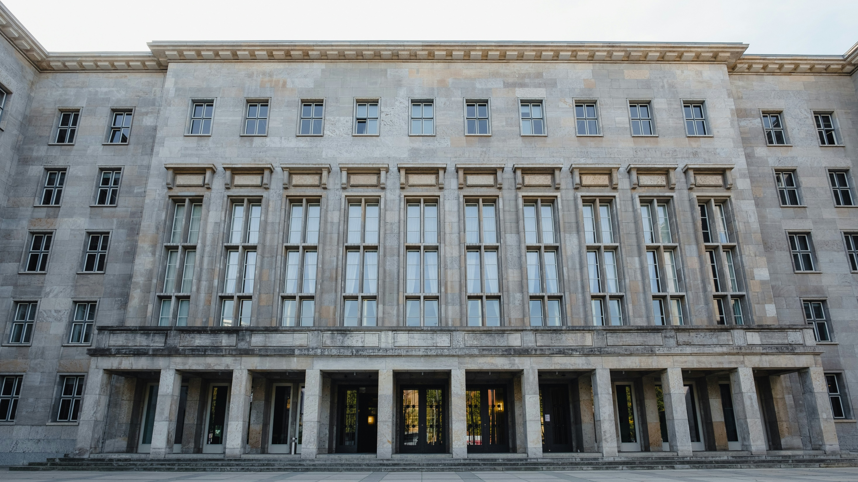
Study course "Civil Protection"
3. Civil Protection Duties, Tasks and Rights
Developed in the framework of the European Commission’s Civil Protection Financial Instrument "Track1" project "Establishment of comprehensive civil protection and disaster management training for governmental institutions, civil protection commissions of municipalities, universities, Fire Safety and Civil Protection College, as well as establishing safety advice for the public" (ECHO/SUB/2022/TRACK1/884396)
Funded by The European Union
State Fire and Rescue Service

Slide 2
Tasks
3. CIVIL PROTECTION DUTIES, TASKS AND RIGHTS
Intended Results
To introduce educatees to:
the main civil protection and disaster management responsibilities of civil protection actors, as laid down in laws and regulations.
Educatees:
know duties, tasks and rights in civil protection and disaster management,
are familiar with the tasks and duties of, and cooperation mechanisms with, other parties involved in the system of civil protection.

Slide 3
Table of Contents
3. CIVIL PROTECTION DUTIES, TASKS AND RIGHTS
3.1. Duties, Tasks and Rights of State Authorities, Local Governments, Legal and Natural Persons in the Field of Civil Protection
3.2. Duties and Rights of an Object of Increased Danger, Its Owner or Lawful Possessor
3.3. Civil Protection Commissions for Local Government Cooperation Territory

Slide 4
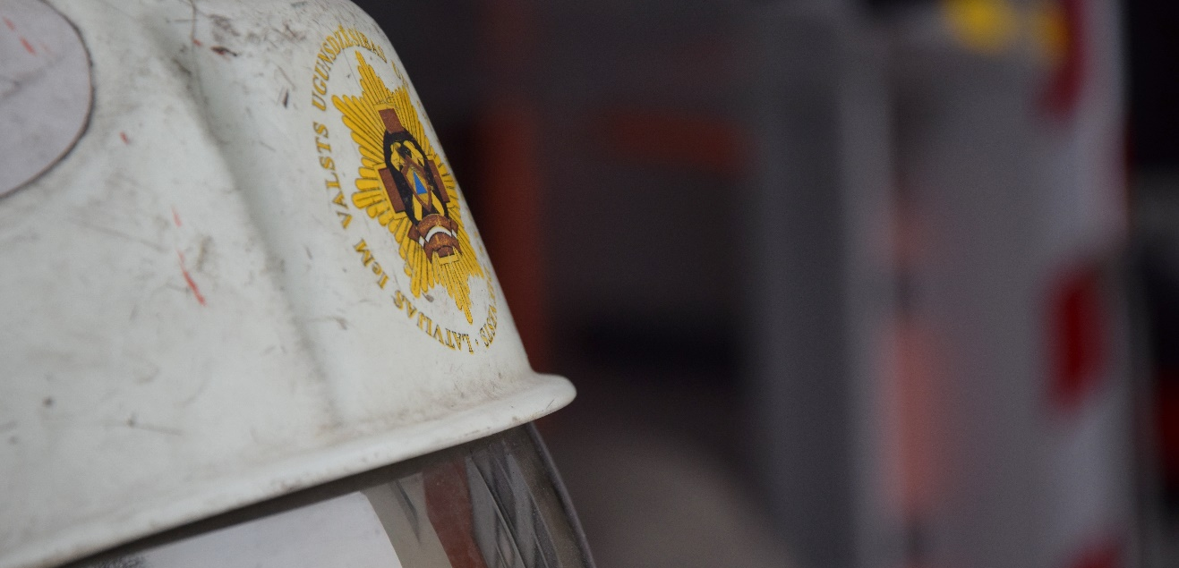
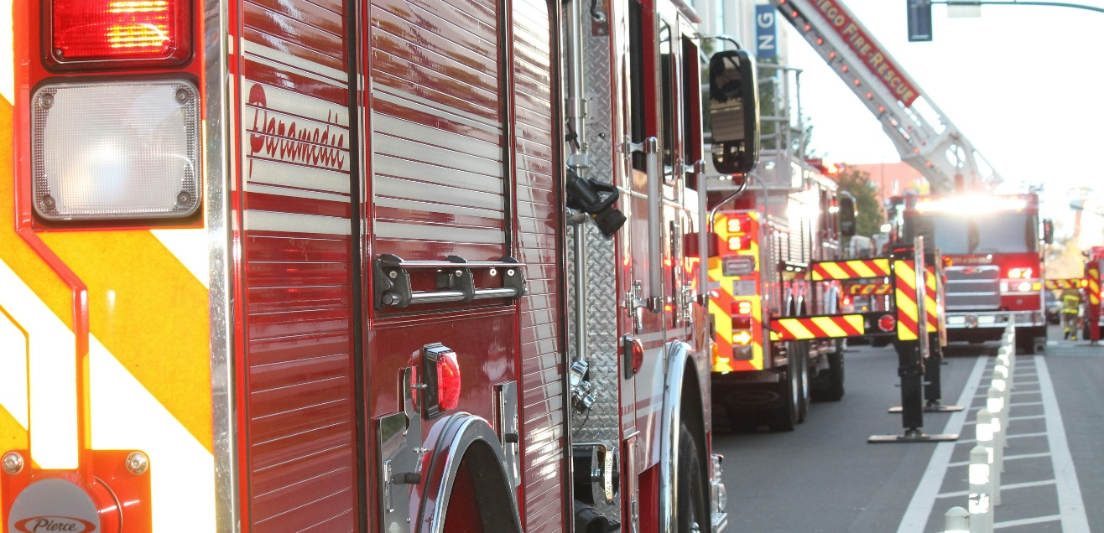
Introductory Discussion with Educatees on Civil Protection Duties
3. CIVIL PROTECTION DUTIES, TASKS AND RIGHTS
Do you remember the most important parties involved in civil protection?
Can you name any duties in civil protection?

Slide 5
Governance Structure in Civil Protection Repetition
3. CIVIL PROTECTION DUTIES, TASKS AND RIGHTS
The system of civil protection is organised as follows:
Civil Protection and Disaster Management Law, which regulates what to do in the event of a disaster or threat of disaster
Cabinet Regulations issued to ensure the functioning of the system of civil protection (including institutional regulations, civil protection plans)
National level
Prime Minister
Decision-making
Ministries and State authorities
Crisis Management Council
Coordination
Support
Crisis Management Council Secretariat
Infrastructure
State Fire and Rescue Service
Operational Control Centre of Civil Protection
Regional level
Local government
SFRS territorial units
Civil Protection Commission for Local Government Cooperation Territory
Public authorities
Merchants
Non-governmental organisations
Local level
Rescue manager
Operational services and organisations
National Armed Forces
Non-governmental organisations
Legal and natural persons

Slide 6
Bodies Responsible for Civil Protection and Disaster Management Repetition
3. CIVIL PROTECTION DUTIES, TASKS AND RIGHTS
Prime Minister
Ministry of the Interior
Civil Protection Commission for Local Government Cooperation Territory
supervises the operation of the system of civil protection and implementation of the tasks thereof
supervises the operation of the system of civil protection and implementation of the tasks thereof
manages, coordinates and controls the operation of the system of civil protection
Sectoral ministries
Chairperson of the Local Government Council
ensure the implementation of civil protection tasks, development of draft laws and regulations necessary in the field and disaster management coordination at a national, regional and local level
State Fire and Rescue Service
manages the implementation of the civil protection tasks in the local government
coordinates measures in the event of a disaster or its threat
Head of state and local government
Local Government
plans and implements the necessary action to ensure uninterrupted operation of the State authority in case of a disaster or threats thereof, ensure accurate and timely fulfilment of the measures determined in the civil protection plans
coordinates disaster management for local disasters in its administrative area – collapse of buildings and structures, heating, water supply, wastewater and sewerage system emergencies

Slide 7
3.1. Duties, Tasks and Rights of State Authorities, Local Governments, Legal and Natural Persons in the Field of Civil Protection

Slide 8
The Role of the Prime Minister in the System of Civil Protection
3.1
Duties, Tasks and Rights of State Authorities, Local Governments, Legal and Natural Persons in the Field of Civil Protection
3.2
3.3
3. CIVIL PROTECTION DUTIES, TASKS AND RIGHTS
Prime Minister
Level: Country | Municipal | Local
The role of management: Decision-making | Coordination | Support | Infrastructure
Key duties:
Examples:
Supervising the operation of the system of civil protection and implementation of the tasks thereof
The Prime Minister signs an order establishing a Thematic Committee on Civil Protection and Disaster Management System
By-law of the Crisis Management Council
Civil Protection and Disaster Management Law
Chairing the Crisis Management Council
The Prime Minister, as Chair of the Crisis Management Council, convenes and chairs meetings of the Council, approves the agenda, signs the protocols, assigns tasks to members of the Council, approves expert groups and their tasks
On the State Civil Protection Plan

Slide 9
The Role of the Cabinet in the System of Civil Protection
3.1
Duties, Tasks and Rights of State Authorities, Local Governments, Legal and Natural Persons in the Field of Civil Protection
3.2
3.3
3. CIVIL PROTECTION DUTIES, TASKS AND RIGHTS
Cabinet of Ministers
Level: Country | Municipal | Local
The role of management: Decision-making | Coordination | Support | Infrastructure
Key duties:
Examples:
Establishing legislation on the following aspects of civil protection:
management and planning of the system of civil protection
Cabinet Regulation No. 658 "Regulation on the Structure of Civil Protection Plans and the Information to Be Included In Them"
Civil Protection and Disaster Management Law
minimum requirements for the content of the mandatory course in civil protection
Cabinet Regulation No. 716 "Minimum Requirements for the Content of the Mandatory Course in Civil Protection and the Content of Training of Employees in Civil Protection"
request for and provision of international assistance
Cabinet Regulation No. 722 "Procedures for Requesting International Assistance"
On the State Civil Protection Plan

Slide 10
Crisis Management Council
3. CIVIL PROTECTION DUTIES, TASKS AND RIGHTS
3.1
Duties, Tasks and Rights of State Authorities, Local Governments, Legal and Natural Persons in the Field of Civil Protection
3.2
3.3
The Crisis Management Council is a co-ordinating institution, the objective of the operation of which is to ensure co-ordinated actions of State and local government institutions in taking measures for the prevention and suppression of danger to the State, as well as measures for the liquidation of consequences caused thereby
KVP sastāvs
Functions of the Council
The Crisis Management Council is chaired by the Prime Minister
To co-ordinate the co-operation of State and local government institutions in matters related to measures for the prevention and suppression of danger to the State, as well as measures for the liquidation of consequences caused thereby
The members of the Crisis Management Council are the members of the Cabinet
To co-ordinate civil-military co-operation in prevention and suppression of the danger to the State
Officials or experts of State, local government and other institutions
By-law of the Crisis Management Council
*On invitation, not part of the Crisis Management Council

Slide 11
The Role of the Crisis Management Council in the System of Civil Protection
3.1
Duties, Tasks and Rights of State Authorities, Local Governments, Legal and Natural Persons in the Field of Civil Protection
3.2
3.3
3. CIVIL PROTECTION DUTIES, TASKS AND RIGHTS
Level: Country | Municipal | Local
The role of management: Decision-making | Coordination | Support | Infrastructure
Key duties:
Examples:
Coordinating improvement of the national crisis management
The restructuring of the Crisis Management Council and the creation of the Crisis Management Center are planned in order to ensure centralised and quick decision-making in the future, coordinating the work of the participating state and local government institutions
By-law of the Crisis Management Council
Examining the dangers to the sectors within the competence of ministries and assess the draft plans for the prevention, suppression and liquidation of possible consequences
The Crisis Management Council has been involved in case studies and response measures, such as the 2017 African swine fever outbreak in Krimulda municipality and the 2023 flooding situation in Jēkabpils municipality
Civil Protection and Disaster Management Law
Preparing or examining proposals to the Cabinet on funding, resource attraction, providing aid to a foreign country, etc.
*Crisis Management Council meeting of May 20, 2013 "Proposals on Measures to Be Taken to Improve Infrastructure and Capacity of National and Local Authorities to Prevent, Mitigate and Respond to Potential Future Flood and Inundation Risks"
On the State Civil Protection Plan

Slide 12
The Role of Ministries in the System of Civil Protection
3.1
Duties, Tasks and Rights of State Authorities, Local Governments, Legal and Natural Persons in the Field of Civil Protection
3.2
3.3
3. CIVIL PROTECTION DUTIES, TASKS AND RIGHTS
Level: Country | Municipal | Local
The role of management: Decision-making | Coordination | Support | Infrastructure
Key types of involvement*:
Examples:
Civil Protection and Disaster Management Law
Ensuring the implementation of civil protection tasks and coordinating disaster management
Ministry of Environmental Protection and Regional Development convenes inter-institutional flood coordination meeting in February
Developing draft laws
Regulations Project "Procedures for the Supply of Energy Users and Sale of Heating Fuel During a Declared Energy Crisis and in the Event of a Threat to the State"
On the State Civil Protection Plan
Providing recommendations regarding action in case of a disaster or threats thereof
Each ministry prepares a sector-specific threat prevention plan
Other sector-specific regulatory documents
The Ministry of the Interior coordinates the development planning and operation of the system of civil protection
Prepares the methodological material "Minimum Requirements for the Content of Civil Protection Courses in General and Vocational Education"
*Refers to the 8 ministries involved in disaster management

Slide 13
Disaster Risk Management Authorities
3.1
Duties, Tasks and Rights of State Authorities, Local Governments, Legal and Natural Persons in the Field of Civil Protection
3.2
3.3
3. CIVIL PROTECTION DUTIES, TASKS AND RIGHTS
Ministry of the Interior | Earthquakes, landslides, building fires, building collapse, civil disturbances, terrorist act, internal conflicts
Ministry of Environmental Protection and Regional Development | Floods, windstorms, torrential rainfall (heavy rain, thunderstorms) and hail, storms (wind gusts), severe wind gusts, tornadoes, severe frost, snow, blizzards, ice, wet snow, heat, leakage of hazardous chemicals at on site, radioactive accident on site
Ministry of Agriculture | Drought, forest and peat bogs fires, epizootics, epiphytoties
Ministry of Health | Epidemics, pandemics, biological agent incidents
Ministry of Transport | Accidents in oil product pipeline transport infrastructure, accidents or incidents in port and offshore hydraulic engineering structures, road transport accident, aircraft accident, rail transport accident
Ministry of Climate and Energy | Natural gas supply system failure, dam and other hydraulic structure breaks – Daugava hydroelectric cascade hydraulic structure, distribution power grid failures and transmission power grid failures
Ministry of Defence | Ship spills of hazardous chemicals, ship groundings, ship strikes, passenger ship disasters, aircraft accidents
Local government | Disaster management in the municipality
Civil Protection and Disaster Management Law
On the State Civil Protection Plan
Other sector-specific regulatory documents

Slide 14
The Role of Other State Authorities in the System of Civil Protection
3.1
Duties, Tasks and Rights of State Authorities, Local Governments, Legal and Natural Persons in the Field of Civil Protection
3.2
3.3
3. CIVIL PROTECTION DUTIES, TASKS AND RIGHTS
Level: Country | Municipal | Local
The role of management: Decision-making | Coordination | Support | Infrastructure
Key forms of involvement:
Example
In accordance with the field of activity thereof, developing and providing recommendations to authorities and also providing recommendations to inhabitants regarding action in case of a disaster or threats thereof
Booklet "What to Do In the Event of a Terrorist Attack" by the State Security Service
Providing civil protection education to employees and the public
Information material on protection measures in the event of radiation accidents, produced by the State Environmental Service
Civil Protection and Disaster Management Law
Planing and organising civil protection and disaster management training
Practical civil protection training on local level radiation emergency was held in the territory of Daugavpils Regional Hospital by the Radiation Safety Centre of the State Environmental Service
On the State Civil Protection Plan

Slide 15
Incident Commanders of Response and Elimination of Consequences Operations in State Authorities
3.1
Duties, Tasks and Rights of State Authorities, Local Governments, Legal and Natural Persons in the Field of Civil Protection
3.2
3.3
3. CIVIL PROTECTION DUTIES, TASKS AND RIGHTS
State Fire and Rescue Service | Fire-fighting, except in forests and marshes, rescue operations, except at sea and in inland waters from the base line to the seaward limit, spillage of dangerous chemicals or mixtures, except at sea and in inland waters from the base line to the seaward limit, pollution of dangerous chemicals or mixtures at sea, earthquake, transport accident in inland waters to the seaward limit
State Police | Civil disturbances, internal conflicts, discovery of a substance or object of unknown origin
State Border Guard | Air transport accident
State Security Service | Terrorist act
Center For Disease Prevention and Control | Epidemic
State Environmental Service | Hazardous waste (orphan) management
State Forestry Service | Fire-fighting in forests and marshes
Food and Veterinary Service | Epizootics
State Plant Protection Service | Epiphytotia
Civil Protection and Disaster Management Law
On the State Civil Protection Plan
Other sector-specific regulatory documents

Slide 16
Operational Control Centre of Civil Protection Tasks in Civil Protection and Disaster Management
3. CIVIL PROTECTION DUTIES, TASKS AND RIGHTS
3.1
Duties, Tasks and Rights of State Authorities, Local Governments, Legal and Natural Persons in the Field of Civil Protection
3.2
3.3
The operation of the civil protection system in the case of war, military invasion or threat thereof shall be organised by an operational
control centre for civil protection, the activities and analytical capabilities of which need to be improved, and shall be regularly tested in crisis management training.
Tasks
Undertakes inter-agency coordination of activities, implementing the measures set out in the State Civil Protection Plan
Coordinates activities to be carried out (including deconfliction) with the Operational Control Centre for National Armed Forces and provide support to the national defence system
On Operational Control Centre of Civil Protection
Coordinate the attraction of additional resources
Analyses information on the national threat situation and its possible developments in the field of civil protection and transfers information to the strategic level (the Cabinet) for decision-making
Manages uncontrolled movement of people or evacuation if its scale exceeds the area of one Civil Protection Commission of the Co-operation Territories
On the State Civil Protection Plan
Coordinates the receipt and provision of international and humanitarian aid

Slide 17
The Role of the State Fire and Rescue Service in the System of Civil Protection
3.1
Duties, Tasks and Rights of State Authorities, Local Governments, Legal and Natural Persons in the Field of Civil Protection
3.2
3.3
3. CIVIL PROTECTION DUTIES, TASKS AND RIGHTS
Level: Country | Municipal | Local
By-law of the State Fire-fighting and Rescue Service
The role of management: Decision-making | Coordination | Support | Infrastructure
Regulation on the Procedures in which the State’s Highest Officials are to be Notified in the Event of a State Threat and Emergency Events in the State
Key duties:
Examples:
Managing, coordinating and controling the operation of the system of civil protection
Makes a decision on the activation of the national early warning system
Regulation on the National Contact Point of Civil Protection
Developing the State Civil Protection Plan in co-operation with other authorities, as well as revising and coordinating draft civil protection plans for objects and objects of increased danger
Collects information from sectoral ministries on the implementation of the State Civil Protection Plan
State Fire and Rescue Service provides humanitarian aid to Ukraine
Ensuring the functions of the National Contact Point and its 24-hour operation
On the State Civil Protection Plan
Fire-fighting, rescue after road accidents, chemical accidents, explosions and radiation accidents, in inland waters, etc.
Performing rescue operations and measures for the elimination of consequences
Civil Protection and Disaster Management Law

Slide 18
The Role of Local Governments in the System of Civil Protection
3.1
Duties, Tasks and Rights of State Authorities, Local Governments, Legal and Natural Persons in the Field of Civil Protection
3.2
3.3
3. CIVIL PROTECTION DUTIES, TASKS AND RIGHTS
Level: Country | Municipal | Local
The role of management: Decision-making | Coordination | Support | Infrastructure
Key forms of involvement:
Example
Determining the preventive, preparedness, response and elimination of consequences measures, based on risk assessment
Jūrmala City Council has submitted a project "Measures to Prevent Flood and Coastal Erosion Risks From the Lielupe River in Dubulti-Majoros-Dzintari"
Local Government Law
A total of €1.4 million has been paid to residents of Dobele region for the elimination of storm's consequences and recovery measures
Civil Protection and Disaster Management Law
After the disaster, in co-operation with other authorities determining and performing recovery measures
Riga City Council has launched a public awareness campaign and a series of eight seminars on civil protection, with the first seminar providing practical information on evacuation, the Riga Civil Protection Plan and other important personal protection topics
Providing civil protection education and safety to employees and the public
On the State Civil Protection Plan

Slide 19
The Role of Legal Entities in the System of Civil Protection
3.1
Duties, Tasks and Rights of State Authorities, Local Governments, Legal and Natural Persons in the Field of Civil Protection
3.2
3.3
3. CIVIL PROTECTION DUTIES, TASKS AND RIGHTS
Level: Country | Municipal | Local
Management role: -
Key forms of involvement:
Example
Ensuring the maintenance and exploitation of the property at the disposal or under the ownership thereof in a way to prevent harm to the safety of people, the environment and property
In accordance with the Protection Zone Law, "Conexus Baltic Grid" has established safety protective zones to ensure the safety of the environment and people
Informing the operative services about the possible leakage of hazardous chemicals at on site
Civil Protection and Disaster Management Law
Ensuring accurate and timely fulfilment of measures determined for the legal person in the State Civil Protection Plan and Civil Protection Plans of the the Local Government Cooperation Territory
"Conexus Baltic Grid" publishes an article "Safety Information for Citizens" on its website, providing information on what to do in case of a possible transmission gas pipeline accident and what protective measures to take
Providing civil protection education to employees and the public
On the State Civil Protection Plan

Slide 20
The Role of Natural Persons in the System of Civil Protection
3.1
Duties, Tasks and Rights of State Authorities, Local Governments, Legal and Natural Persons in the Field of Civil Protection
3.2
3.3
3. CIVIL PROTECTION DUTIES, TASKS AND RIGHTS
Level: Country | Municipal | Local
Management role: -
Key forms of involvement:
Example
Ensuring the maintenance and exploitation of the property in a way to prevent harm to the safety
The use of defective and home-made wiring, electrical equipment and electrical appliances is prohibited
Civil Protection and Disaster Management Law
In the event of a threat, report the threat, cooperate and act in accordance with the instructions of the responsible authorities
In the event of a fire, report it to the State Fire and Rescue Service and obey the lawful requirements of an official with special service rank
On the State Civil Protection Plan

Slide 21
Duties and Rights of Natural Persons in Civil Protection and Disaster Management
3.1
Duties, Tasks and Rights of State Authorities, Local Governments, Legal and Natural Persons in the Field of Civil Protection
3.2
3.3
3. CIVIL PROTECTION DUTIES, TASKS AND RIGHTS
Duties
To ensure the maintenance and exploitation of the property at the disposal or under the ownership thereof in a way to prevent harm to the safety of people, the environment and property
To notify immediately the relevant State or local government authorities regarding a disaster or threats thereof
In case of a disaster or threats thereof, to act in accordance with the information provided by the responsible State or local government authorities and instructions given by the officials thereof
To ensure accurate and timely fulfilment of measures determined for the legal person in the State civil protection plan and civil protection plans of the co-operation territories
Civil Protection and Disaster Management Law
Rights
To receive an early warning and recommendations regarding action in case of a disaster or threats thereof
On the State Civil Protection Plan
In case of a disaster or threats thereof, to receive assistance from the State and local government authorities

Slide 22
3.2. Duties and Rights of an Object of Increased Danger, Its Owner or Lawful Possessor

Slide 23
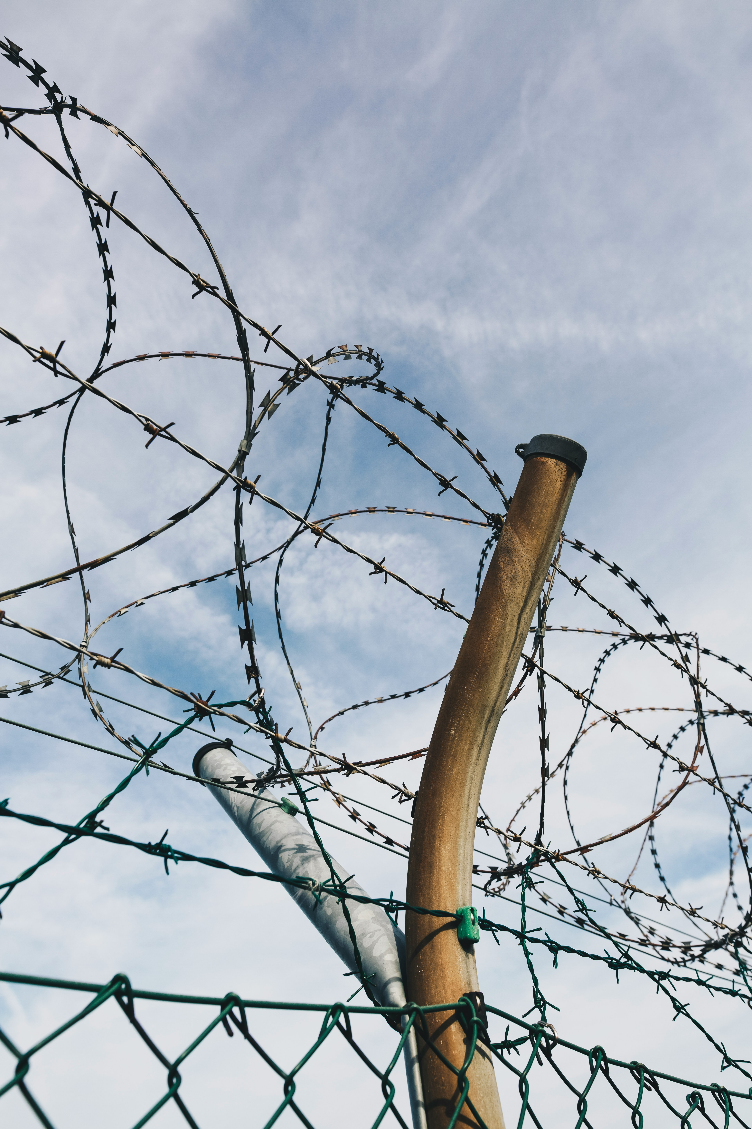
Objects of Increased Danger
3. CIVIL PROTECTION DUTIES, TASKS AND RIGHTS
3.1
3.2
Duties and Rights of an Object of Increased Danger, Its Owner or Lawful Possessor
3.3
The list of objects of increased danger is identified and updated annually. The State Fire and Rescue Service prepares list of sites and submits it to the Cabinet for approval.
An object of increased danger is a building or an engineering structure used
in a way that is connected to:
Generation and accumulation of energy
Electromagnetic radiation
Procedures for Identifying and Determining Objects of Increased Danger, as well as for the Planning and Implementation of Civil Protection and Disaster Management
Flammable, explosive, dangerous chemical substance and mixture
Hazardous waste
Plant quarantine organism and
Civil Protection and Disaster Management Law
Radioactive substances, nuclear materials and waste thereof processing, treatment, production, use, storage and transportation

Slide 24
The Role of the Owner or Lawful Possessor of the Object of Increased Danger in the System of Civil Protection
3.1
3.2
Duties and Rights of an Object of Increased Danger, Its Owner or Lawful Possessor
3.3
3. CIVIL PROTECTION DUTIES, TASKS AND RIGHTS
Level: Country | Municipal | Local
The role of management: Decision-making | Coordination | Support | Infrastructure
Key forms of involvement:
Example
Determining the preventive, preparedness, response and elimination of consequences measures, based on risk assessment
In the event of or during an industrial accident, the person in charge of the installation ensures that technological equipment, electrical appliances, etc., are disconnected or switched to an operating mode that does not contribute to the development of the fire and does not restrict its extinction
Procedures for Identifying and Determining Objects of Increased Danger, as well as for the Planning and Implementation of Civil Protection and Disaster Management
Appropriate storage and location of hazardous substances on the site to prevent interactions between them
Annex 1 to Cabinet Regulation No. 131 "Industrial Accident Risk Assessment Procedures and Risk Reduction Measures" defines dangerous chemical substances and their qualifying quantities
Familiarising employees with the civil protection plan and its measures, and to provide training
"Conexus Baltic Grid" Inčukalns underground gas storage facility hosted a local civil protection and disaster management training simulating a natural gas leak with ignition
Civil Protection and Disaster Management Law
Ensure early warning and information in the event of a threat
In the event of a fire or accident, the employee shall report it to the station controller, who shall activate the early warning siren

Slide 25
3.3. Civil Protection Commissions for Local Government Cooperation Territory

Slide 26
Objectives of the Civil Protection Commissions for Local Government Cooperation Territory in Civil Protection and Disaster Management
3. CIVIL PROTECTION DUTIES, TASKS AND RIGHTS
3.1
3.2
3.3
Civil Protection Commissions for Local Government Cooperation Territory
Civil Protection Commission for Local Government Cooperation Territory is a coordinating and advisory body. Latvia has 38 Civil Protection Commissions for Local Government Cooperation Territory.
Objectives
Coordinate measures in case of disaster and threat of disaster
Facilitate the resolution of civil protection, disaster management or disaster management coordination issues
Regulation on Civil Protection Commissions for Local Government Cooperation Territory

Slide 27
The Role of the Civil Protection Commissions for Local Government Cooperation Territory in the System of Civil Protection
3.1
3.2
3.3
Civil Protection Commissions for Local Government Cooperation Territory
3. CIVIL PROTECTION DUTIES, TASKS AND RIGHTS
Level: Country | Municipal | Local
Regulation on Civil Protection Commissions for Local Government Cooperation Territory
The role of management: Decision-making | Coordination | Support | Infrastructure
Key forms of involvement:
Example
Recommendations for the drafting of the rules of procedure of the Civil Protection Commission for Local Government Cooperation Territory
Coordinating disaster and disaster risk response
Jēkabpils Civil Protection Commission for Local Government Cooperation Territory coordinated information and evacuation of residents during floods
Civil Protection and Disaster Management Law
Analysing information on the disaster threat, the possible development of the disaster and the situation at the disaster site
Riga Civil Protection Commission for Local Government Cooperation Territory convened regular meetings to plan and prepare in advance for various Covid-19 crisis scenarios
On the State Civil Protection Plan

Slide 28
Sources of information (1/3)
3. CIVIL PROTECTION DUTIES, TASKS AND RIGHTS
Images sourced from the website "Unsplash". https://unsplash.com/
Akciju sabiedrība “Latvenergo”. 2019. Rīgas TEC-1 saīsinātais civilās aizsardzības plans. https://latvenergo.lv/storage/app/uploads/public/612/cba/fd9/612cbafd9b9d0853581739.pdf
Akciju sabiedrības “Latvijas finieris” rūpnīca “LIGNUMS”. 2019. Ārpusobjekta civilās aizsardzības plāns. https://www.vugd.gov.lv/lv/media/691/download?attachment
Civilās aizsardzības un katastrofas pārvaldīšanas likums. https://likumi.lv/ta/id/282333
Conexus. Drošības informācija iedzīvotājiem. https://www.conexus.lv/parvades-drosibas-informacija-iedzivotajiem
Conexus. Siguldas novadā norisināsies vietēja līmeņa civilās aizsardzības un katastrofu pārvaldīšanas mācības. https://www.conexus.lv/zinas-presei/siguldas-novada-norisinasies-vieteja-limena-civilas-aizsardzibas-un-katastrofu-parvaldisanas-macibas
Iekšlietu ministrija. 2023. Valsts ugunsdzēsības un glābšanas dienests sniegs humāno palīdzību Ukrainai saistībā ar Krievijas militārās agresijas rezultātā iznīcināto Kahovkas HES aizsprostu. https://www.iem.gov.lv/lv/jaunums/valsts-ugunsdzesibas-un-glabsanas-dienests-sniegs-humano-palidzibu-ukrainai-saistiba-ar-krievijas-militaras-agresijas-rezultata-iznicinato-kahovkas-hes-aizsprostu
Iekšlietu ministrijas Informācijas centrs. https://www.ic.iem.gov.lv/lv
Jēkabpils novads. 2023. Tiks nodrošināti evakuācijas autobusi no vairākām vietām Jēkabpilī. https://www.jekabpils.lv/lv/jaunums/tiks-nodrosinati-evakuacijas-autobusi-no-vairakam-vietam-jekabpili?utm_source=https%3A%2F%2Fwww.google.com%2F
Jūrmalas pašvaldība. 2024. Lielupes radīto plūdu un krasta erozijas risku apdraudējumu novēršanas pasākumi Dubultos-Majoros-Dzintaros. https://www.jurmala.lv/lv/projekts/lielupes-radito-pludu-un-krasta-erozijas-risku-apdraudejumu-noversanas-pasakumi-dubultos-majoros-dzintaros
Ķīmisko vielu likums. https://likumi.lv/ta/id/47839
Likums "Par radiācijas drošību un kodoldrošību". https://likumi.lv/ta/id/12484
LSM. 2023. Postošās vētras seku likvidēšana maksās vairākus miljonus eiro. https://www.lsm.lv/raksts/zinas/latvija/29.08.2023-postosas-vetras-seku-likvidesana-maksas-vairakus-miljonus-eiro.a521966/
LV portāls. 2020. M. Staķis: situācija ar Covid-19 izplatību Rīgā tiek kontrolēta. https://lvportals.lv/dienaskartiba/320606-m-stakis-situacija-ar-covid-19-izplatibu-riga-tiek-kontroleta-2020
LV portals. 2023. Pašvaldības izstrādā rīcības plānus militāra apdraudējuma gadījumā. https://lvportals.lv/norises/352590-pasvaldibas-izstrada-ricibas-planus-militara-apdraudejuma-gadijuma-2023
Ministru kabineta 2003. gada 29. aprīļa noteikumi Nr. 236 "Aizsardzības ministrijas nolikums". https://likumi.lv/ta/id/74716
Ministru kabineta 2003. gada 29. aprīļa noteikumi Nr. 237 "Ārlietu ministrijas nolikums". https://likumi.lv/ta/id/74754

Slide 29
Sources of information (2/3)
3. CIVIL PROTECTION DUTIES, TASKS AND RIGHTS
Ministru kabineta 2003. gada 29. aprīļa noteikumi Nr. 242 "Satiksmes ministrijas nolikums". https://likumi.lv/ta/id/74749
Ministru kabineta 2004. gada 13. aprīļa noteikumi Nr. 286 "Veselības ministrijas nolikums". https://likumi.lv/ta/id/87141
Ministru kabineta 2010. gada 27. aprīļa noteikumi Nr. 398 "Valsts ugunsdzēsības un glābšanas dienesta nolikums". https://likumi.lv/ta/id/209089
Ministru kabineta 2010. gada 28. septembra instrukcija Nr. 16 "Kārtība, kādā valsts augstākās amatpersonas apziņojamas valsts apdraudējuma gadījumā un par ārkārtas notikumiem valstī". https://likumi.lv/ta/id/218821
Ministru kabineta 2011. gada 18. janvāra noteikumi Nr. 42 "Krīzes vadības padomes nolikums". https://likumi.lv/ta/id/224553
Ministru kabineta 2016. gada 1. marta noteikumi Nr. 131 "Rūpniecisko avāriju riska novērtēšanas kārtība un riska samazināšanas pasākumi". https://likumi.lv/ta/id/280652
Ministru kabineta 2016. gada 19. aprīļa noteikumi Nr. 238 "Ugunsdrošības noteikumi". https://likumi.lv/ta/id/281646
Ministru kabineta 2017. gada 12. decembra noteikumi Nr. 723 "Valsts civilās aizsardzības kontaktpunkta noteikumi". https://likumi.lv/ta/id/295780
Ministru kabineta 2017. gada 19. septembra noteikumi Nr. 563 "Paaugstinātas bīstamības objektu apzināšanas un noteikšanas, kā arī civilās aizsardzības un katastrofas pārvaldīšanas plānošanas un īstenošanas kārtība". https://likumi.lv/ta/id/293660
Ministru kabineta 2017. gada 26. septembra noteikumi Nr. 582 "Noteikumi par pašvaldību sadarbības teritorijas civilās aizsardzības komisijām". https://likumi.lv/ta/id/293820
Ministru kabineta 2017. gada 7. novembra noteikumi Nr. 658 "Noteikumi par civilās aizsardzības plānu struktūru un tajos iekļaujamo informāciju". https://likumi.lv/ta/id/294938
Ministru kabineta 2019. gada 30. aprīļa noteikumi Nr. 187 "Zemkopības ministrijas nolikums". https://likumi.lv/ta/id/306912
Ministru kabineta 2020. gada 22. septembra noteikumi Nr. 588 "Ekonomikas ministrijas nolikums". https://likumi.lv/ta/id/317511
Ministru kabineta 2020. gada 22. septembra noteikumi Nr. 589 "Iekšlietu ministrijas nolikums". https://likumi.lv/ta/id/317512
Ministru kabineta 2020. gada 26. augusta rīkojums Nr. 476 "Par Valsts civilās aizsardzības plānu". https://likumi.lv/ta/id/317006
Ministru kabineta 2022. gada 14. jūlija noteikumi Nr. 434 "Vides aizsardzības un reģionālās attīstības ministrijas nolikums". https://likumi.lv/ta/id/334038
Ministru kabineta 2022. gada 20. decembra noteikumi Nr. 817 "Klimata un enerģētikas ministrijas nolikums". https://likumi.lv/ta/id/338391
Ministru prezidenta 2022. gada 3. marta rīkojums Nr. 2022/1.2.1.-68 "Par Civilās aizsardzības Operacionālo vadības centru". https://likumi.lv/ta/id/330539
Nacionālās drošības likums. https://likumi.lv/ta/id/14011

Slide 30
Sources of information (3/3)
3. CIVIL PROTECTION DUTIES, TASKS AND RIGHTS
Pašvaldību likums. https://likumi.lv/ta/id/336956
Preiļu novads. 2022. Akciju sabiedrības “Conexus Baltic Grid” informācija. https://www.preili.lv/lv/jaunums/akciju-sabiedribas-conexus-baltic-grid-informacija?utm_source=https%3A%2F%2Fwww.google.com%2F
Rīgas dome. 2024. Vispārīgie ieteikumi rīdziniekiem, kā rīkoties militāra apdraudējuma gadījumā. https://www.riga.lv/lv/jaunums/visparigie-ieteikumi-ridziniekiem-ka-rikoties-militara-apdraudejuma-gadijuma
Ugunsdrošības un ugunsdzēsības likums. https://likumi.lv/ta/id/68293
Valsts drošības dienests. Rīcība terora akta gadījumā. https://www.112.lv//file-uploads/files/42/Izgl%C4%ABtojo%C5%A1i%20materi%C4%81li/Bukleti/VDD-buklets-riciba-terora-akta-gadijuma.pdf
Valsts ugunsdzēsības un glābšanas dienests. Sadarbības teritorijas civilās aizsardzības komisija nolikuma izstrādes rekomendācijas. https://www.vugd.gov.lv/lv/media/349/download?attachment
Valsts vides dienests. 2024. Informatīvie materiāli. https://www.vvd.gov.lv/lv/informativie-materiali
Vides aizsardzības un reģionālās attīstības ministrija. 2021. Plūdu risku pārvaldība. https://www.varam.gov.lv/lv/pludu-risku-parvaldiba
Vides aizsardzības un reģionālās attīstības ministrija. 2023. VVD RDC vadībā aizvadītas praktiskās civilās aizsardzības mācības par rīcību vietēja līmeņa radiācijas avārijas gadījumā. https://www.varam.gov.lv/lv/jaunums/vvd-rdc-vadiba-aizvaditas-praktiskas-civilas-aizsardzibas-macibas-par-ricibu-vieteja-limena-radiacijas-avarijas-gadijuma
Vides aizsardzības un reģionālās attīstības ministrija. 2024. VARAM sasauc starpinstitūciju plūdu koordinācijas sanāksmi. https://www.varam.gov.lv/lv/jaunums/varam-sasauc-starpinstituciju-pludu-koordinacijas-sanaksmi-0

