Slide 1
Study course "Civil Protection"
1. Introduction
Developed in the framework of the European Commission’s Civil Protection Financial Instrument "Track1" project "Establishment of comprehensive civil protection and disaster management training for governmental institutions, civil protection commissions of municipalities, universities, Fire Safety and Civil Protection College, as well as establishing safety advice for the public" (ECHO/SUB/2022/TRACK1/884396)
Funded by The European Union
State Fire and Rescue Service

Slide 2
Tasks
1. INTRODUCTION
Intended Results
To introduce educatees to:
the concept of civil protection;
civil protection tasks
To provide an overview of the history of civil protection.
Educatees:
can explain what civil protection is;
can name civil protection tasks, explain their complex nature;
can tell about the most important events of the historical development of the civil protection system.

Slide 3
Table of Contents
1. INTRODUCTION
1.1. The Concept of Civil Protection
1.2. Tasks of the System of Civil Protection
1.3. An Overview of the History of Civil Protection

Slide 4
1.1. The Concept of Civil Protection

Slide 5
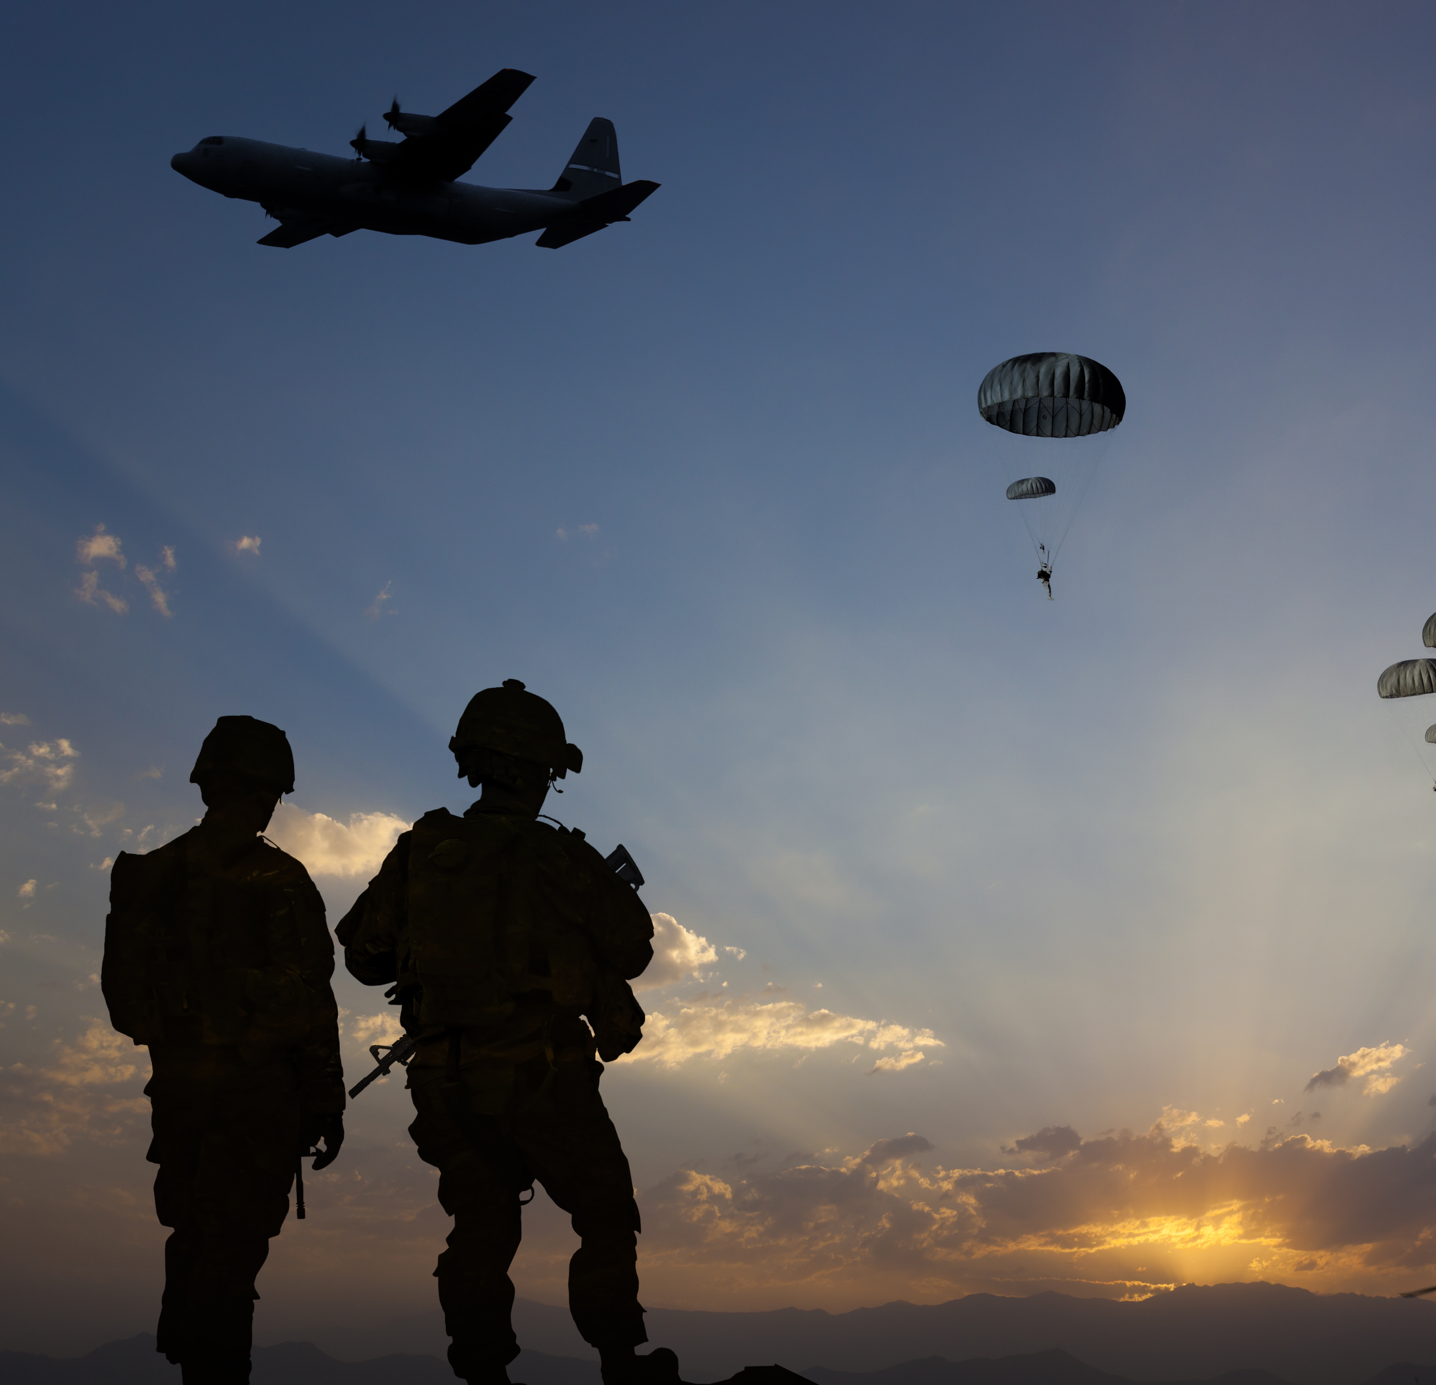
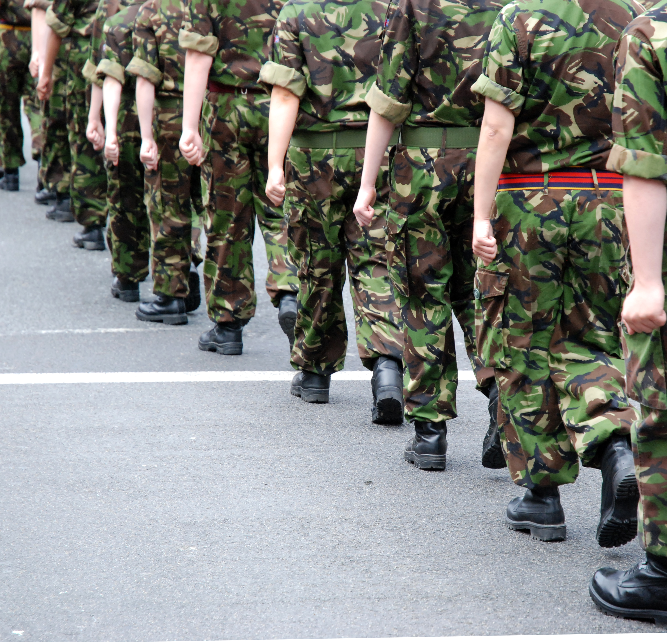
Educatees’ Understanding of and Exposure to Civil Protection
1. INTRODUCTION
1.1
The Concept of Civil Protection
1.2
1.3
What do you think the term "civil protection" means?
What could be the tasks of civil protection?
Have you come across civil protection measures in your daily life?
Please give examples!

Slide 6
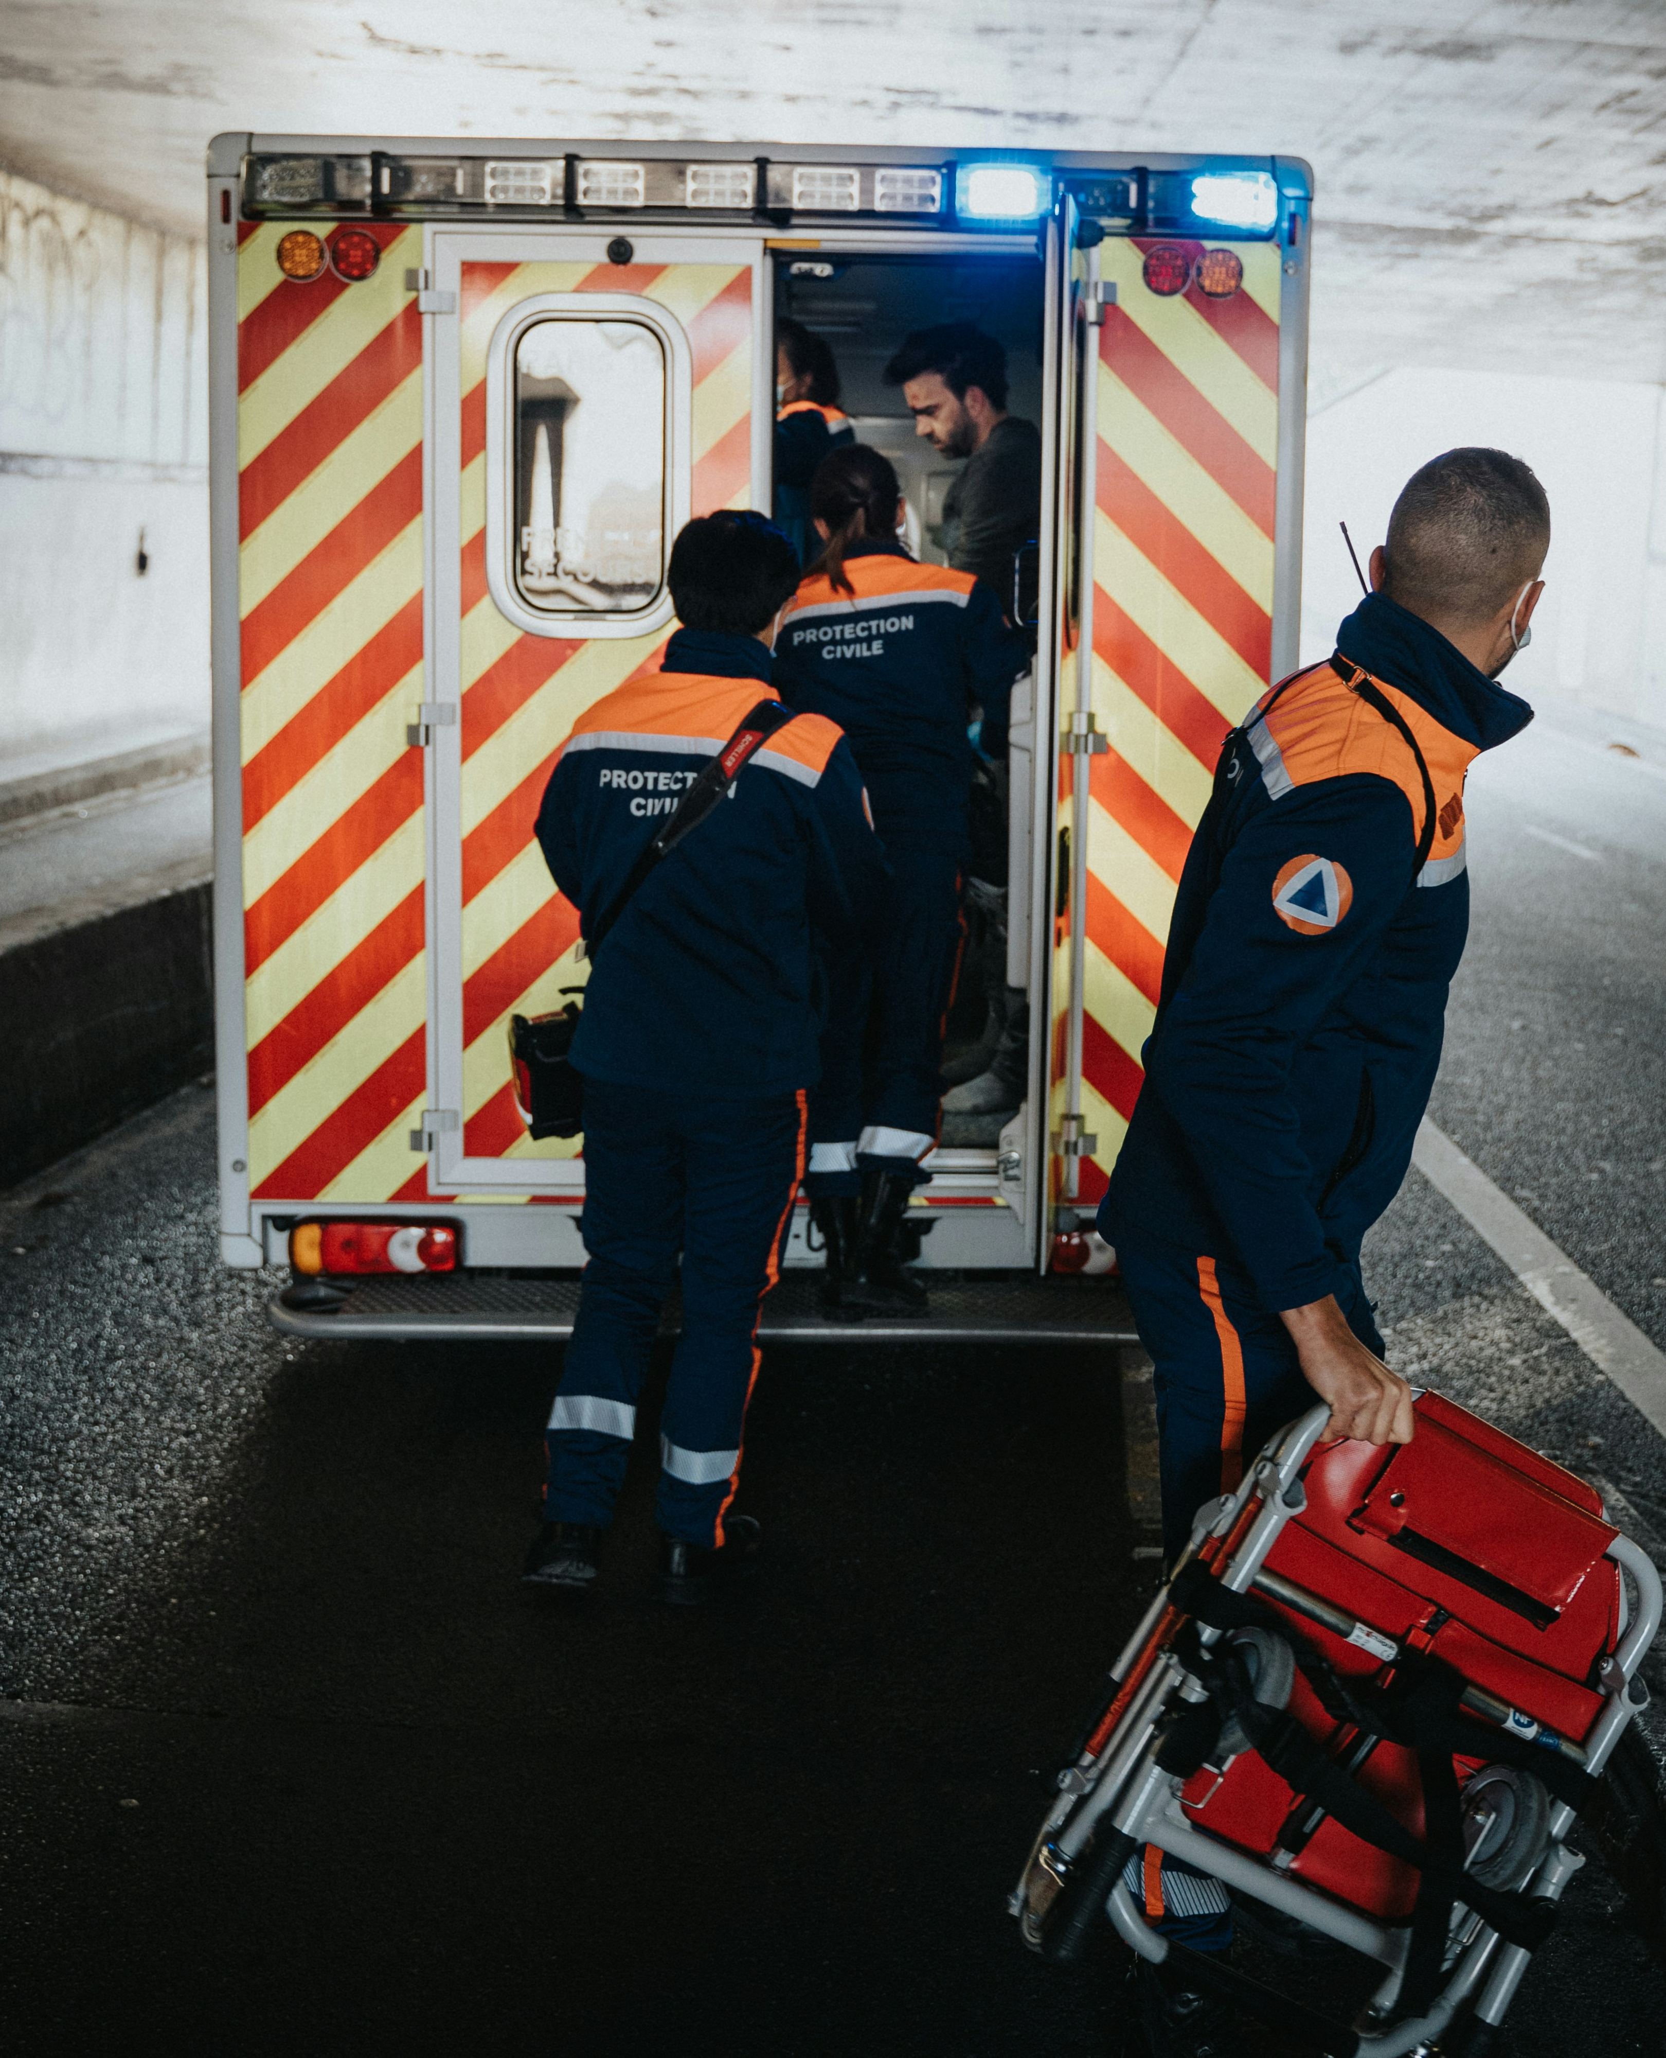
The Concept of Disaster
1. INTRODUCTION
1.1
The Concept of Civil Protection
1.2
1.3
Definitions set out in the Civil Protection and Disaster Management Law:
Disaster
An accident which has caused human casualties or endangers human life or health, caused damage or threat to people, the environment or property, and also inflicted or inflicts significant material and financial losses and exceeds the daily capacity of the responsible State and local government authorities to prevent the devastating conditions.
Threats of a disaster
A situation when risk assessment, forecasts, information or other circumstances reasonably indicate to the likelihood of a disaster.

Slide 7
The Concept of Civil Protection
1. INTRODUCTION
1.1
The Concept of Civil Protection
1.2
1.3
The definition set out in the Civil Protection and Disaster Management Law:
A set of measures:
implemented by:
State authorities
Local government authorities
Society
to ensure the safety of people, the environment and property,
Organisational
Engineering
Economic
Financial
to implement corresponding actions in case of a disaster or threats thereof
Social
Educational
Scientific

Slide 8
1.2. Tasks of the System of Civil Protection
Module 1. Introduction

Slide 9
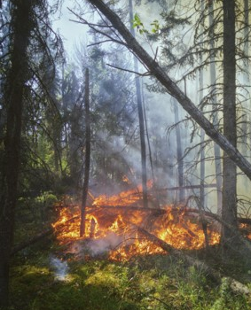
Tasks of the System of Civil Protection (1/6)
1. INTRODUCTION
1.1
1.2
Tasks of the System of Civil Protection
1.3
1
To ensure the safety of people, the environment and property
2
To ensure, to the extent possible, the minimal basic needs for the public in case of a disaster or threats thereof
3
To forecast in a timely manner the threats of a disaster
4
To plan and perform preventive measures in a timely manner
5
To provide assistance to victims of disasters and reduce damage that has been or may be caused by the disaster to people, the environment and property
6
To plan and perform recovery measures
7
To provide and receive international assistance in accordance with the procedures laid down in the laws and regulations
8
To support the national defence system if a military invasion or war has begun

Slide 10
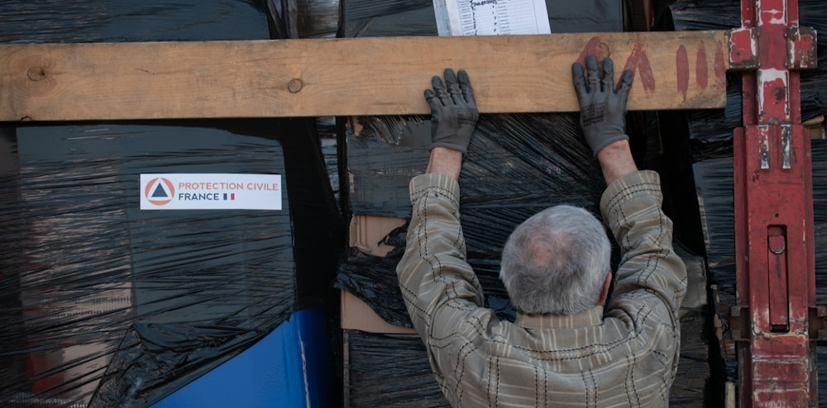
Tasks of the System of Civil Protection (2/6)
1. INTRODUCTION
1.1
1.2
Tasks of the System of Civil Protection
1.3
1
To ensure the safety of people, the environment and property.
2
To ensure, to the extent possible, the minimal basic needs for the public in case of a disaster or threats thereof.

Slide 11
Tasks of the System of Civil Protection (3/6)
1. INTRODUCTION
1.1
1.2
Tasks of the System of Civil Protection
1.3
3
To forecast in a timely manner the threats of a disaster.
4
To plan and perform preventive measures in a timely manner.
Training
Provision of information
Risk assessment
Technology improvement
Action plan development
Practical training

Slide 12
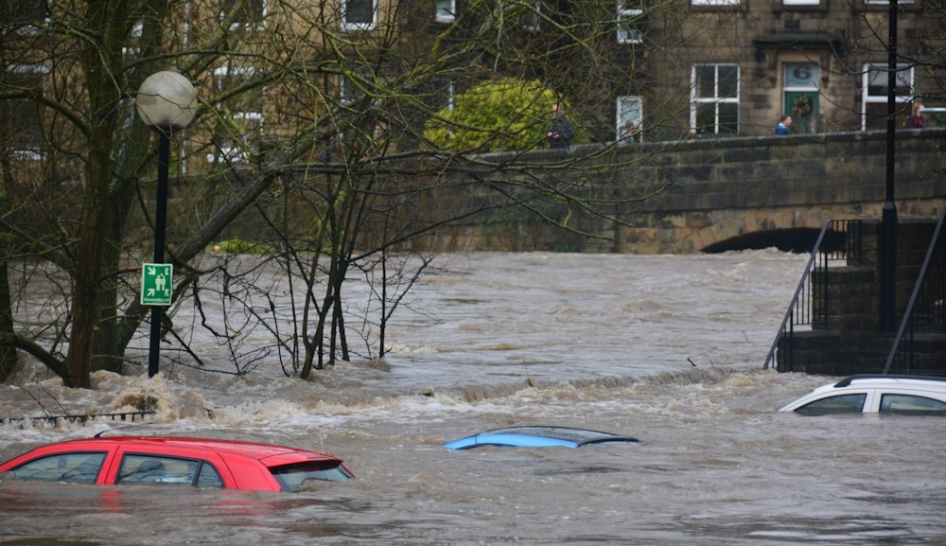
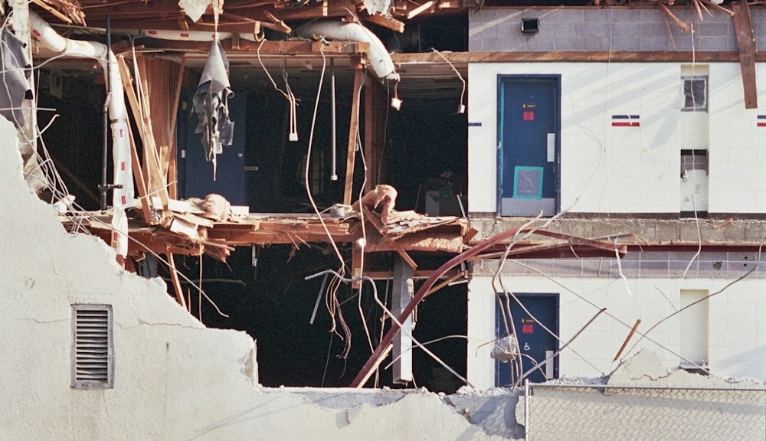
Tasks of the System of Civil Protection (4/6)
1. INTRODUCTION
1.1
1.2
Tasks of the System of Civil Protection
1.3
5
To provide assistance to victims of disasters and reduce damage that has been or may be caused by the disaster to people, the environment and property.
6
To plan and perform recovery measures.

Slide 13
Tasks of the System of Civil Protection (5/6)
1. INTRODUCTION
1.1
1.2
Tasks of the System of Civil Protection
1.3
7
To provide and receive international assistance in accordance with the procedures laid down in the laws and regulations.
Mechanism for requesting assistance
Mechanism for providing assistance
The national contact point for civil protection receives an international request for humanitarian aid
The national contact point for civil protection immediately informs the responsible ministry
NATO EADRCC
International organisations
1
2
The responsible ministry prepares information for Crisis Management Council on the type, capacity, funding and source of humanitarian aid, etc.
ERCC
Foreign countries
The Cabinet makes a decision on the provision of assistance
Crisis Management Council
The Cabinet
National Contact Point for Civil Protection
4
3
The Ministry of Foreign Affairs prepares further Orders
The responsible ministry coordinates the provision of humanitarian aid
5
6

Slide 14
Tasks of the System of Civil Protection (6/6)
1. INTRODUCTION
1.1
1.2
Tasks of the System of Civil Protection
1.3
8
To support the national defence system if a military invasion or war has begun.
In accordance with the National Security Law:
In case of war or its declaration, officials responsible for national security and state defence have no right to refuse to protect the country and society.
The Cabinet shall be responsible for the overcoming of the threat to national security and the liquidation of such consequences.

Slide 15
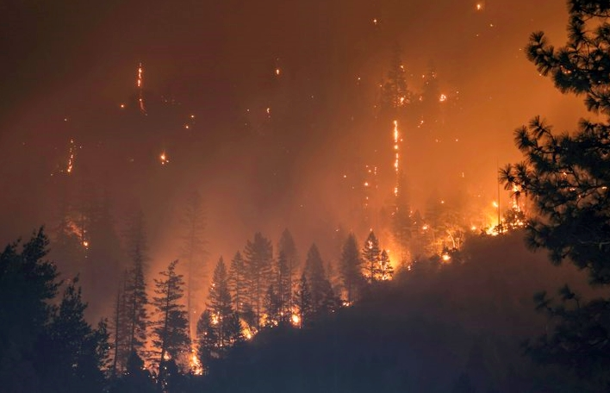
A Set of Disaster Management Measures Conducted to Ensure the Implementation of Civil Protection Tasks
1. INTRODUCTION
1.1
1.2
Tasks of the System of Civil Protection
1.3
The set of measures laid down in the Civil Protection and Disaster Management Law:
Preventive measures
Preparedness measures
EVENT
Recovery measures
Disaster
management
Response
measures
Elimination of consequences measures

Slide 16
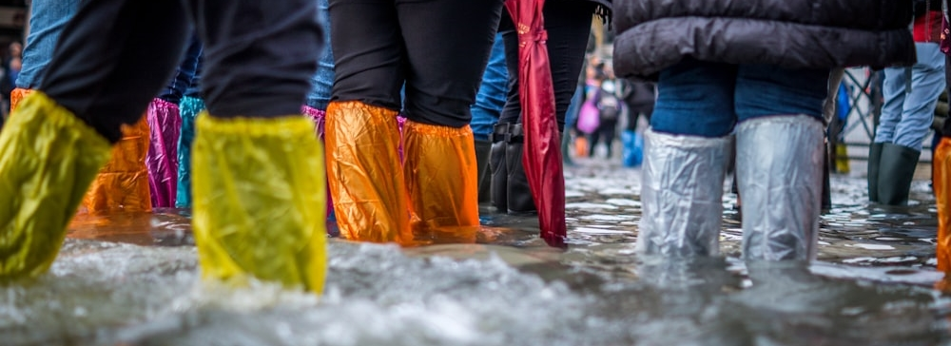
Preventive and Preparedness Measures
1. INTRODUCTION
1.1
1.2
Tasks of the System of Civil Protection
1.3
Preventive measures
A set of measures performed to prevent or reduce the threats of a disaster.
Example:
Cabinet Regulation No. 1354 "Regulations Regarding Preliminary Flood Risk Assessment, Flood Maps and Flood Risk Management Plan"
Civil protection and disaster management training

Slide 17
1.3. An Overview of the History of Civil Protection

Slide 18
The Evolution and Role of the Geneva Convention in Civil Protection
1. INTRODUCTION
1.1
1.2
1.3
An Overview of the History of Civil Protection
The Geneva Convention – the first international agreement on the protection of civilians in time of war and the cornerstone of modern international human rights law. It protects civilians caught up in hostilities and prisoners of war.
1864 - Geneva
1899 - The Hague
1906 - Geneva 1907 - The Hague
1929 - Geneva
1949 - Geneva
First Geneva Convention
Amendments
Amendments
Geneva Convention I
Ratified by 12 countries
Hague Convention III
Hague Convention X
New Geneva Convention II
On the application of the principles of the 1864 Geneva Convention to naval warfare
On the application of the principles of the 1906 Geneva Convention to naval warfare
Second Geneva Convention
Geneva Convention III
Hague Convention II
Hague Convention IV
For prisoners of war and civilians
For prisoners of war and civilians
New Geneva Convention IV

Slide 19
Geneva Convention IV
1. INTRODUCTION
1.1
1.2
1.3
An Overview of the History of Civil Protection
The first three Conventions apply to soldiers, while Geneva Convention IV deals specifically with the humanitarian protection of civilians in war zones.
Brief about Geneva Convention IV
Civil Protection Symbol as defined in Geneva Convention IV
Adoption: 12 August 1949
Entry into force: 21 October 1950
Ratified by 196 countries
Protection of civilians in time of war
Special protection for civilians, women and children
Prohibits aimless destruction of personal property, public, cooperative and state property

Slide 20
The Geneva Convention Today
1. INTRODUCTION
1.1
1.2
1.3
An Overview of the History of Civil Protection
The Additional Protocols
The development of artificial intelligence and autonomous weapon systems has created challenges for the interpretation and application of the Geneva Convention.
Over the years, the 1949 Convention has been supplemented by three Additional Protocols:
Protocol I (1977) on the Protection of Victims of International Armed Conflicts
Protocol II (1977) on the Protection of Victims of Non-International Armed Conflicts
Protocol III (2005) on the Adoption of an Additional Distinctive Emblem

Slide 21
Development of the System of Civil Protection in Latvia
1. INTRODUCTION
1.1
1.2
1.3
An Overview of the History of Civil Protection
1934
Law on passive defense against air attacks
("Par pasīvo aizsardzību pret uzbrukumiem no gaisa")
1956
Local passive air defence system included in the national defence system
1986
Top priority – preparedness to eliminate peacetime emergencies and the consequences of disasters
2016
Civil Protection and Disaster Management Law
1945
(Hiroshima, Nagasaki)
Defence against nuclear war
1961
(Chernobyl accident)
Transformation into civil protection, with a mandate to protect the population and the economy in wartime and in peacetime in the event of disasters
1991, 1992
The Republic of Latvia ratifies the Geneva Convention
Reorganisation of the system of civil protection is launched, and the Operational Control Centre of Civil Protection is established on the basis of the Civil Protection Headquarters of the Republic of Latvia
Law On Civil Protection of the Republic of Latvia ("Par Latvijas Republikas civilo aizsardzību")

Slide 22
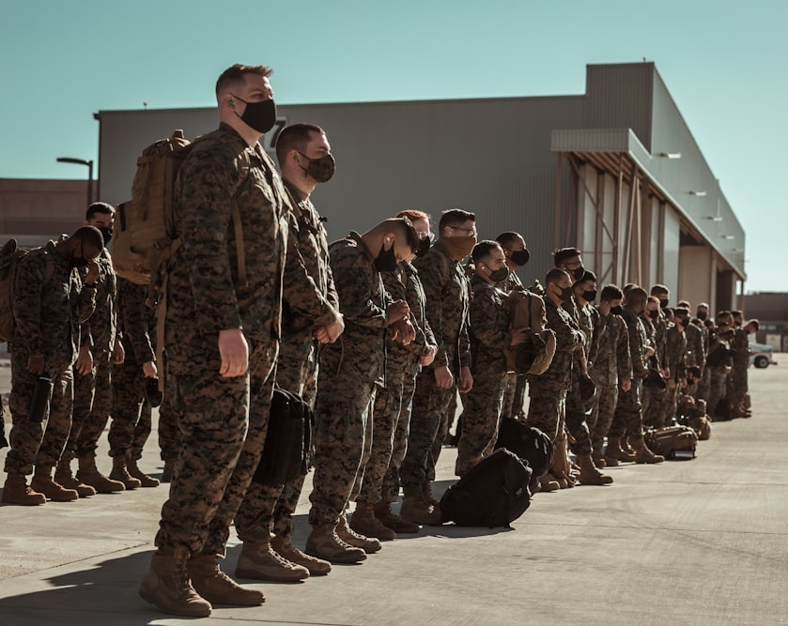
Summary
1. INTRODUCTION
1.1
1.2
1.3
An Overview of the History of Civil Protection
The main purpose of the system of civil protection:
The system of civil protection must help people in times of disaster and increase their own resilience and capacity to act.
Civil protection means that the state and society are prepared for early warnings, rescue operations, evacuations, shelters, first aid and disaster medicine, emergency social, psychological and other assistance.
Civil protection is based on the ability of people to protect themselves and each other in crisis situations until help arrives.

Slide 23
Sources of information
1. INTRODUCTION
Images sourced from the website "Unsplash". https://unsplash.com/
Civilās aizsardzības un katastrofas pārvaldīšanas likums. https://likumi.lv/ta/id/282333
Ministru kabineta 2009. gada 24. novembra noteikumi Nr. 1354 "Noteikumi par sākotnējo plūdu riska novērtējumu, plūdu kartēm un plūdu riska pārvaldības plānu". https://likumi.lv/ta/id/201369
Ministru kabineta 2017. gada 12. decembra noteikumi Nr. 722 "Starptautiskās palīdzības pieprasīšanas kārtība". https://likumi.lv/ta/id/295779
Ministru kabineta 2017. gada 12. decembra noteikumi Nr. 721 "Humānās palīdzības saņemšanas un sniegšanas kārtība". https://likumi.lv/ta/id/295778
Nacionālās drošības likums. https://likumi.lv/ta/id/14011
Riigikogu. Eesti julgeolekupoliitika alused. https://www.riigiteataja.ee/aktilisa/3280/2202/3001/julgeolekupoliitika_2023.pdf
Wikipedia. Geneva Conventions. https://en.wikipedia.org/wiki/Geneva_Conventions
International Committee of the Red Cross. The Geneva Conventions of 1949, Additional Protocols and their Commentaries. https://ihl-databases.icrc.org/en/ihl-treaties/geneva-conventions-1949additional-protocols-and-their-commentaries

